Slide 1
Confined/Enclosed Spaces Continuing Education Fourth Quarter 2017

Slide 2
Objectives
Upon completion of this review you should be able to:
Define an enclosed space, a confined space, and a permit required confined space
Explain pre-entry requirements
Explain training requirements
Explain rescue requirements
Explain the role of the, Qualified Person, Attendant, & Entry Supervisor

Slide 3
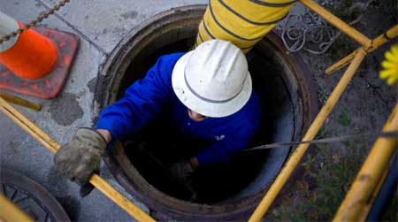
Definitions
A confined space:
Large enough and configured that you can bodily enter and perform assigned work
Limited or restricted means for entry and exit
Not designed for continuous employee occupancy

Slide 4
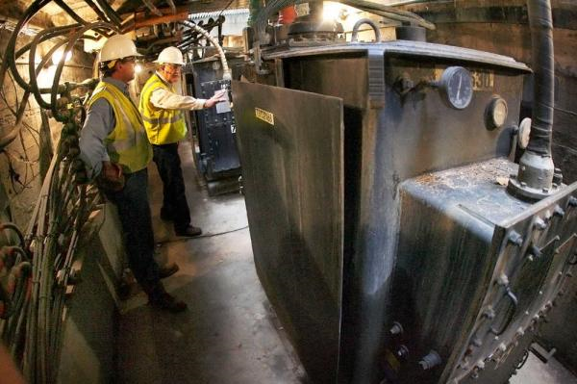
Definitions
A non-permit required space is a confined space that:
Does not or have the potential to contain any hazard capable of causing death or serious physical harm

Slide 5
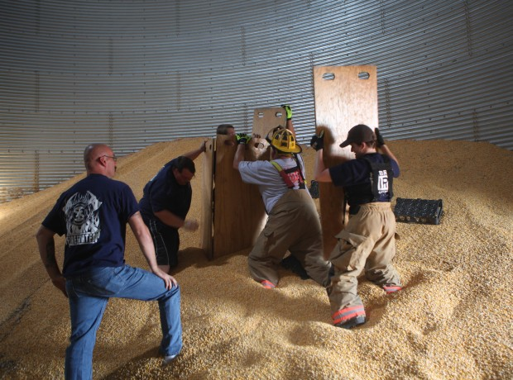
Definitions
A permit required space is a confined space that:
Contains or has the potential to contain a hazardous atmosphere
Contains a material that has the potential for engulfing an entrant

Slide 6
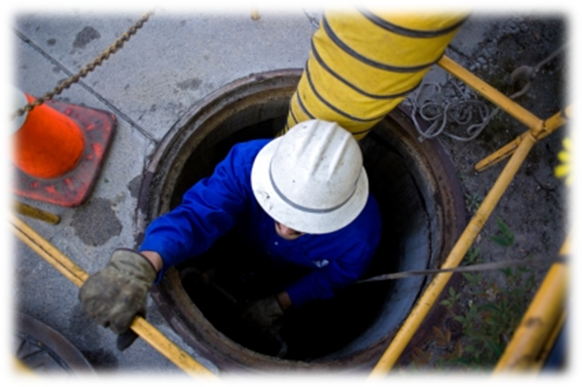
Permit Space (Continued)
Has an internal configuration such that an entrant could become trapped or asphyxiated
By inwardly conveying walls or by a floor which slopes downward and tapers to a smaller cross-section
Contains any other recognized serious safety or health hazard

Slide 7
Definitions
An enclosed space is a confined space that:
Can be a working space, such as a
Manhole
Vault
Tunnel
Shaft

Slide 8
Enclosed Space (Continued)
Has a limited means of egress or entry
Designed for periodic employee entry under normal operating conditions
Under normal conditions, does not contain a hazardous atmosphere
But may contain a hazardous atmosphere under abnormal conditions

Slide 9
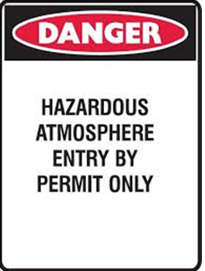
Hazardous Atmosphere
An atmosphere that may expose employees to the risk of death, incapacitation, impairment of ability to self-rescue
Flammable Gas
Airborne Dust
Obscured vision
Toxic substance
IDLH

Slide 10
Applicable Standards
Enclosed spaces are regulated under both the OSHA Construction and General Industry Standards §1926.953 and §1910.269
Confined Spaces and Permit Required Confined Spaces are regulated under the OSHA General Industry Standard §1910.146

Slide 11
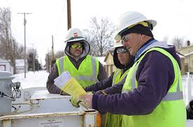
Similarity
Pre-Job Briefing
Discussion Topics
Space type
Hazards
Testing
Cover removal
Fall protection
Rescue
Emergency response

Slide 12
Similarity
All employees required to enter or serve as an attendant
Hazards of entry
Entry Procedures
Rescue Procedures

Slide 13
Permit Required Confined Spaces

Slide 14
Written Program Required
Permit process
Testing
Ventilation
Equipment
Fire
Attendant
Emergency plan

Slide 15
Employer Responsibilities
The employer shall verify that the space is safe for entry and that the pre-entry measures have been taken
Through a written certification that contains the:
Date
Location of the space
Signature of the person providing the certification.
The certification shall be made before entry
Shall be made available to each employee entering the space or to that employee's authorized representative

Slide 16
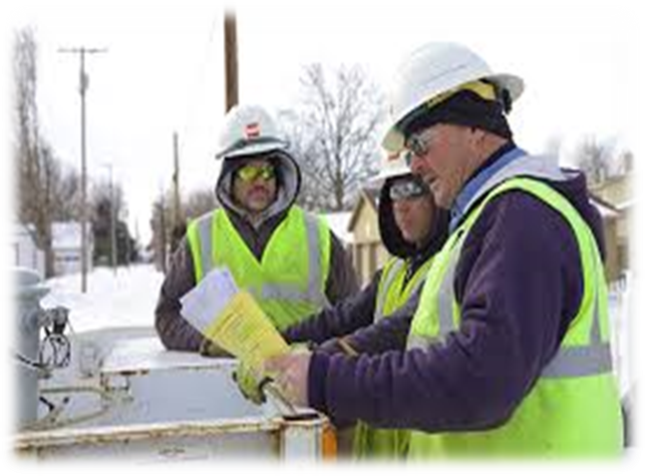
Entry Supervisor
Responsible for determining if acceptable entry conditions are present when entry is planned
Verifies rescue is available
Authorizes entry & removes unauthorized individuals
Overseeing entry operations and terminating entry as required

Slide 17
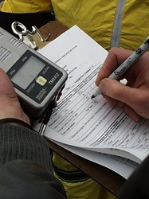
Testing
If space fails
Report to Entry Supervisor
Post appropriate warning
Ventilate if appropriate
If space fails while occupied, immediately remove entrants

Slide 18
Hazards
Oxygen Deficient
Less than19.5%
Oxygen Enriched
Greater than 23.5%
Flammability
Upper Flammable Limit
Toxic Contaminants
Hydrogen Sulfide, Carbon Monoxide
Physical Hazards
Cave-in, Falls, Electrical

Slide 19
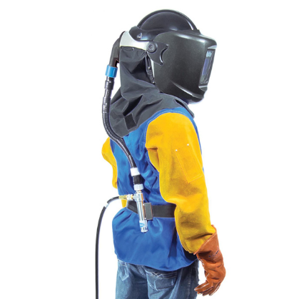
Ventilation
When sufficient ventilation cannot be obtained without blocking the means of egress
Employees inside are protected by air line respirators

Slide 20
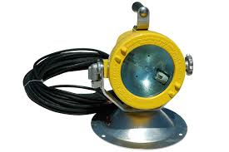
Lighting
Lighting equipment must enable employees to see well enough to work safely and to exit the space quickly in an emergency
Meets requirements for hazardous atmospheres where necessary
12 volt in wet and/or other conductive locations, or GFCI

Slide 21
Welding & Cutting
Do not take cylinders containing oxygen, acetylene, or other fuel gas into confined spaces
Remove hoses immediately when disconnected
Positively shut off gas supply if the torch is not in use or left unattended
Remove torch and hose from the space
Shift Change
Overnight
21
Notes:
.

Slide 22
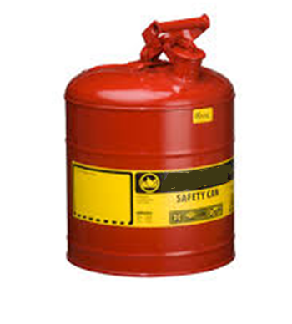
Flammable Liquids
Stored in approved container
Quantity necessary for single shift
Properly rated fire extinguisher immediately available
Post a fire watch after welding, burning, heating
No smoking is permitted in space
22

Slide 23
Attendant
Is Trained in and Knows:
The hazards that may be faced during entry
Signs and symptoms of overexposure
Procedures for summoning rescue or other emergency services
Proper use of equipment used for communication, if necessary
Performance of non-entry rescue
Maintain an accurate count of entrants
Remain outside of the PRCS unless relieved of attendant duties
Monitors activities inside space
Performs NO OTHER duties that may interfere with attendant duties
23

Slide 24
Emergency Plan
Emergency plan will specify:
Who to notify
How to summon other assistance
The emergency equipment on hand
Procedure for extraction without the attendant(s) entering space
First aid and CPR
24

Slide 25
Enclosed Spaces

Slide 26
Employer Responsibilities
The employer shall ensure the use of safe work practices for entry into, and work in, enclosed spaces
And for rescue of employees from such spaces

Slide 27
Attendant
All employees required to enter or serve as an attendant
Hazards of enclosed space entry
Entry Procedures
Rescue Procedures

Slide 28
Enclosed Space Testing
Before entry
Periodic sampling during work
Test after breaks and when conditions change
Continuously monitor for oxygen deficiency during welding or cutting

Slide 29
Open Flames
If open flames are used in enclosed spaces
A test for flammable gases and vapors shall be made immediately before the open flame device is used
At least once per hour while the device is used in the space

Slide 30
Enclosed Space Ventilation
If continuous forced-air ventilation is used
Shall begin before entry is made
Maintained long enough that a safe atmosphere exists before employees are allowed to enter
The forced-air ventilation shall be so directed
Ventilate the immediate area where employees are present within the enclosed space
Continue until all employees leave the enclosed space

Slide 31
Review
What similar features do enclosed space and a confined space share?
Name some of the physical hazards one may encounter in a confined or enclosed space.
Flammable liquids must be stored in an _________ _______.
Prior to removing a manhole cover one must check to see if the cover is _____________.
The employer must verify that, prior to entering a confined/enclosed space that __________ is available.
31
Notes:
1. Limited means of access/egress, May be entered, Not designed for continuous occupancy
2. Cave-in, Falls, Electrical, Entrapment
Approved Containers
Hot
Rescue
Yes. While work is being performed in the enclosed space, the attendant is not precluded from performing other duties outside the enclosed space if these duties do not distract the attendant from monitoring employees within the space or ensuring that it is safe for employees to enter and exit the space.

