Slide 1
Grounding & Bonding
Continuing Education
First Quarter 2020
Notes:
Introduce the module

Slide 2
Module Objectives
Why Grounding & Bonding is Important
Installing & Removing Grounds
Equipment Selection
Applications
Notes:
Explain that during the module we will discuss the following topics

Slide 3
The First Rule To Live By:
Never Second Guess Electrical Hazards! If you are ever in doubt about a course of action,
STOP!
Consult a Supervisor, Safety Person and/or Journeyman
Notes:
4
4
4
4
4
Strong emphasis. There is always time to do it the right way the first time.

Slide 4
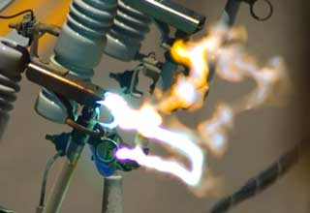
Effects of Electrical Contact
Shock Trauma
Burns
Loss of limbs
Internal injuries
Psychological Trauma
Loss of livelihood
Notes:
Discuss the path of the current determines the severity of the shock. If the path crosses the heart, results may be fatal. Explain all the negative consequences of electrical contact.

Slide 5
Electrical Contact Events by General Activity
Injury Classification | General Activity | 2018 | 2017 | Grand Total
Electric Contact | Aerial Work |  | 1 | 1
 | Conductors Installing/Removing (*1) | 10 | 8 | 18
 | Digging/Excavation Manual |  | 1 | 1
 | Equipment Assembly/Disassembly |  | 1 | 1
 | Grounds Installing Removing (*1) | 1 | 1 | 2
 | Materials Handling Manual | 2 |  | 2
 | Operating Vehicle/Equipment | 1 |  | 1
 | Other/Unknown/Blank |  | 1 | 1
 | Pole/Tower/Structure -Assembly/Disassembly (*1) | 3 | 2 | 5
 | Standing |  | 1 | 1
 | Unknown | 1 |  | 1
Grand Total |  | 18 | 16 | 34
* Fatal events 2018
Notes:
This table was pulled from the 2018 OSHA 300 log Analysis Report. There has been an increase in the data provided from 2017, to 2018. In 2018 there were three events which were fatal involving installing/removing conductors, installing/removing grounds, and assembly/disassembly of a pole/tower/structure.

Slide 6
Electrical Contact Statistics
Injury Classification | 2018 | 2017 | 2016 | 2015
Electric Contact | 3 | 5 | 1 | 1
Struck By (*1) | 1 |  |  | 2
Fall | 1 | 2
Misc/Other (*2) | 2
Caught Between (*1) | 2
Motor Vehicle |  | 1 |  | 1
Grand Total | 9 | 8 | 1 | 4
*2018 – Helicopter Events
Notes:
This slide shows that while the fatalities have declined in the year 2018 as compared to 2017, we still continue to have these types of events.

Slide 7
Electrical Contact and Arc Flash Events
OSHA Recordable |  |  |  |  |  |  | SIF Events
Injury Classification | 2018 | 2017 | 2016 | 2015 | Grand Total |  | 2018 | 2017
Electric Contact | 18 | 16 | 11 | 26 | 71 |  | 8 | 9
Arc Flash | 17 | 10 | 27 | 17 | 71 |  | 6 | 1
Grand Total | 35 | 26 | 38 | 43 | 142 |  | 14 | 10
Notes:
Events which electrical contact and arc flash occurred have increased since 2016.

Slide 8

How a circuit can become unintentionally energized?
Switching
Induction
Back-feed
Lightning strikes
Vehicle Accidents
Equipment Failure
Notes:
Explain that we definitely want to keep our work areas as safe as possible! On systems that have been de-energized, many items have to be considered for the continuous safety of employees. Accidental Energizing - The employee in charge of the work and the employees will undoubtedly make certain that the system is de-energized before starting work, but through carelessness or misunderstanding, switches may be closed and energize the system in the work area. Accidents on adjacent systems, at crossovers or on overbuild, could result in an energized line coming in contact with the de-energized system. Fault Currents- on adjacent systems can cause an increase in the amount of induced or feed-over voltage on de-energized lines. While these fault currents should be of a short duration and until circuit protection takes over the values are high enough to require the work area be properly grounded.
Lightning - Although the de-energized work area may be bathed in bright sunlight, a storm on some other portion of the system could result in lightning striking the system causing increases in voltage and current transients which would make the work area unsafe. Induced Voltage - from adjacent power lines is a constant consideration. Even though the system has been de-energized there is an electro-magnetic feed over from adjacent energized circuits. The value of the induced feed-over will depend on the voltage and how close it is to the de-energized circuit. Induced voltages must be grounded to avoid possible electrical injury, discomfort, and inadvertent jerk reactions that could cause the employee to fall into circuits or equipment or otherwise be injured. Vehicle accidents can cause unintentional contact.

Slide 9
Key Safety Fundamental
To avoid hazardous differences in electrical potential:
Insulate yourself from the hazard
Isolate yourself from the hazard
Work in a Equal Potential zone

Slide 10
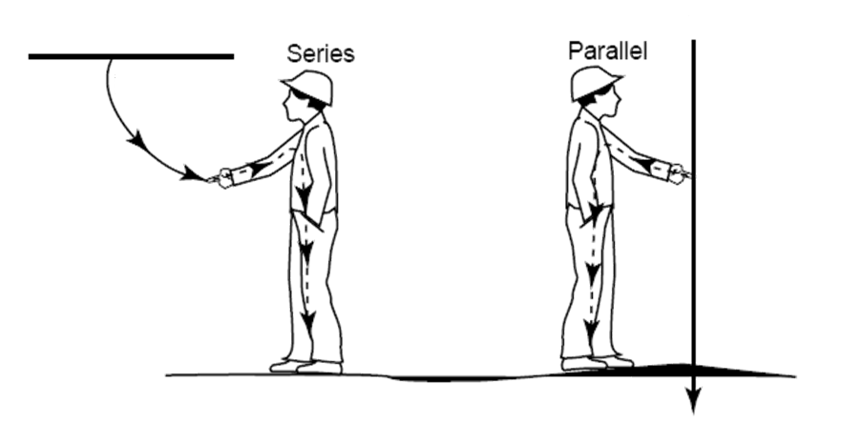

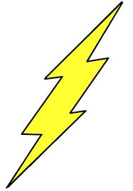
Safety Fundamental
Voltage
Voltage
Lower Potential
Notes:
Explain that a key safety fundamental is to never place your body in series or in parallel with two possible potential differences. Bridging these differences may place the worker at risk.

Slide 11
Installing and Removing Grounds

Slide 12
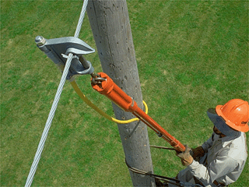
Installing Grounds
When attaching grounds
  Attach ground end of the cable to a earth ground potential first
  Always use a live line tool
Notes:
Explain that once potential testing is complete, and it’s been confirmed that the line is de-energized, the grounds may be attached. In order for grounds to work properly, the conductor or part the ground clamp is to be attached to must be cleaned. One method to accomplish this is to use a wire brush mounted on the end of a live line tool to brush oxidation from the part.
It is critical to maintain the minimum approach distance from the part of the circuit during this step. Also grounding clamps must be brushed and cleaned prior to use to ensure a good connection.
The grounds must be applied with a live line tool and tightened down. Should a fault occur, the violent reaction may cause a loose or improperly installed clamp to fail.

Slide 13
Removing Grounds
When removing grounds
  The grounding device shall be removed from the normally energized conductor, line or equipment first
  Always use a live line tool
Notes:
Explain that when removing grounds, the grounding device shall be removed from the normally energized (but now de-energized) conductor, line or equipment first using insulating live line tools. Emphasize that the installation and removal of grounds in not a bare-hand or rubber glove procedure.

Slide 14
Equipment Selection

Slide 15
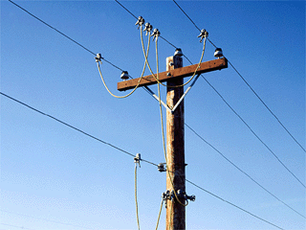
OSHA Standard
1926.962(c) Equipotential zone
  Temporary protective grounds shall be placed at such locations and arranged in such a manner that the employer can demonstrate will prevent each employee from being exposed to hazardous differences in electric potential
Notes:
Explain that Subpart V, from the OSHA standards regulated the construction of power transmission and distribution systems. This OSHA standard is a “Performance” standard. OSHA does not tell the employer how to do this only that the employer shall do this.

Slide 16

Maximum Fault Current Capability for Grounding Cables
Cable Size | Clearing Time | RMS Amperes
#2 | 15 Cycles | 17,000
 | 30 Cycles | 13,000
1/0 | 15 Cycles | 26,000
 | 30 Cycles | 20,000
2/0 | 15 Cycles | 33,000
 | 30 Cycles | 26,000
4/0 | 15 Cycles | 53,000
 | 30 Cycles | 41,000
ASTM F-855
Notes:
Review current carrying capabilities chart. Discuss company and host employer grounding cable size standards.
Reference ASTM F 855

Slide 17
Applications

Slide 18
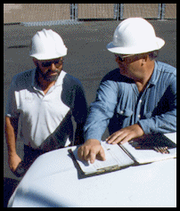
Safe Work Practices
Job Briefing
  Shall be held with all workers involved before beginning any job to discuss the potential hazards and what protective measures will be used for employee protection and safeguarding of the public and the customer
Notes:
Discuss that prior to starting any grounding task, a job briefing must be held. Discuss the hazards involved. Discuss the preventative measures that will be used to protect the workers, the public and the customer. Consider documenting the location of the grounds on the job briefing. This will help avoid the chance of unintentionally leaving grounds on a line.

Slide 19
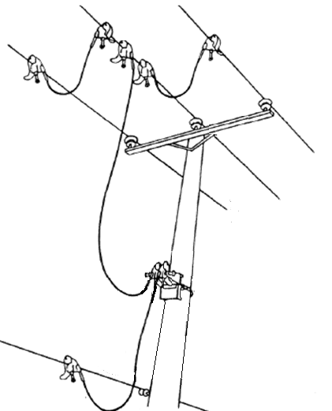
Distribution-Neutral on Pole
Notes:
Explain that this is one method of creating an equal potential zone on a wooden pole, distribution circuit. Explain that some of the steps here are: Obtain a clearance, Identify and isolate the line - obtain visible openings on the source side (and the load side if possible) of the line or equipment. Use a voltage detector to test the line or equipment to be sure it is de-energized
Install a cluster bar on the pole just below the work area. Leave adequate clearance above it. Clamp a suitable length jumper to the cluster bar, and the other end to the common neutral
Jumper from the cluster bar to the closest phase conductor. Jumper the other phases together, working from the nearest to farthest away. Remove the grounds in reverse order.

Slide 20
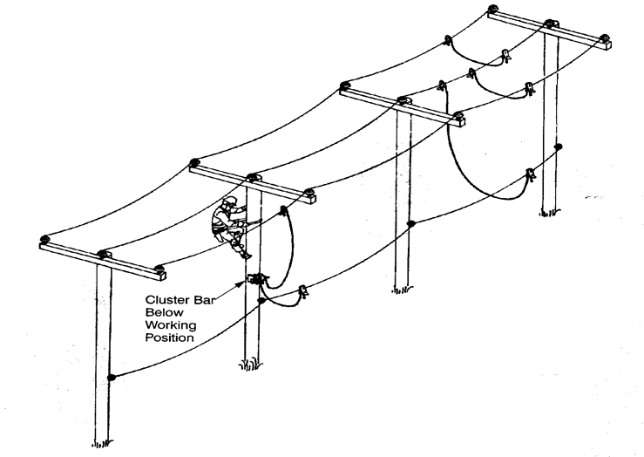
More Than One Span Away
This jumper moves
to each phase
Notes:
Explain that when working away from the master or trip grounds one method of creating an equal potential work zone is: Obtain a clearance, Identify and isolate the line - obtain visible openings on the source side (and the load side if possible) of the line or equipment. Use a voltage detector to test the line or equipment to be sure it is de-energized. At one location of the job, install a grounding jumper from the common or primary neutral to the closest phase conductor. From that conductor, jumper the remaining phases together, working from the nearest to the farthest away. At each work site, attach a cluster bar to the pole below the work area. Leave adequate working space above it. Install a jumper (bond) from the cluster bar to the primary phase being worked. When work moves to another phase on the same pole, move the jumper to the new phase and begin work. When work moves to the next pole, remove the phase jumper, then remove the cluster bar, and install at the new work site. Remove the grounds in reverse order.

Slide 21
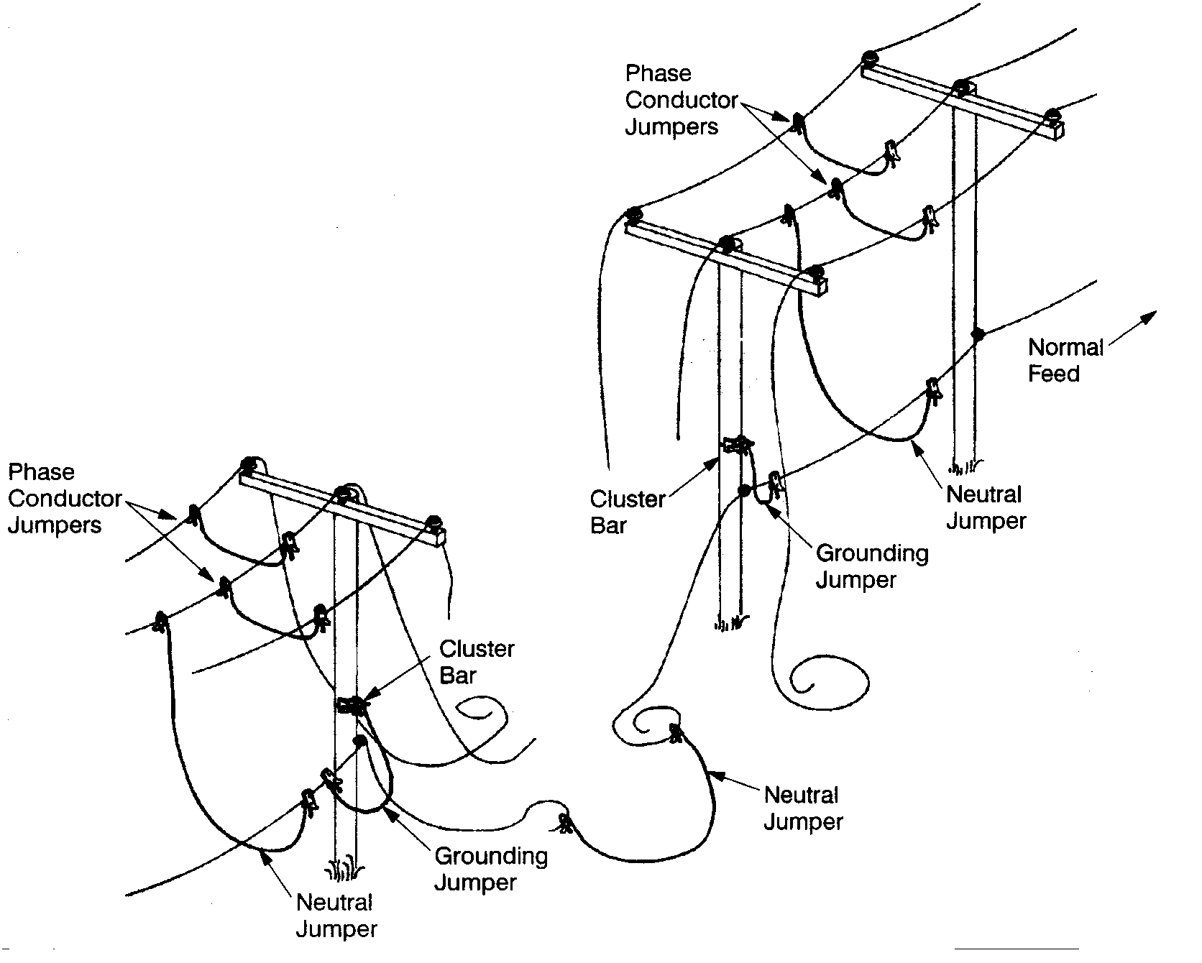
Primary Conductors Broken and on the Ground
If possible, make the splices
above the ground in an
Insulated Aerial lift
Notes:
Explain that working with downed conductors creates particular hazards. In this care the worker may consider using the “Insulate” method of protection. The worker may choose to wear rubber insulating gloves (and sleeves) and rubber insulating over-shoes for protection. The downed conductor may also be handled using live line tools. If possible consider making the splice(s) working from an insulated aerial lift truck.

Slide 22
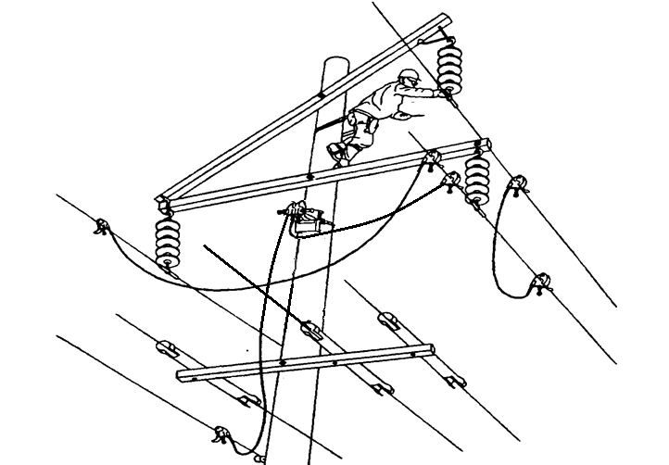
Transmission Lines with Distribution Underbuilt
Does not indicate
Good line cover
Notes:
Steps here are: Obtain a clearance, Identify and isolate the line - obtain visible openings on the source side (and the load side if possible) of the line or equipment. Use a voltage detector to test the line or equipment to be sure it is de-energized. Install a cluster bar on the pole just below the work area. Leave adequate clearance above it. Install a grounding jumper from the either system neutral, shield wire if present, and/or a temporary ground rod (TGR) to the cluster bar. Jumper from the cluster bar to the closest phase conductor. Jumper the other phases together, working from the nearest to the farthest away. NOTE: Install barriers to prevent grounding jumpers from contacting energized conductors. Note: It is important to bond the phases together so that the protective devices will work. Remove the grounds in reverse order. Also be aware, one may not be able or allowed to use the system neutral as a ground source.

Slide 23
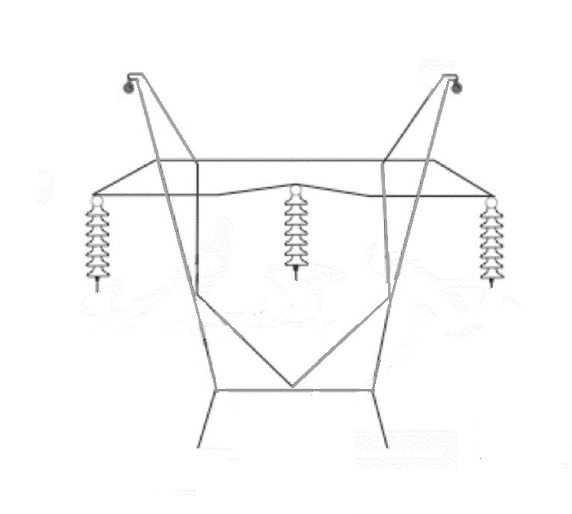
Grounding for Lattice Towers
Insulated shield
wire is hazardous
Notes:
The steps here are: Obtain a clearance, Identify and isolate the line - obtain visible openings on the source side (and the load side if possible) of the line or equipment. Use a voltage detector to test the line or equipment to be sure it is de-energized. Inspect the tower structure grounds to make sure they are in good condition, If they are the grounds will have to be repaired first. Install tower clamps on the tower legs, leave adequate working space above them. Clamp one end of a suitable length grounding jumper to a tower clamp, and the other end to the closest phase conductor. Install the other grounding jumpers to the tower clamps and other phases if required.
Important note: Be sure to discuss that hazards of insulated shield wire. In certain cases the shield wire is energized at a distribution voltage to supply lighting at river crossings and/or airports. In other cases the shield wire may be a communication conductor. In either case the point is to explain that insulated shield wires may have possess a dangerous potential. This must be considered during the pre-job planning stage of the operation.

Slide 24
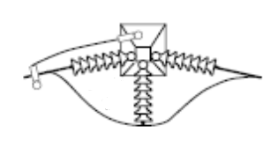
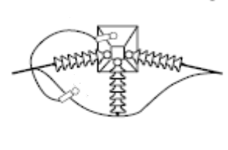
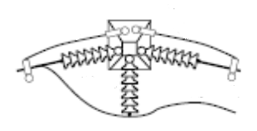
Dead End Structures
If the continuity is maintained with the permanent jumper, one grounding jumper may suffice
If the continuity is not maintained with the permanent jumper, two grounding jumpers are required
Notes:
Explain the need to maintain continuity.

Slide 25
With Shield Wire
Notes:
Discuss that this is the grounding set-up that will most commonly be used especially on wooden “H” frame structures. Explain that if the structure has a shield wire that a ground jumper must be installed between the shield wire and a phase conductor. Ask the group what would have to be done if a worker was on each pole? The desired answer is “A cluster bracket and personal ground would need to be installed on the opposing structure.” Explain that in certain cases it may be a good work practice to use both shield wires.

Slide 26
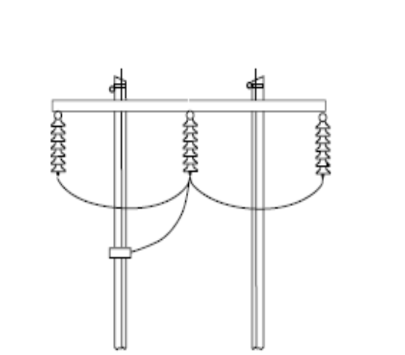
No Shield Wire
Notes:
Explain that in the absence of a shield wire, or in situations where the customer does not permit the use of a shield wire, it may be necessary to use a TGR as the ground source.

Slide 27
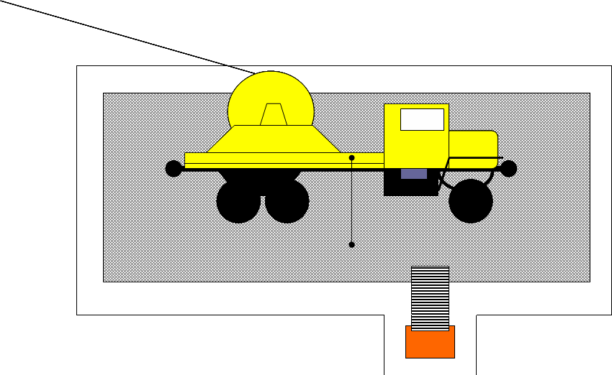
Component Parts
Ground Rods (each corner)
Outer Fence
Mat
Inner Fence
Equipment Ground
to Ground Rod
Isolation Platform
Equipment Bond to Mat
Insulation Platform
Entrance
Notes:
Various methods to establish an equal potential zone for conductor stringing.

Slide 28
Component Parts
Ground Rods (Each corner)
Rolling Ground
Equipment Bond to mat
Mat
Equipment Ground to Rod
Isolation Platform
Inner Fence
Outer Fence
Insulation Platform
Entrance
Notes:
Various methods to establish an equal potential zone for conductor stringing.

Slide 29
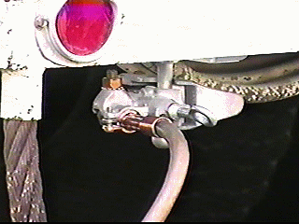
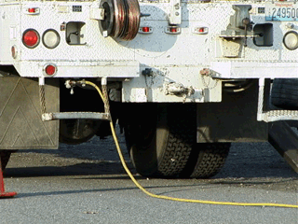
Equipment Grounding
Equipment
  Approved connection point capable of handling the anticipated fault current
Ground Source
  To system neutral (or)
  A pole ground (or)
  To a grounded structure (or)
  To a Temporary Ground Rod
    driven or screw type
Notes:
Explain that connections of the vehicle grounds to the vehicle and the ground point are determined by company safe work practices. In most cases the attachment point will be either to the system neutral or a driven or portable screw type ground. The choice will be based on company policy and the availability of the system neutral and if the customer will allow it to be used for protective grounding. The system neutral and/or pole ground may provide the lowest resistance path for fault current to return, thus offering the best protection available. When a driven or screw ground is used, it’s ability to conduct fault current will depend on it’s setting depth, soil conditions, amount of contact with the earth and the size and material composition of the ground rod. These elements, unless tested are unknown and could cause problems if fault current were to flow. These unknowns can also increase the risk of hazardous step and touch potentials. When grounding vehicles and equipment, always make the first connection to the vehicle (make sure the connection point is clean of oil, paint or debris that could increase the resistance). Then connect the ground to the designated connection point (neutral or ground rod). When connecting to the system neutral, use a hot line tool to make the connection. Workers must not climb on or off vehicles that are in proximity to energized conductors

Slide 30
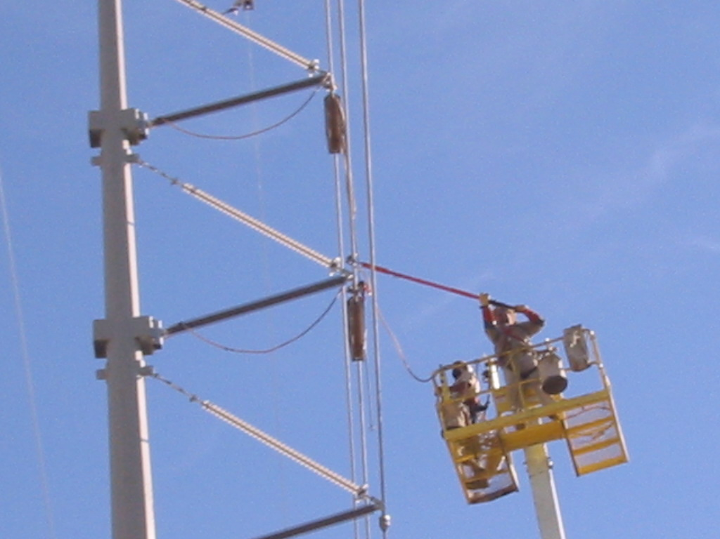
Bonding
Non-Insulated Aerial Lift
Notes:
Discuss the need to bond a non-insulated basket to the conductor before contacting the conductor. Discuss that this must be done (both on and off) using an insulated tool. Also discuss that the chassis of the vehicle should be bonded to the structure so that in the event of an accidental re-energization the fault current will not flow solely to ground through the boom of the aerial lift truck.

Slide 31
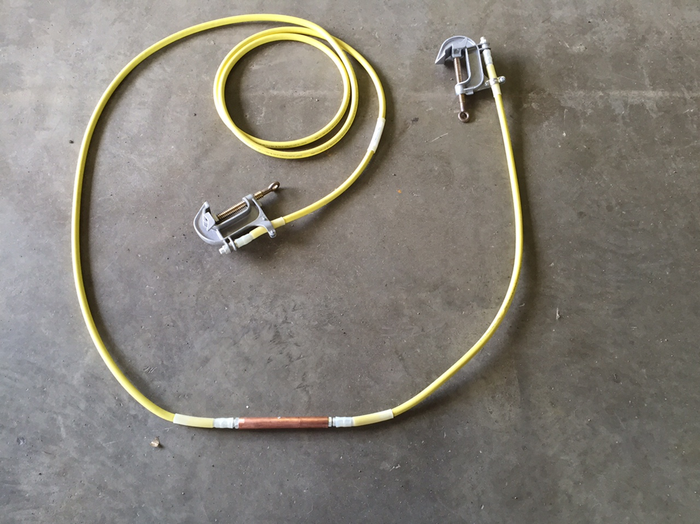
Notes:
Explain that when using a basket bond in an elevated work location, it is important that if an emergency situation should occur, and the worker in the basket may not be able to remove the bond, that a plan is in place to bring the basket down. One method is to use a “Breakaway” bonding cable. The particular item shown in the picture is made by the Tallman equipment company.
Part number: BAC 625 on page 220 of the Tallman catalogue.

Slide 32


Insulated Aerial Lift
Notes:
Explain that when working from an INSULATED aerial lift, a Temporary Protective Ground is not needed so long as you Maintain Minimum Approach Distance from all other objects at a different potential

Slide 33


Parallel Ground Sets
Determine the current carrying capacity of a single ground
Multiply by 2
  Reduce by 10% if restrained
  Reduce by 20% if unrestrained
Notes:
Explain that more than two parallel protective grounding sets should be avoided if possible. The increased available fault current that makes paralleling necessary also creates other risk issues at the worksite. Extreme electromechanical forces are present as the current approaches 60 000 A. These forces may cause the clamp to break. These forces may also reduce the rated use time of the grounding system by an unknown and inconsistent amount. The conductor, heated by the fault current flow, may break before reaching the fusing time associated with a particular current magnitude. The voltage drop caused by mutual inductance may also cause current imbalance in the multiple paths. It may be possible to reduce the protective ground system requirement from two cables to one cable by allowing an increased cable size, a reduction of the required protection time, or a combination of both. The appropriate source within the users company should be consulted for resolution of these variations. If more than two grounding cables are required, custom-designed grounding cables with special installation techniques should be developed for that site. An alternative technique is the installation of rigid bus grounds.

Slide 34

Barricade
Grounding a vehicle will not protect workers that may contact the vehicle if the vehicle becomes energized
Notes:
Discuss that vehicle grounding helps protect the vehicle and relay the circuit interrupting device. The simple act of grounding a vehicle or piece of equipment does not guarantee employee safety. When a worker touched a vehicle or piece of equipment, the worker is a resistor in a parallel circuit. All branches of a parallel receive the same voltage. If the vehicle or equipment can become energized, ground it, barricade it, and: STAY AWAY!

Slide 35
Recap

Slide 36
Safety Fundamental
Voltage
Voltage
Lower Potential
Notes:
Explain that a key safety fundamental is to never place your body in series or in parallel with two possible potential differences. Bridging these differences may place the worker at risk.

Slide 37
Key Safety Fundamental
To avoid hazardous differences in electrical potential:
Insulate yourself from the hazard
Isolate yourself from the hazard
Work in a Equal Potential zone

