Slide 1
Risk Tolerance Continuing Education First Quarter 2021
Notes:
Introduce the module. Explain that the intent of this presentation is as a continuing education training topic related to certain aspects from the ET&D 20-Hour (Safety Leadership In Action) OSHA training class.

Slide 2
Objectives
In this presentation we will be discussing the following:
Risk Tolerance defined
The factors affecting personal and organizational Risk Tolerance (as outlined in the ET&D 20-Hour Safety Leadership In Action Training)
Risk Tolerance communication strategies

Slide 3
Risk Tolerance Defined What is Risk Tolerance?

Slide 4
Definition
Risk Tolerance
In the context of Safety, Risk Tolerance is defined as:
“The willingness of a worker or a group to take safety risks.”
Notes:
How many of us would take risks if we understood the seriousness of the consequences?

Slide 5
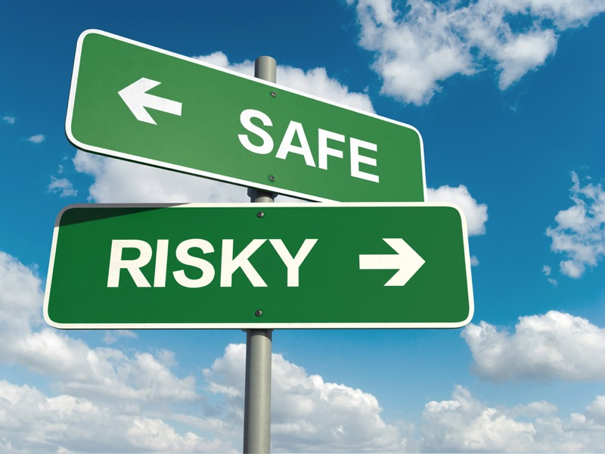
Discussion
The term “Risk Tolerance” may imply that the workers or group who willingly take the risk are:
Aware of the risk (hazard awareness)
Aware of all possible outcomes of taking that risk
That may not always be the case!
Notes:
Most people you ask tend to assume things are less risky or less hazardous than they really are. For example, most individuals accept that speeding in excess at 5 miles an hour may expose them to a ticket but never consider the additional risk of a crash. What if they were speeding in excess of 10 or 15 miles an hour over the speed limit? At what speed would you consider the increased risk of a crash?

Slide 6
Example:
YES
NO
YES
NO
NO
NO
YES
YES
YES
YES
Notes:
Explain the flow chart beginning with workplace exposure and follow through to the end. Pick a hazard such as Line of Fire or an Underground Energized Cable.

Slide 7
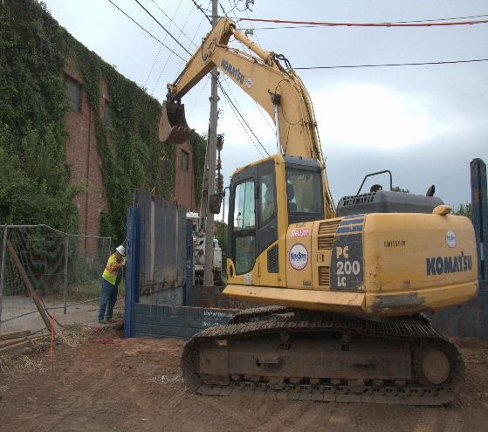
Risk vs. Reward or Consequence
Do I see it?
Is the person able to “see” the risk? What about an “invisible” hazard like stored energy, radiation, electricity, or a hazardous atmosphere?
Has the person been trained or have experience in order to recognize all risks, including those difficult to detect?
Notes:
Discuss this slide with the group.

Slide 8
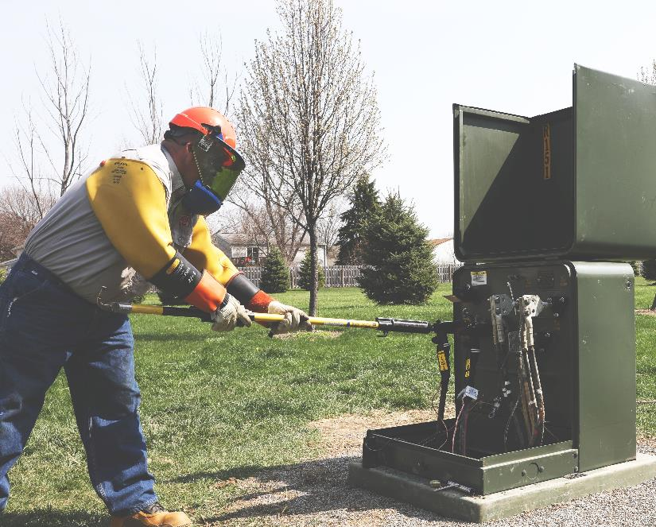
Risk vs. Reward or Consequence
Do I understand it?
Does the person truly understand the nature and severity of the risk?
Is the person aware of all possible outcomes including worst case scenario by taking that risk?
Does the person understand the probability of that outcome?
Notes:
Discuss the importance of probability and severity when considering controls for risk.

Slide 9
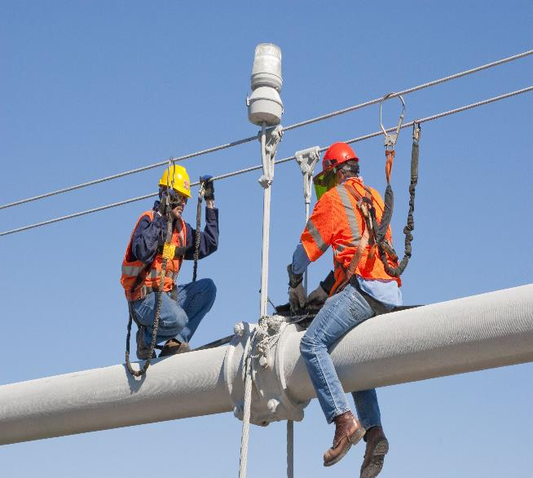
Risk vs. Reward or Consequence
Do I accept it?
When accepting the risk, is the person also accepting the possibility of the worst outcome (serious injury), a less severe outcome (minor injury), or hoping for no negative outcome (no injury or reward)?
By accepting the risk, the person most likely believes that the worst “won’t happen to them.”
Notes:
Would you perform this task without inspecting your harness? How is this scenario different from say, if you were performing work in a basket, or aerial lift?

Slide 10
Factors Affecting Risk Tolerance
Notes:
Introduce this section to the group

Slide 11
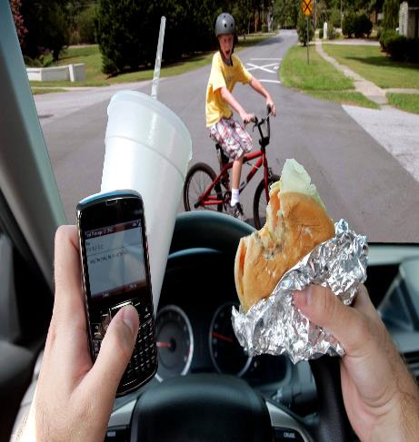
Factors Affecting Risk Tolerance
Overestimating capability or experience Greater risks are tolerated when there is a belief in one’s physical ability, strength, agility, reaction time and reflexes in preventing an incident.
“Of course, I can lift that!”
“No, I don’t need someone to help me.”
“I can drive faster because I’m a better driver.”
Notes:
Overestimating capability and/or experience is a human performance concept we often see on jobsites.

Slide 12
Factors Affecting Risk Tolerance
Familiarity with the task (or complacency) This occurs when a worker has completed a task successfully multiple times and perceive they have the skill to complete it successfully without thinking.
“I’ve done this a million times.”
“I can do this in my sleep.”
Notes:
Complacency can get us into trouble, especially when we have developed an incorrect work practice which we keep repeating and possibly passing on to others.

Slide 13
Factors Affecting Risk Tolerance
Seriousness of the outcome The increased risk is based on the premise that nothing could go wrong. The worker under-estimates how serious the consequences might be.
“What’s the worst that can happen?”
“I know what will happen if this goes wrong and it’s really not that bad.”
Notes:
Why are we willing to take these kinds of risk with low voltage work?

Slide 14
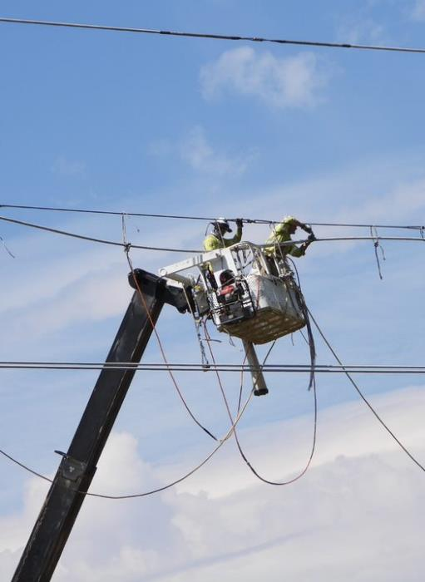
Factors Affecting Risk Tolerance
Personal Gain or Adrenaline Rush Some people need to take risks to “feel alive.” Safe behaviors are sometimes viewed as “boring.” A person might take risks to either fuel their ego or gain admiration from others.
Workers who can’t satisfy their need for risk in their personal lives might feel the need to get it in the workplace.
Notes:
How often are employees rewarded for being fast? How often is a worker who accepts high risk considered “better”? How does risk in personal lives affect risk at work? Ask the group if there is a correlation.

Slide 15
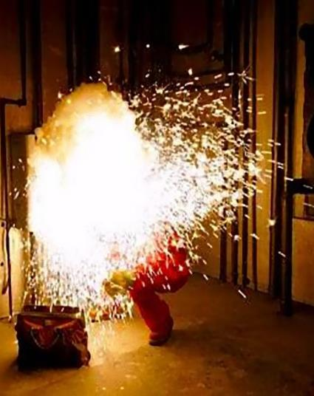
Factors Affecting Risk Tolerance
Personal experience with a serious outcome Personal events can stick with an individual for a long time - sometimes a lifetime. It can result in being intolerant of any risk associated with a similar task. Newer workers need to hear firsthand accounts of past serious incidents to reduce their risk acceptance (Conscious/Unconscious).
Communicating lessons learned from industry events is critical to promote organizational learning.
Notes:
Lessons learned can deter workers from making the same mistake twice by educating workers on the outcome of the event. Root causes, follow ups, action plans should all be included as part of the lessons learned.

Slide 16
Factors Affecting Risk Tolerance
Cost of Non-Compliance If the cost of noncompliance (taking a risk), is going to be high, such as losing a job or receiving a fine or penalty, the person may decide to conduct themselves in a less risky manner.
In the moment of taking a risk, most people don’t consider the “costs” that may occur or they believe risk taking is endorsed by their immediate supervisor or employer. What does a severe injury or fatality cost?
Notes:
What are the other costs of Non-Compliance?
Injury
Fatality
Reduced Morale
Reputation Damage
Equipment Damage
Others?

Slide 17
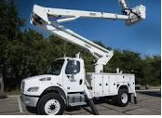
Factors Affecting Risk Tolerance
Confidence in Equipment Overconfidence occurs when a worker places excessive or unwarranted trust that the equipment or tool will always perform exactly as designed.
Our equipment has limitations and understanding those boundaries can prevent serious consequences.
Notes:
Conductive components of the material handler bucket include; control mechanism/pistol grip, mounting hardware, swivel hardware (all boom components minus fiberglass inserts).
Monthly boom inspections, DOT inspections, equipment housekeeping, information in the operators manual, etc.

Slide 18
Factors Affecting Risk Tolerance
Confidence in PPE or Rescue
Higher levels of risk are accepted when workers are overconfident in the safety equipment they use and their belief that if something does go wrong, the PPE will keep them from harm.
To create layers of protection, understanding the limitations of the equipment and the importance of additional layers.
Notes:
What are some other layers of protection that should be considered?
Effective Hazard Recognition
Engineering Controls
Administrative Controls
Last is PPE
Confidence in PPE, not air testing gloves each day before use, and inspecting sleeves.

Slide 19
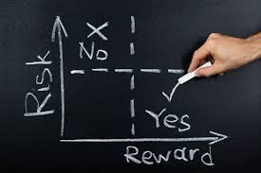
Factors Affecting Risk Tolerance
Profit or Gain from Actions If an employee perceives gain whether it’s Profit or Gain it increases a persons Risk Tolerance.
This could be finishing sooner by taking shortcuts. The gain could be direct financial impact, or it could be the gain of pride, status or a general good feeling. People may dangerously increase their risk tolerance when the rewards are perceived to be greater than the risk.
Another gain people experience is the comfort of not wearing rubber gloves.
Notes:
We shouldn’t let time pressures allow us to develop a habit of putting workers at risk by taking shortcuts, ultimately only you can make that decision.

Slide 20
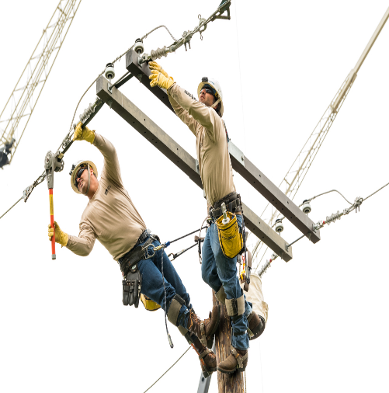
Factors Affecting Risk Tolerance
Role Models Accepting Risk The level of risk accepted by our role models and mentors will directly impact the level of risk individuals will accept. Workers will watch their peers, supervisors and mentors to determine how they should behave.
If a worker has a leader who is a risk taker, the worker is in constant conflict with the safety training he/she may have received in the past and the risk culture exhibited in the field.
Notes:
As a supervisor or higher level peer, you should always follow the rules/procedures at bare minimum.

Slide 21
Summary
The fundamental goal of this OSHA Strategic Partnership (OSP) is to reduce the number of injuries and fatalities in the Industry.
ET&D 20-Hour Safety Leadership In Action Training lists the 10 Factors affecting Risk Tolerance and management strategies for each.
We need to continually identify areas where our “risk tolerance” is resulting in unnecessary risk exposures to our people.
In order to lower our risk exposure, we need to identify and correct the individual motivations for a person to increase their risk tolerance.

