Slide 1
Slips, Trips, and Falls
Continuing Education
Second Quarter 2019
Session One
Notes:
Introduce the module. Explain that the intent of this course is to provide continuing education on training topics relative to trends and leading indicators identified by the ET&D Partnership. Along with the partnership task teams, the Bureau of Labor Statistics identifies slips, trips and falls as the cause of 15 percent of all accidental deaths, second only to motor vehicle accidents. The National Safety Council reports that slips, trips and falls account for more than 26% of injury-related visits to the emergency room. They consistently rank among the highest frequency and severity (cost) claims. Yet most people fail to recognize the hazard or realize that the majority of fall-related injuries occur as a result of falls from same-level walking surfaces. Even workplaces that have a specific plan to address slip, trip and fall hazards are unable to completely eliminate these types of incidents. The reason is that slip, trip and fall prevention programs generally address the physical factors that lead to incidents.

Slide 2
Desired Outcomes
Upon completion of this continuing education module, you should be able to:
Identify the key worker locations where slip, trip, and fall events are likely to occur
Explain factors associated with slip, trip, and fall injuries
Discuss common causes of slip, trip, and fall events
Identify preventative measures
Discuss behavioral risk factors that can contribute to slip, trip, and fall events
Notes:
Explain the objectives and the learning expectations of this continuing education module. Be sure to explain why this module is important and why the attendee should devote their attention to the lesson topic.

Slide 3
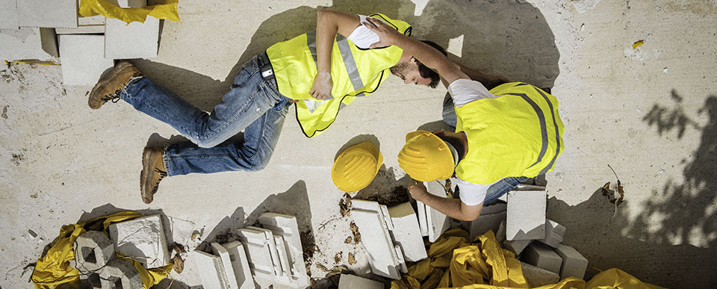
Slips, Trips, Falls
Possible Results
Disabling injuries
Deaths
Basic Truth
Many are Preventable
Notes:
Explain Slips, trips and falls are frequent causes of accidents both on and off the job. According to OSHA, slips, trips and falls constitute the majority of general industry accidents and result in back injuries, strains and sprains, contusions and fractures.

Slide 4
Introduction
Notes:
State that Slip, trip, and fall events have the potential to be a major cause of injury for employees and visitors to our premises. There is a common misconception that slip and fall injuries “just happen” and that there is little that can be done to prevent them. The potential for slips, trips and falls can be widespread, but it is important to understand where the greatest potential for danger lies.
Some causal factors associated with slip, trip and fall injuries include:
Slippery surfaces, such as a gloss-finished tile, polished stone, etc.
Holes or broken surfaces.
Uneven walking surfaces.
Poorly marked and/or poorly lit walkway transitions.
Wet surfaces caused by spills or poor drainage.
Slippery conditions due to mud, ice or water during inclement weather.

Slide 5
Partnership Facts
Falls are our fourth leading cause of OSHA Recordable injuries
81 of 644 reported in 2017
2017 (13%)
2016 (14%)
2015 (14%)
2014 (15%)
2013 (15%)
Ongoing Issue
Notes:
Explain that the information on this slide emanates directly from Task Team One’s 2017 Analysis. Annually, each partner submits their OSHA 300 log data to Task Team One for analysis. The data is submitted, redacted, and compiled. For calendar year 2017 the partner member companies submitted 636 cases recorded on OSHA logs. Task Team One performed a high-level analysis and then reviewed specific cases for clarification. Falls were in the top 5 for 2017.

Slide 6
Industry Facts
1-6
Notes:
Explain that this chart shows the types of injuries our workers are experiencing as a result to slip, trip, and/or fall events. Be sure to mention that the majority of the time, the result of one of these events is some type of fracture. Slip, trip, and fall events can be and are life changing and life altering events.

Slide 7
Industry Facts
Injury Classification | Worker Location | Total
Fall | On Ground Level | 32
 | From Vehicle | 31
 | On Pole | 6
 | On Other Surface | 3
 | On a Ladder | 5
 | In Manhole/Vault | 1
 | On Structure | 1
 | Excavation | 1
Fall Total |  | 81
More than 77% (63 of 81 events)
Notes:
Explain the industry facts and how they pertain to our job. Explain that over 77% (63 out of 81) of all fall injuries occurred due to falls from equipment and falls from same level.

Slide 8
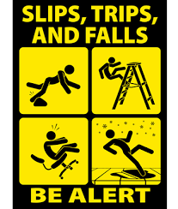
Industry Facts
1-8
Notes:
Explain that according to the partnership data, the ankle is the body part most injured in a slip, trip, fall, event. Engage the group and ask how or if we can perform our jobs without injuring these body parts?

Slide 9
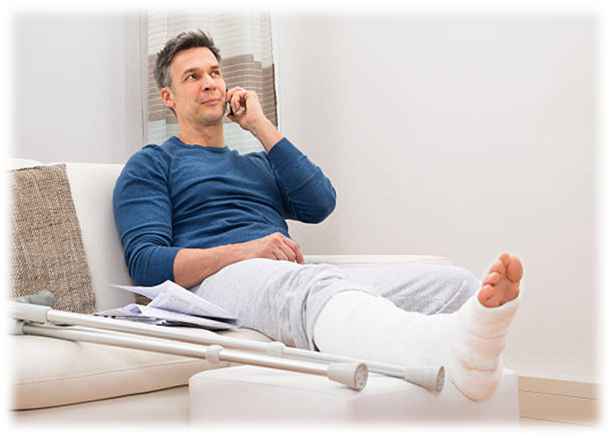
Consequences
This stinks!
To the worker:
Lost wages & out-of-pocket expenses
Pain
Temporary or permanent disability
Reduced quality of life
Depression
Loss of livelihood
Possible loss of life
Notes:
Explain in addition to their social costs, workplace injuries and illnesses have a major impact on an employer's bottom line. It has been estimated that employers pay almost $1 billion per week for direct workers' compensation costs alone. The costs of workplace injuries and illnesses include direct and indirect costs. Direct costs include workers' compensation payments, medical expenses, and costs for legal services. Examples of indirect costs include training replacement employees, accident investigation and implementation of corrective measures, lost productivity, repairs of damaged equipment and property, and costs associated with lower employee morale and absenteeism.

Slide 10
Key Points-Session One
Slips, Trips, and Falls are a leading cause of workplace injuries.
True
False
Approximately 25,000 slip, trip, and fall injuries occur daily in the United States.
True
False
Of all fall categories, falls from ground level and falls from vehicles/equipment are the most common.
True
False
Regarding ETD partnership company workers, the most frequently injured body part, due to a slip, trip, and/or fall is the ankle.
True
False
Notes:
Slips, Trips, and Falls are a leading cause of workplace injuries.
True
False
Approximately 25,000 slip, trip, and fall injuries occur daily in the United States.
True
False
Of all fall categories, falls from ground level and falls from vehicles/equipment are the most common.
True
False
Regarding ETD partnership company workers, the most frequently injured body part, due to a slip, trip, and/or fall is the ankle.
True
False

Slide 11
Slips, Trips, and Falls From Ground Level
Session Two
Notes:
Explain that the following section will discuss slip, trip, and fall events that occur from ground level or same elevation.

Slide 12
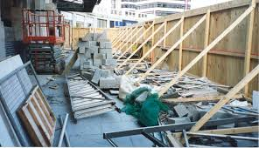
Common Causes
Possible Deficiencies
Housekeeping
Unguarded holes
Barriers
Awareness
Loss of Focus
Notes:
Explain the typical job sites hazards and certain common causes of slip, trip, and fall events. Engage the group by asking if they have seen or experienced any of these instances at their worksites?

Slide 13
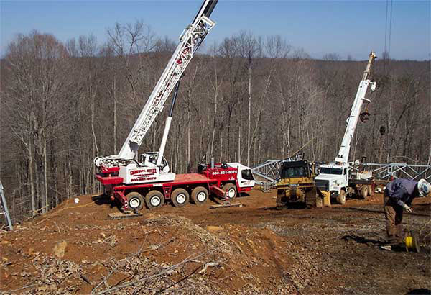
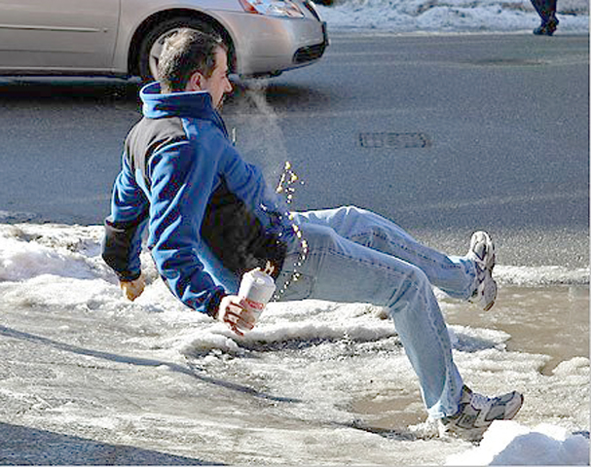
Common Causes
Environmental Issues
Ruts
Mud
Rain
Ice
Snow
Uneven/rough terrain
Notes:
Explain how weather and terrain need to be identified and the hazards associated with them must be controlled to the best of our abilities prior to and while working.

Slide 14
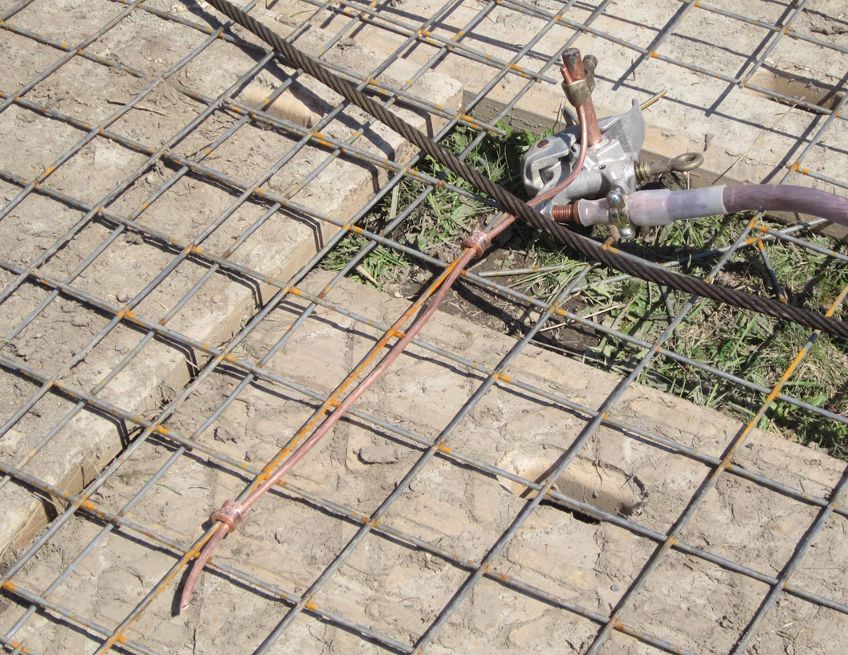
Hazard?
Possible Solution(s)?
Notes:
Use this as an involvement activity. Ask the group if they see a potential hazard in this image. Ask them to identify the hazard and suggest a corrective solution. The desired answers here are that there is a possible trip hazard as well as a possible impalement hazard. The best solution is to move this ground rod to a non-travel location where people will not normally be walking. If the hazard absolutely cannot be removed then try to lower the exposure. Maybe drive the rod a bit deeper into the ground.

Slide 15
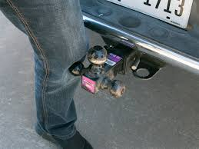
Hazard?
Possible Solution(s)?
Notes:
Use this as an involvement activity. Explain how a receiver hitch can cause trips and falls, including bruising. Explain the need to identify with barriers or eliminate by vehicle placement or removing them when not in use. Ask the group what could be some possible solutions to this hazard? This is a good slide to foster some discussion.

Slide 16
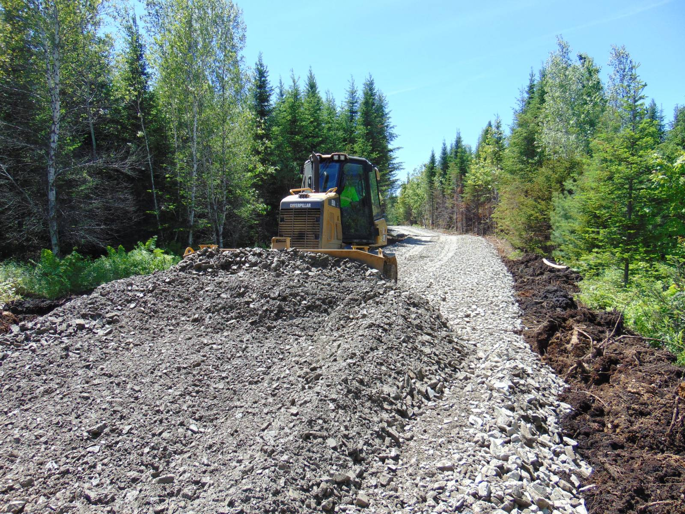
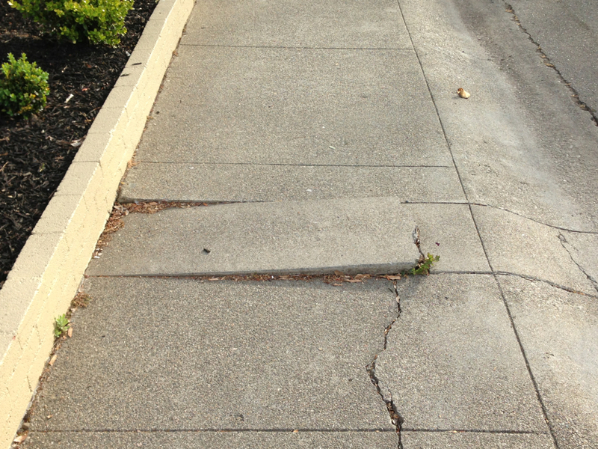
Common Causes
Uneven surfaces
Curbs
Cracks
Damaged surfaces
Loose gravel or debris
Notes:
Explain the need to identify hazards and maintain situational awareness when walking. State that irregular walking surfaces pose a risk. Identify these issues in the pre-task analysis.

Slide 17
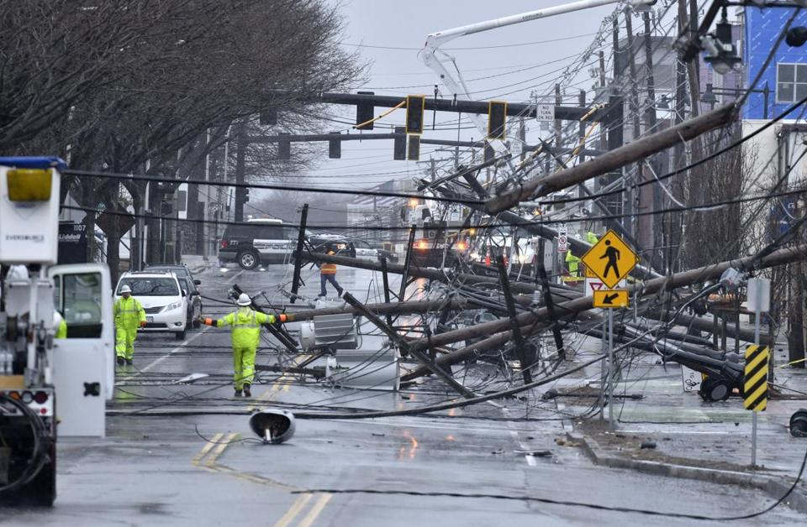
Slip, Trip, & Fall Environment!
Possible Solution(s)?
Notes:
Use this as an involvement activity. Ask the group to look at this picture and state some of the obvious hazards. The facilitator is looking for items such as electrical hazards, trip hazards, slick surfaces from spilled oil, puncture hazards, back feed, and step potential issues. Then explain how conditions are unpredictable and ever changing on storms. Explain that we need to do our best to address all STF hazards in our work areas. After a short discussion, ask the attendees to list some methods for controlling these obvious hazards.

Slide 18
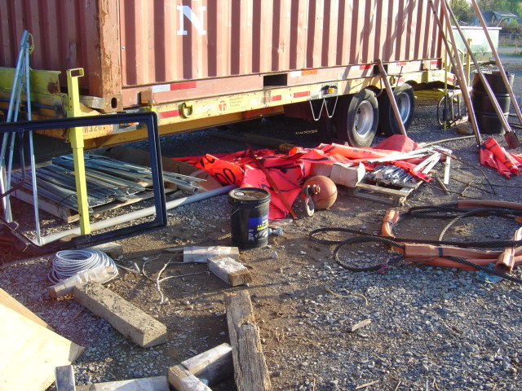
Common Causes
Housekeeping
Hoses
Cables
Conductor
Extension cords
Rigging
Hardware
Poor housekeeping is a precursor to an injury
Notes:
Explain that housekeeping or lack thereof can be a contributing factor to an injury. Poor housekeeping is a precursor to an injury. Rarely is there a time when housekeeping is deficient and productivity, quality, and/or safety is good. Poor housekeeping equals poor performance. Time is wasted, materials and tools are damaged or lost, workers are frustrated and may be injured. There is no plus-side to poor housekeeping.

Slide 19
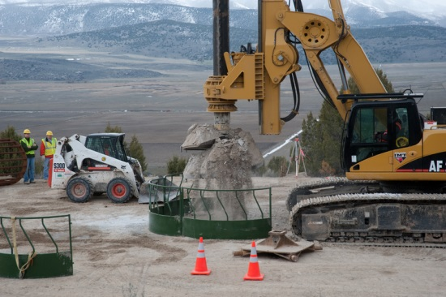
5-10-15 Method
Recognize
Every 5 minutes
Take 10 seconds
Look 15’ around you
Have a plan
Consider your next steps
Escape route
Evaluate
Control
Notes:
Explain the 5, 10, 15, process. Tell the attendees that they need to be purposeful in their thinking and plan their next steps. Explain the need to not only have a plan, but they need to have an escape route if something goes wrong.

Slide 20
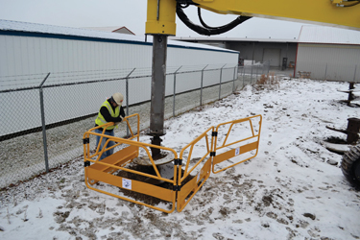
O.E.P.S.
Open Excavation Protection System
Protection from falling into open excavations such as pole and/or foundation holes
Notes:
Explain that workers must be protected from falling into an excavation or drilled hole. The illustration shows an open excavation protection system. This system is a guardrail system that will keep workers from falling into a drilled hole. However it is important to mention that there are times a worker may need to enter this workspace. There must be a system in place to keep the worker from falling into the hole and in the worst case, retrieve the worker should the edge of the excavation fail and the worker slips into the hole.

Slide 21
Key Points-Session Two
Falls from ground elevation can be caused by poor housekeeping.
True
False
Open excavations should be guarded to prevent fall hazards.
True
False
Uneven and or damaged surfaces may cause falls and result in an injury.
True
False
The meaning of the 5-10-15 rule is:
Every 5 steps, take a 10 to 15 minute smoke break
Every 5 days, take 10 minutes to do 15 push-ups
Every 5 minutes, take 10 seconds to look 15 feet around you
Every 5 minutes, take 10 seconds to snap 15 selfies and post them on Facebook.
Notes:
Falls from ground elevation can be caused by poor housekeeping.
True
False
Open excavations should be guarded to prevent fall hazards.
True
False
Uneven and or damaged surfaces may cause falls and result in an injury.
True
False
The meaning of the 5-10-15 rule is:
Every 5 steps, take a 10 to 15 minute smoke break
Every 5 days, take 10 minutes to do 15 push-ups
Every 5 minutes, take 10 seconds to look 15 feet around you
Every 5 minutes, take 10 seconds to snap 15 selfies and post them on Facebook.

Slide 22
Slips, Trips, and Falls From Vehicles
Session Three
Notes:
Explain that this section will discuss slip, trip, and fall hazard exposures to workers working above the ground and entering or exiting vehicles and/or equipment.

Slide 23
Equipment Related
Falls
13% Partnership recordable injuries
Almost 40%
Involve falls from vehicles and/or equipment
Fall injuries
32% result in some type of bone fracture
Notes:
Explain that falls account for almost 13% (12.58%) of the total number of ET&D Partnership recordable injuries. Almost 40% of those falls involve vehicles and/or equipment. Fall injuries result in some type of bone fracture 32% of the time making it one of the most severe injury classifications. Climbing in or out of a truck, bucket truck basket, or other type of equipment can be one of the most dangerous tasks we perform. Falls during mounting or dismounting such equipment are the most frequently reported source of injury involving line workers.

Slide 24
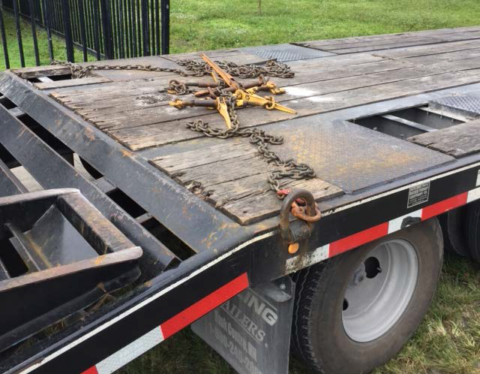
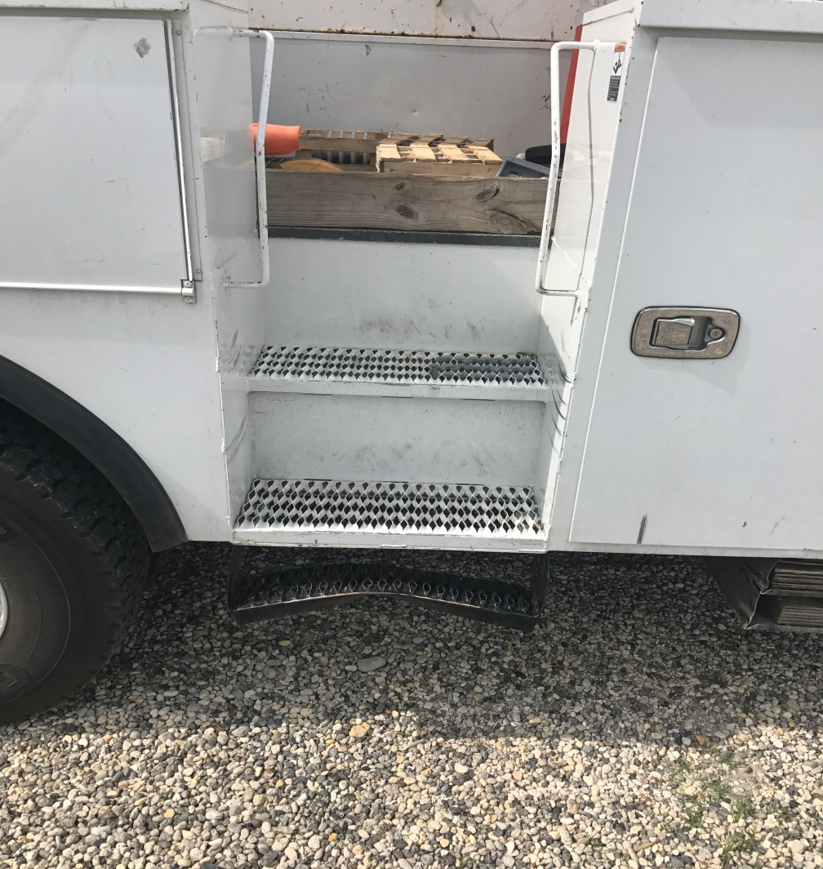
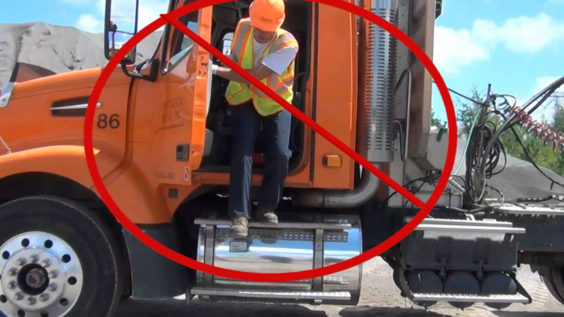
Common Causes
Exiting vehicle while facing forward
3-points of contact not used
Mud/debris on steps
Damage
Hazard?
Possible Solution(s)?
Notes:
Explain that there are some reoccurring themes involving slip, trip, and fall events. The three most common are failing to maintain three points of contact which is two hands and one foot or two feet and one hand on the vehicle or equipment during entry and exit. Explain that another common cause is exiting the vehicle or equipment while facing forward. Always look in both directions for oncoming traffic and other hazards when entering and exiting vehicles or equipment. Lastly look out for uneven, wet, slick, muddy, terrain. In our work those items will almost always be an issue. Always place footing firmly and deliberately before trusting your weight to the transition.

Slide 25
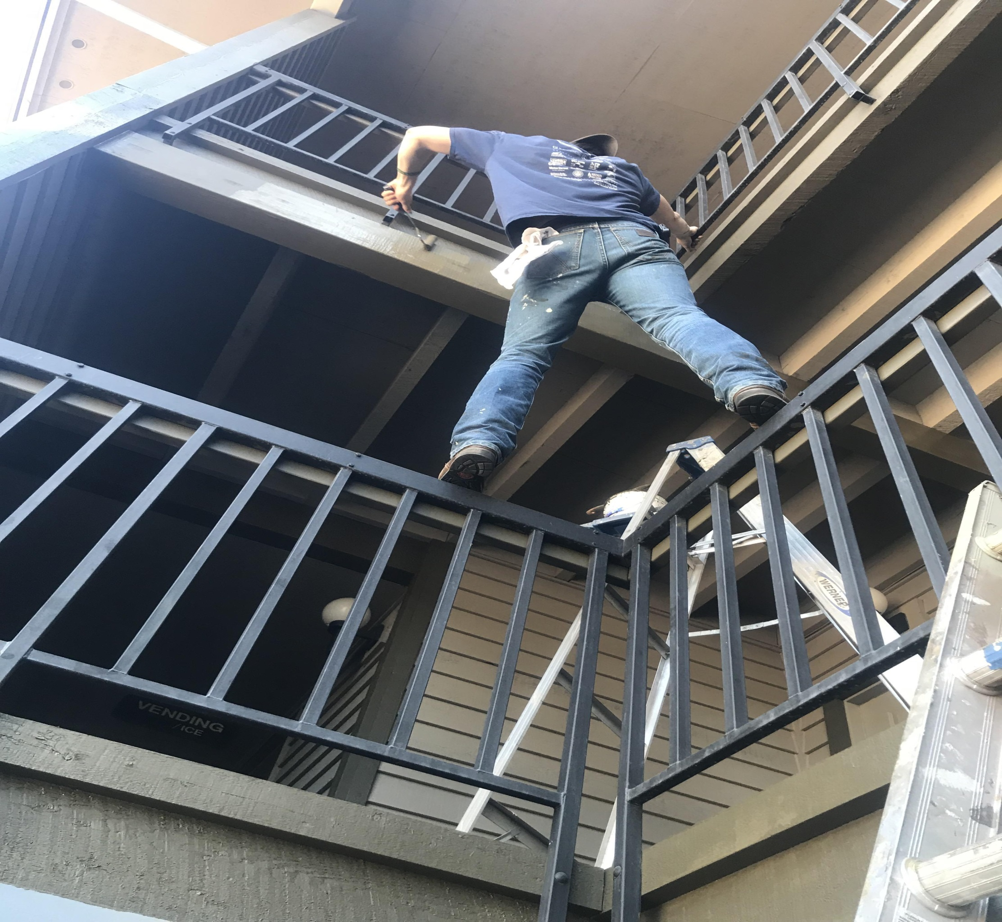
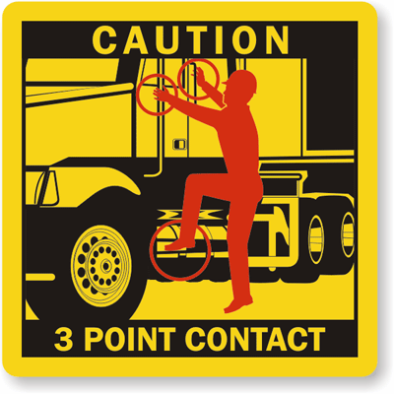
Safe Practices
Always
Use designated access points
Use grab rails
Face the equipment
Climb don’t jump
Keep eyes on path
Maintain the triangle
Not!
Notes:
If one is the loneliest number, three is the safest. We have all heard of the “three points of contact” rule to help prevent falls. But what is it, and how do you use it? Three points of contact means you’re using two hands and one foot, or one hand and two feet, to support your body while mounting or dismounting a vehicle, stable platform or ladder. The three points of contact should be broken only after your reach your destination. Keep these tips in mind when using the “three points of contact” rule:
Dry your hands and wipe excess mud or snow off your boots for surer grip.
Face the vehicle, platform or ladder when you enter or exit.
Use the handrails when mounting a platform.
Keep your hands free. If you need to bring tools or materials up with you, place them in a tool belt or use a hoist line for larger items. If you’re climbing down from a vehicle, put the tool or other item on the floor and then grab it from the ground.
Don’t use a tire as a ladder. Enter the vehicle way the manufacturer intended.
Don’t reach for the steering wheel to pull yourself up.
Don’t jump off the machine onto the ground.
Don’t try to enter a piece of equipment that’s moving.
Check for obstacles, debris or fluids on the ground before dismounting.
Don’t wear loose clothing or dangling jewelry that could catch on something.
Three points of contact sounds simple, and you probably already do it most of the time. But it’s that one time you don’t that can land you in trouble. Explain proper access and use of three points of contact and situational awareness. The last picture is a humorous but sad example of what three points of contact is not! The sad aspect is that a worker would intentionally place themselves in such a tenuous situation. Explain that this is an illustration of unnecessary “at-risk” behavior.

Slide 26
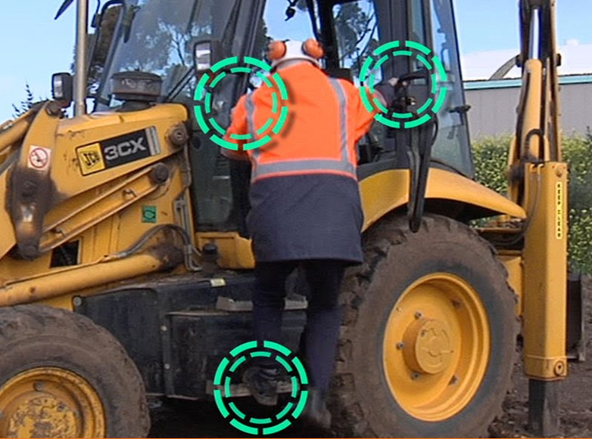
Equipment
Keep hands free
Housekeeping
Remove ice cleats before mounting
Repair damaged ladders, grab rails, and steps
Maintain the Triangle
Notes:
Explain the importance of maintaining good housekeeping and parking equipment for access / egress. Also explain that it is important to keep hands free for climbing into and off of equipment. Place any object in the cab from ground level if possible. Reverse the process when exiting.

Slide 27
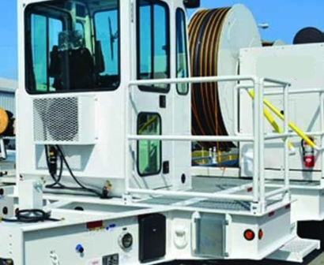
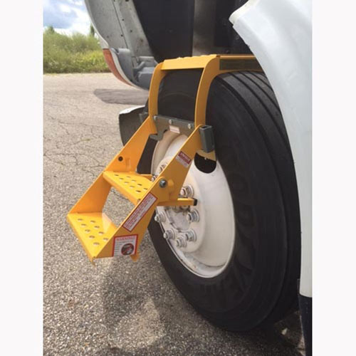
Additional Controls
Slip resistant steps
Additional grab rails
Extend grab rails
Temporary, removable access ladders
Fall Protection
Notes:
Explain that sometimes we have to implement engineering controls to help minimizer the hazards. The product shown in the next-to-last image is called “The Big Truck Tire Step”. The manufacturer states that it is the only tire step that allows you to safely step on the top of the tire. The Big Truck Tire Step provides safe maintenance on 18-wheelers, flat bed trailers, 1-1/2 ton, 2 ton, and most medium sized trucks. The Standard Two-Step tire step is approximately 18" from the ground to the first step when on a tire. Weighing around 13 pounds, the Two-Step tire step folds into a space just over a cubic foot. This product fits tire Sizes: 255, 265, 275, 285, 295 (Fits 10" to 11-1/2" tread width). It is tested to 400 pound capacity, has spring loaded grips for stability, and is made of 3003 aluminum and steel. This is not an endorsement of this product but simply an illustration of available options. The final image shows guard rails installed on a conductor stringing machine. These guard rails offer convenient grab points for access and egress and help prevent falls.

Slide 28
Slips, Trips, and Falls Behavior Risk Factors
Notes:
State that more often than not, we fail to address the human factors that lead to accidents, injuries, and fatalities. In a 2014 survey of safety professionals by Safety Daily Advisor, “Understanding How Human Factors Affect Slips, Trips, and Falls,” respondents identified human factors as the primary cause of more than half of all slip, trip and fall incidents. They usually were the result of errors in judgment, such as how fast to walk or how tidy to keep a work area. People tend to perceive these behaviors as much less risky than they actually are, which makes a solution challenging.

Slide 29
Behavior
May be Intentional or Unintentional
Physical condition
Fatigue
Stress
Illness
Medications
Rushing
Distraction
Complacency
Notes:
Explain how their behavior leads to additional risk. Be sure to emphasize that the listed behaviors are not to point the finger and be considered as intentional risk taking even though some are. Others may just be the way we normally behave. We continue to train workers to address the physical factors that lead to slip, trip and fall incidents, but we also need to focus on behavior. As in any other training, regular reinforcement is necessary, and supervisors and managers also need to model the behaviors they expect in their employees. Risky behaviors we specifically need to train workers to be aware of and that both we and they need to avoid include:
Rushing – Employees try to rush through tasks for many reasons. They may be overachievers, or they may feel overwhelmed and rush to catch up. Some see work as a competition where they need to stay ahead of their coworkers, while others simply want to manage their time as efficiently as possible. Whatever the reason for rushing, it often leads to poor decisions, such as walking faster than is safe across an icy walkway or failing to stop and don the ice grippers before stepping outside. Emphasize the importance of safe behavior over speed.
Distraction – Our work culture places a high value on multi-tasking, but we need to realize the danger we place ourselves and others in with our constant distractions. Those electronic devices we can’t seem to take our eye off of may be the death of us all if we don’t start watching where we’re going. Replaying this morning’s argument with your spouse over and over again in your head is equally distracting. Teach employees to recognize and avoid distractions.
Complacency – This is probably the biggest behavioral challenge. Webster’s Dictionary defines complacency as “self-satisfaction especially when accompanied by unawareness of actual dangers or deficiencies.” It’s easy to become complacent when you do the same tasks day after day without incident or injury. If no one has tripped over the electrical cord strung across the office floor, you eventually tell yourself that there is no real danger there. Sadly, it often takes a serious accident involving one’s self or a coworker to jolt us out of this complacency. A strong safety culture is the best defense against complacency.
Explain that rapid changes in direction create a similar problem.

Slide 30
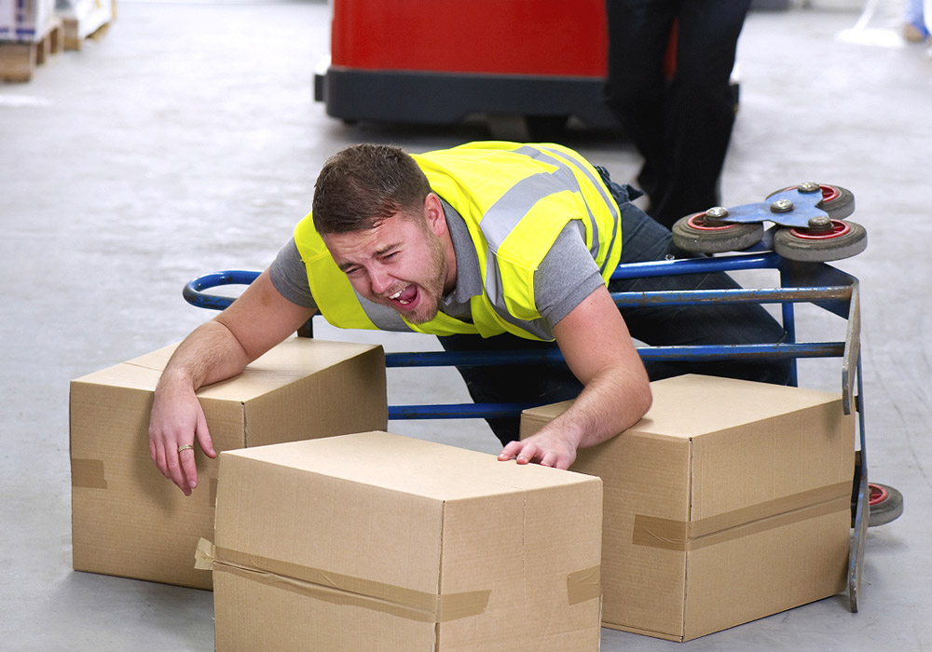
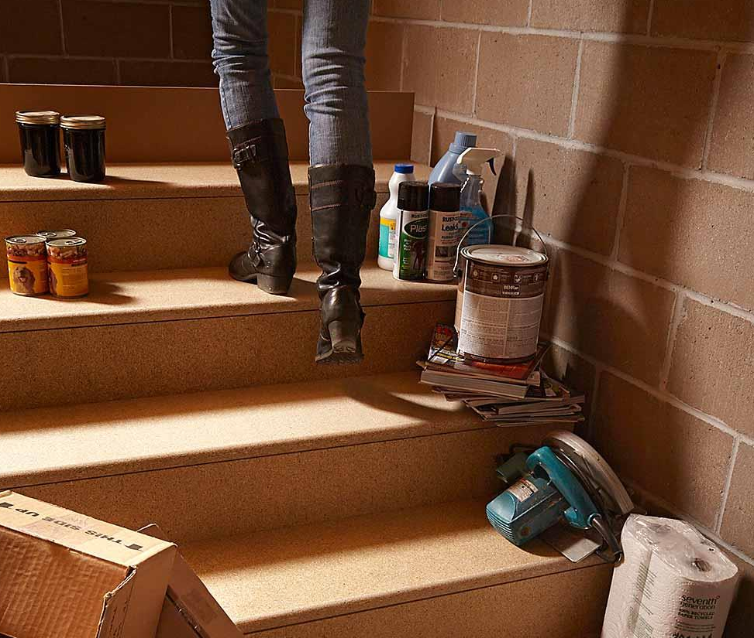
Risk Factors
Behavioral Factors
Carrying too much at one time
Inattention
Housekeeping
Notes:
Explain that we can mitigate much of the risk associated with walking / working surfaces by not being in a hurry, planning our routes, and not taking short cuts. State that carrying or moving cumbersome objects or simply too many objects at one time, not paying attention to surroundings, distraction, taking unapproved shortcuts, and/or being in a hurry and rushing are all examples of taking unnecessary risks.

Slide 31
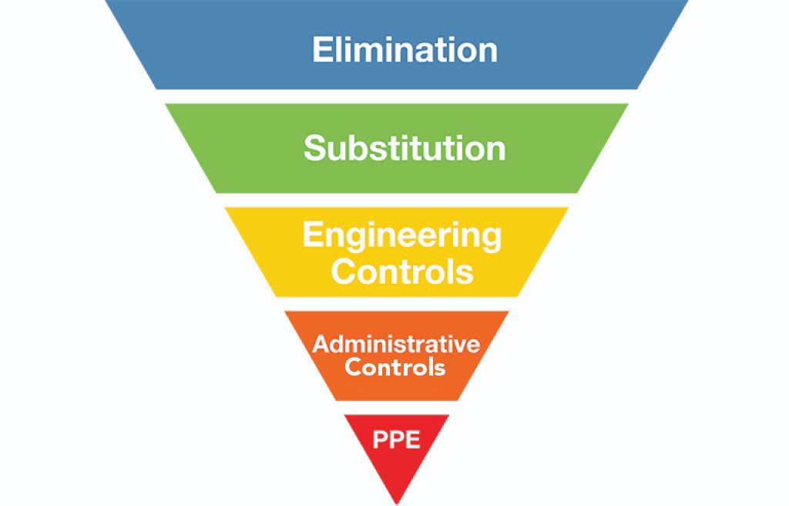
Eliminate the Hazard
Once identified
Take steps to eliminate the Hazard(s)
Elimination of the Hazard should always be the First Consideration
Notes:
5
5
5
5
5
Explain that there are many slip, trip, and fall hazards out there that are easy to identify. The longer we work around a hazard (or in this case the more we place ourselves in the Line-of-Fire) and suffer no negative consequences the less we respect a hazard’s ability to harm us. The best way to avoid line of fire incidents is to eliminate the hazards that cause these incidents whenever possible. By totally eliminating the hazards there is no chance that you or anyone else in the work area can be injured by that hazard.

Slide 32
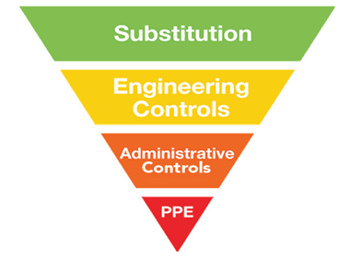
Control
If the hazards cannot be eliminated
Risk
Identify
Evaluate
Control
Effectiveness
Notes:
5
5
5
5
5
State that if it is not possible to remove the hazards, we must mitigate them. Explain the hierarchy of controls. State that elimination is the most effective. For example, use proper personal protective equipment to avoid exposure. Explain that PPE is the last line of defense. Do not rely just on your PPE to avoid injury. Think about the slip, trip, and fall hazards and how to mitigate them. State that some great topics to be identified and discussed during the pre-task meeting are:
Poor lighting
Glare
Shadows
Bulky PPE (includes improper foot-wear)
Excess noise or temperature
Fog or misty conditions
Inadequate or missing signage
Where is my body located in relation to the hazard? What is the worst-case scenario of my task? How can I protect myself from the hazard? When elimination is not possible, engineering controls are the next best choice in protecting yourself from line of fire incidents. Some engineering controls that could protect you from line of fire incidents include physical barriers, guarding around moving parts, and toe boards on elevated work platforms to prevent objects from falling to the area below. There are many other possible engineering controls that could be used depending on the specific hazard. Total elimination of hazards is not always possible and engineering controls may not be feasible or they can fail.

Slide 33
Key Points-Session Three
The most common slip, trip, fall event occurs to workers at ground level.
True
False
Poor or inadequate housekeeping is a leading cause of slip, trip, and fall events.
True
False
Rushing and/or distraction are also leading causes of slip, trip, and fall events.
True
False
Maintaining three-points of contact means:
Text at least 3 of the contacts on your cellphone before performing any task
Hold-on to every object with a minimum of 3 fingers
2 hands and 1 foot or 2 feet and 1 hand in contact when entering/exiting a vehicle
Notes:
The most common slip, trip, fall event occurs to workers at ground level.
True
False
Poor or inadequate housekeeping is a leading cause of slip, trip, and fall events.
True
False
Rushing and/or distraction are also leading causes of slip, trip, and fall events.
True
False
Maintaining three-points of contact means:
Text at least 3 of the contacts on your cellphone before performing any task
Hold-on to every object with a minimum of 3 fingers
2 hands and 1 foot or 2 feet and 1 hand in contact when entering/exiting a vehicle

Slide 34
Review
Notes:
Ask for questions. Once complete thank the attendees and close the session.

