Slide 1
Equipment Spotter Safety Continuing Education Fourth Quarter 2019
Notes:
Introduce the module. Explain that the intent of this presentation is as a continuing education training topic related to certain aspects from the ET&D 10-Hour OSHA training class, the OSHA Partnership Best Practices, and/or incident trending analysis

Slide 2
Objectives
Upon completion of this continuing education module you should be able to:
Define Spotter
Understand “WHY” spotters are necessary
See examples of equipment danger zones
Discuss the Spotters Responsibilities
Provide examples of common spotter hand signals
Notes:
5
5
5
5
5
Explain that this is 4th Q. 2019 ET&D Continuous Education Topic. Read and explain the Objectives for course. Announce that we will begin by defining what a Spotter is.

Slide 3
Why Use a Spotter
Session One
Notes:
Discuss that in this next section we will discuss the “Why” a spotter should be utilized by reviewing some recent injury/fatality statistics from the construction industry as well as from the 2017 ET&D Partnership Statistics.

Slide 4
Common Event
Road worker killed when he was run over by backing equipment
Laborer killed when he fell off of and was run over by a backhoe he was ridding on
Truck driver crushed between loading dock and trailer
Worker injured when struck by backing vehicle
Notes:
Explain that this is a brief list of news headlines from the Occupational Safety & Health Administration website regarding employee’s being fatality injured when not following safe work practices in and around moving equipment.
Trainers Tip – Engage the group by asking if anyone has any first hand knowledge of any near-misses or events regarding vehicles/equipment?

Slide 5
Fatality Statistics
Type of Vehicle causing the most Back-over fatalities (2005 through 2010)
Dump truck 67
Semi truck 40
Straight truck 30
Forklift 21
Garbage truck 20
Pick-up truck 16

Slide 6
Fatality Statistics by Age
Source: Bureau of Labor Statistics
Notes:
Fatality statistics by age from the Bureau of Labor Statistics

Slide 7
2017 ET&D Injury Stats
Struck-By 21.43%
Caught Between 10.71%
Struck-By/Caught Between Accidents combined
2nd leading cause of injuries in 2017
Notes:
2017 ET&D Injury Stats regarding the leading cause of injuries within the companies represented by the Partnership. It is important to note that vehicle/equipment related injuries are classified as Struck By or Caught Between. When these two categories are combined it ranks as the 2nd leading cause of injuries.
Trainers Tip –The most common contributing factor related to Struck By / Caught Between events is failure to utilize a spotter. Many of these events could have been eliminated by properly utilizing a spotter.

Slide 8
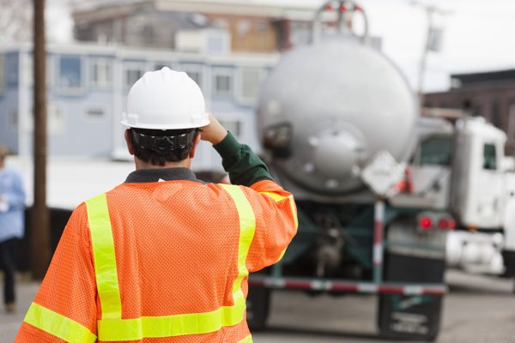
Definition
Spotter
Someone trained to recognize hazards the operator may not see otherwise
Notes:
The definition of a spotter is someone who is trained to recognize hazards the driver/operator may not otherwise see while operating or moving equipment.

Slide 9
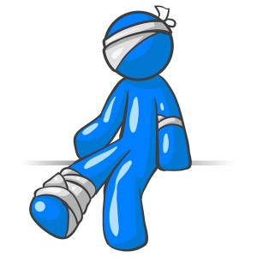
Backing Accidents
Common Causes
Blind spots
Worksite noises
Backup alarm not functioning
Unaware of other vehicles
Not looking in direction of travel
Riding on vehicles
Notes:
Explain that these are common causes of backing accidents. Discuss that each and every piece of equipment has different blind spots and danger zones. Workers should not rely solely on backup alarms to alarm workers because of worksite noises or the backup alarms not functioning properly. Some jobsites can become very congested and conditions are always changing which can lead to drivers/operators becoming unaware of other vehicles entering or exiting the work location. Driver/operators should never allow themselves to become distracted and should always be looking in the direction of travel. Unauthorized riding on vehicles/equipment should never be allowed on any project or jobsite.

Slide 10
When to use a Spotter
Backing a vehicle or machinery
Moving a vehicle or machinery in a congested area
Poor visibility
Close proximity
Pedestrians/coworkers or other workers
Lateral, overhead, or other obstructions
Notes:
Discuss that some project owners may require different rules as to when a spotter is needed or necessary for moving vehicles/equipment. The following list is not all inclusive but rather a general list of when a spotter should be utilized.
Backing a vehicle or machinery
Moving in a congested area
Poor visibility
When in close proximity to other operations
When surrounded by foot traffic
Any time lateral, overhead, or other obstruction pose a threat

Slide 11
Key Points-Session One
A spotter is someone trained to recognize hazards the driver/operator may not see?
True
False
The spotter should also consider lateral and overhead hazards when spotting?
True
False
Blind Spots are a leading contributor to backing accidents?
True
False
In 2017 Struck By/Caught Between Accidents were the 2nd leading cause of injuries within the ET&D Partnership?
True
False
Notes:
5
5
5
5
5
The presenter should have touched on the following items when Explaining session one:
Hazards caused by distractions (and other issues) make it necessary to put in place the proper measures to control the risks encountered in work zones.
a. True
b. False
Every week ______ work zone crashes occurred that resulted in at least one fatality.
a. 5
b. 12
c. 50
The public highway system can be one of the most dangerous work environments in the United States.
a. True
b. False

Slide 12
Blind Spots & Danger Zones
Session Two
Notes:
Discuss that in this section we will review some common industry equipment and show the Blind Spots/Danger Zones.

Slide 13
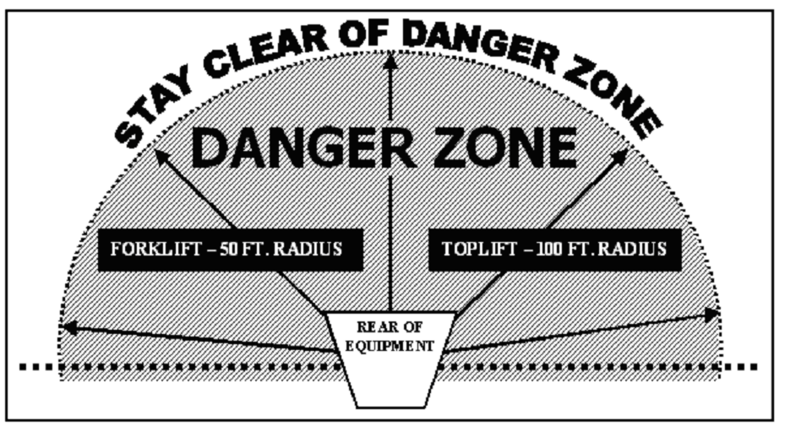
Equipment Danger Zones
Blind Spots
Rotating machinery
Swing radius
Travel path
Approaching machinery before acknowledging the operator
Non-essential workers in the area
Notes:
Remined the group that each and every piece of equipment has different blind spots and danger zones. Some pieces of equipment have additional danger zones, such as equipment with rotating parts or articulating sections. Due to this, its important to identify the required travel path needed to move/operate the equipment. Its always important to never approach machinery without before acknowledging the operator and always keep non-essential workers clear of the construction area.
Trainers Tip – Discuss with the group that these danger zones should be identified during the pre-job briefing process and discussed with any job site visitors upon their arrival. It is also a Best Practice to conduct a job review to determine the safest approach for equipment set up.

Slide 14
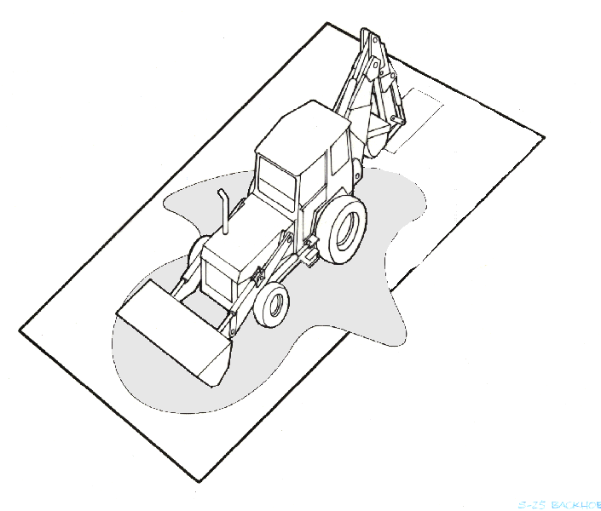
Blind Spots
The following slides illustrate blind spots for various types of common equipment
The shaded areas show potential blind spots for the operator
The red dot indicates the operator’s position
Notes:
Remined the group that each and every piece of equipment has different blind spots and danger zones. Some pieces of equipment have additional danger zones, such as equipment with rotating parts or articulating sections. Due to this, its important to identify the required travel path needed to move/operate the equipment. Its always important to never approach machinery without before acknowledging the operator and always keep non-essential workers clear of the construction area.
Trainers Tip – Discuss with the group that these danger zones should be identified during the pre-job briefing process and discussed with any job site visitors upon their arrival. It is also a Best Practice to conduct a job review to determine the safest approach for equipment set up.

Slide 15
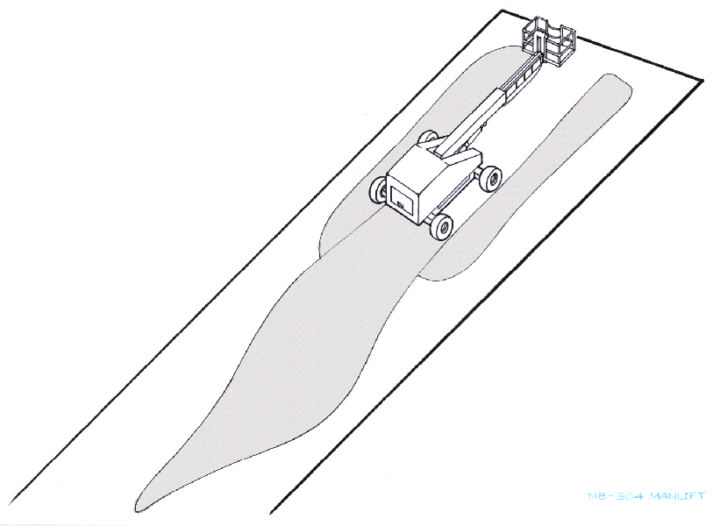
Eye level 10’ above
ground level
34’ 0”
36’ 4”
68’ 0”
95’ 0”
Notes:
Common Man Lift/Genie Lift – With the operators eye level at 10 feet above ground level the danger zone extends 95 feet in from the machine.

Slide 16
Eye level 7’ above
ground level
8’ 4”
29’ 1”
7’ 7”
18’ 5”
Notes:
Common Backhoe – Discuss that with the operator seated, the operator’s eye level is 7’ feet above ground level. The danger zones are in the shaded areas.

Slide 17
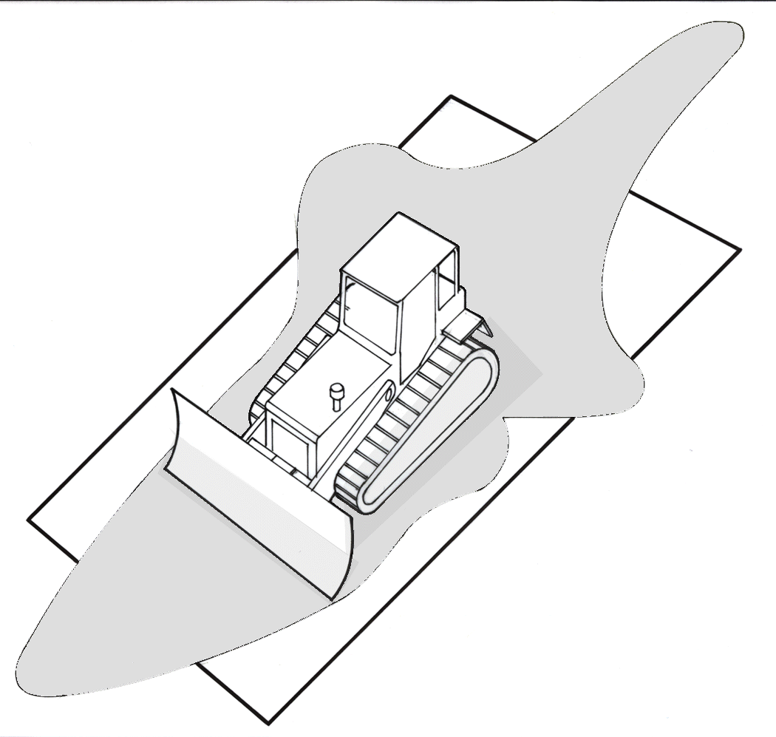
16’ 0”
8’ 2”
8’ 2”
12’ 5”
3’ 10”
12’ 1”
Eye level 6’ 3” above
ground level
18’ 7”
Notes:
Common Bulldozer – With the operators eye level 6 feet above ground level the danger zone extends 18 feet to the front of the machine and 16 feet to the rear of the machine.

Slide 18
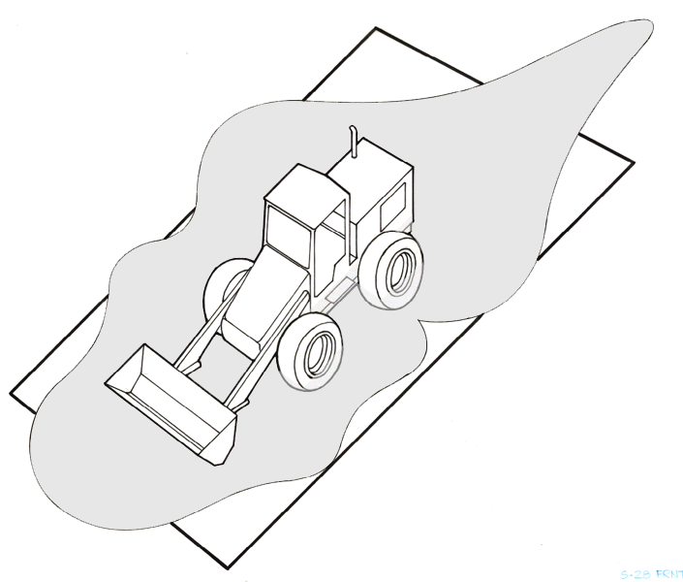
28’11”
14’ 8”
16’ 2”
14’ 3”
14’ 10”
21’ 11”
Eye level 10’ above
ground level
Notes:
Common Front End Loader – With the operators eye level 10 feet above ground level the danger zone extends 21 feet to the front and 28 feet to the rear of the machine.

Slide 19
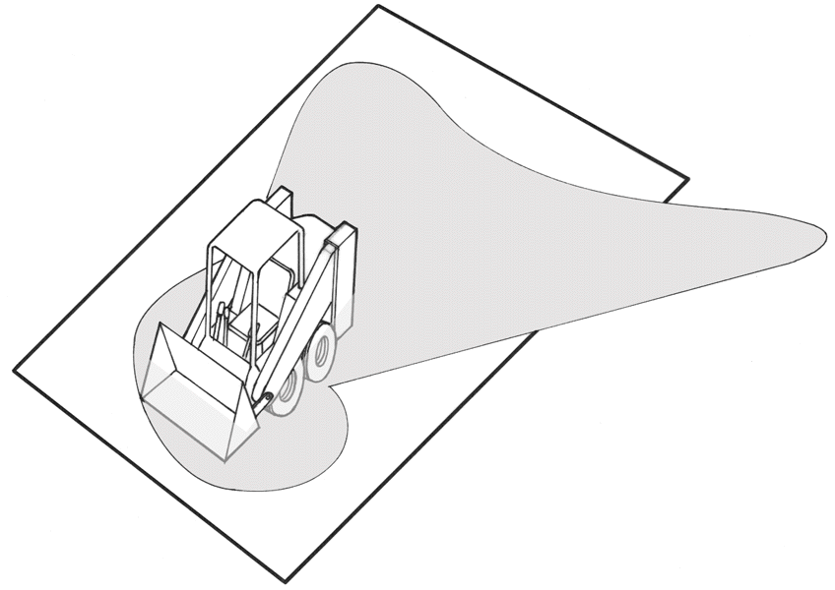
11’ 7”
11’ 5”
4’ 10”
21’ 8”
6’ 1”
3’ 1”
Eye level 5’ above
ground level
6’ 3”
Notes:
Common Skid Steer – With the operators eye level 5 feet above ground level the danger zone extends 21 feet to the rear of the machine.

Slide 20
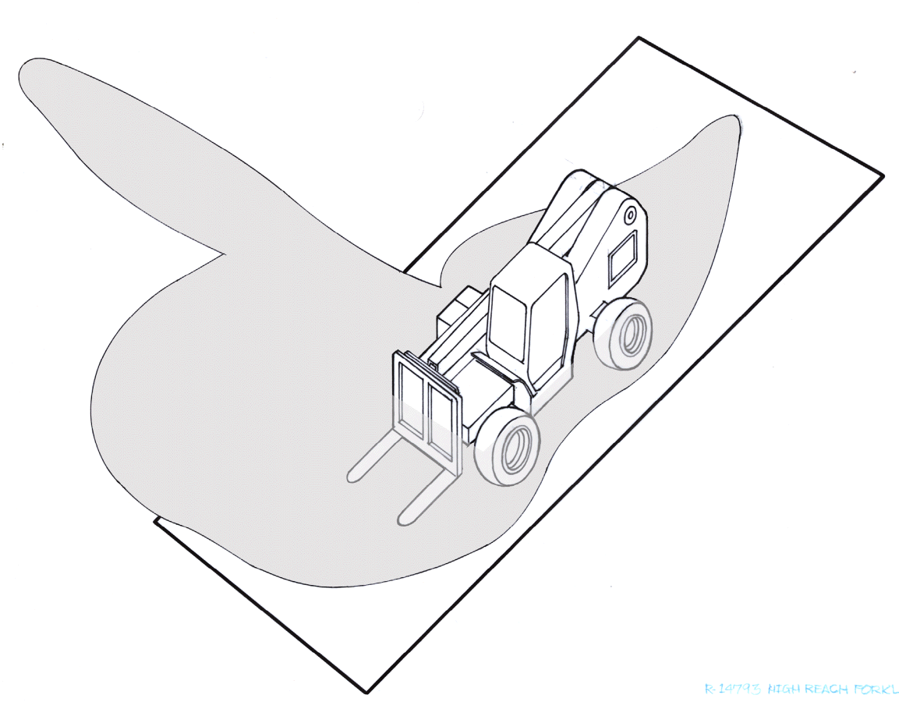
85’ 0”
18’ 2”
10’ 9”
7’ 9”
39’ 0”
3’ 0”
21’ 2”
Eye level 7’ above
ground level
14’ 10”
Notes:
Common All-Terrain Fork Lift – With the operators eye level 7 feet above ground level the danger zone extends 85 feet to the passenger side of the machine.

Slide 21
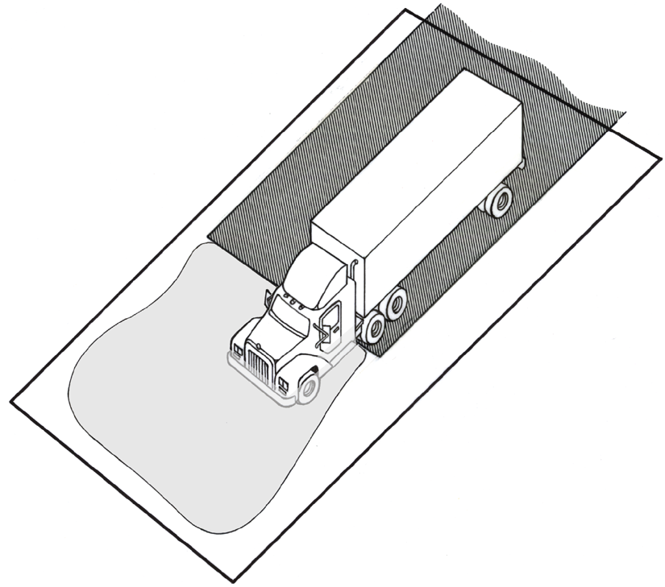
27’ 1”
42’ 8”
6’ 5”
40’ 6”
36’ 8”
Eye level 6’ above
ground level
Notes:
Common Semi-Truck and Trailer – With the operators eye level 6 feet above ground level the danger zone extends 40 feet to the front of the vehicle. Its important to note that the driver cannot see to the rear of the vehicle.

Slide 22
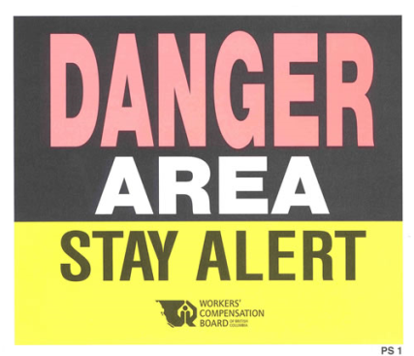
Working Near Moving Vehicles
Stay alert at all times
Avoid distractions
Keep a safe distance
Keep off equipment unless authorized
Watch out for shifting or unstable loads
Wear reflective clothing
Notes:
Discuss with the group that it is important to always be “mindful” when working near moving vehicles/equipment. Don’t allow yourself to become distracted. Always maintain a safe distance, and never approach or operate equipment unless authorized to do so. By wearing reflective clothing you make yourself more visible to operators.

Slide 23
Key Points-Session Two
You should never approach machinery without first acknowledging the operator.
True
False
Non essential employees should be kept clear from worksites.
True
False
You should always wear high visability clothing when working near moving machinery.
True
False
Notes:
5
5
5
5
5
The presenter should have touched on the following items when Explaining session one:
Hazards caused by distractions (and other issues) make it necessary to put in place the proper measures to control the risks encountered in work zones.
a. True
b. False
Every week ______ work zone crashes occurred that resulted in at least one fatality.
a. 5
b. 12
c. 50
The public highway system can be one of the most dangerous work environments in the United States.
a. True
b. False

Slide 24
Spotter Responsibilities
Session Three
Notes:
Discuss in this section we will review the Responsibilities of the Spotter. This person has to watch out for others as well as for him/herself (keeping enough distance in between spotter and equipment moving), and make sure the vehicle doesn't damage property. It may appear as an easy task. But there are a lot of dangers involved.

Slide 25
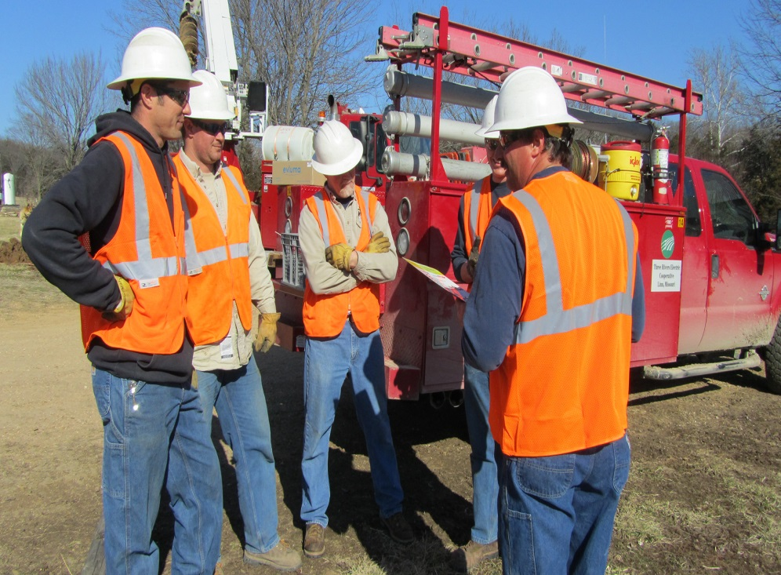
Responsibilities
Spotters, Drivers, Operators must work together
Points of discussion:
Positioning
Backing
Movement
The plan
Notes:
Discuss that in order to execute a successful “spot”, the driver/operator and the spotter must work together. A discussion of the planned movement shall take place between the spotter and the driver/operator prior to executing. Most importantly, if the plan is not followed or the driver/operator looses sight of the spotter the driver/operator shall immediately stop.
Trainers Tip – Effective 3-Way Communication is a great tool to utilize when discussing the plan, this tool will help to eliminate assumptions.

Slide 26
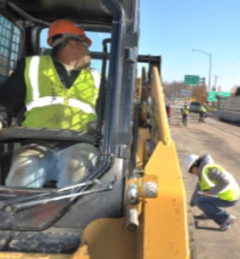
Responsibilities
The operator shall stop the vehicle
Prior to losing sight of the spotter
Upon losing sight of the spotter
Notes:
Discuss that in order to execute a successful “spot”, the driver/operator and the spotter must work together. A discussion of the planned movement shall take place between the spotter and the driver/operator prior to executing. Most importantly, if the plan is not followed or the driver/operator looses sight of the spotter the driver/operator shall immediately stop.
Trainers Tip – Effective 3-Way Communication is a great tool to utilize when discussing the plan, this tool will help to eliminate assumptions.

Slide 27
Responsibilities
In order to give you an unobstructed view stand at the driver's side
Only one person signals
The driver must understand the signals
Discuss with the driver before any movement
Explain the signals that will be used
Allow for stopping distance and clearance
Notes:
Discuss that the spotter should stand in a location that is unobstructed from the drivers/operators view, preferably along the driver’s side of most equipment. Always before proceeding discuss with the driver/operator the plan of action. Most larger vehicles need more distance for stopping so it’s a good practice to warn the driver/operator that they are nearing a stopping point.

Slide 28
Standard Rules
Use the same signals for the same moves
Hand signals are better than vocal signals
If the driver is unclear about the signals stop the vehicle immediately
Drivers/operators should never assume what the spotter is signaling
Notes:
Discuss that its important to use the same signals for the same moves to avoid misunderstanding. Hand signals are generally much better than vocal signals. Because of noise, a shouted signal may not be heard or may be misunderstood. Reiterate, that if the driver is unclear at any point about the spotter’s signals, the vehicle should be stopped immediately. Never assume what the spotter is signaling, if there is any doubt STOP.
Trainers Tip – If mobile communications are to be utilized (i.e. two way radios) it is important to perform frequent “radio checks” to ensure the mobile communications are properly working.

Slide 29
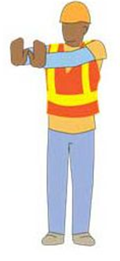
Responsibilities
When spotting, concentrate on spotting
Maintain eye-contact with the driver/operator
If anyone gives the stop signal, the driver/operator STOPS the equipment
Notes:
Review with the group that when spotting, concentrate on spotting and do not allow yourself to become distracted. At any time, anyone can issue a STOP signal. If there is any doubt as to the meaning of the signal then Stop!

Slide 30
Common Hand Signals
Notes:
Discuss that in the next few slides we will show the common hand signals used when engaged in spotting vehicles/equipment. This is not an all inclusive list, however, its important that the driver/operator and the spotter are in agreement of the hand signals prior to moving vehicles/equipment.

Slide 31
What is the Signal?
Stop all movement
Await further instruction
Notes:
Stop – The most important hand signal.

Slide 32
What is the Signal?
To move the vehicle in a straight line
Forward
Backward
Notes:
Stop – The most important hand signal.

Slide 33
What is the Signal?
To move the vehicle either to the right or left while vehicle is moving
Notes:
Stop – The most important hand signal.

Slide 34
What is the Signal
To provide the driver a visual reference for the distance to stopping point
Notes:
Because some equipment needs more time to stop it’s a good practice to warn the driver/operator of the distance before stopping.

Slide 35
What is the Signal?
To move the vehicle forward
Notes:
Because some equipment needs more time to stop it’s a good practice to warn the driver/operator of the distance before stopping.

Slide 36
Key Points-Session Three
Drivers, operators, and spotters must work together to maintain a safe work site.
True
False
If the driver or operator is unsure of the signal given by the spotter they should stop operations immediately.
True
False
If the driver, operator loses site of the spotter they should re-position the equipment until they re-establish site of the spotter.
True
False
Notes:
5
5
5
5
5
The presenter should have touched on the following items when Explaining session one:
Hazards caused by distractions (and other issues) make it necessary to put in place the proper measures to control the risks encountered in work zones.
a. True
b. False
Every week ______ work zone crashes occurred that resulted in at least one fatality.
a. 5
b. 12
c. 50
The public highway system can be one of the most dangerous work environments in the United States.
a. True
b. False

Slide 37
Notes:
5
5
5
5
5
Take this time to answer any remaining questions. Thank the attendees for their time. Document as required by company policy.

