Slide 1
Trenching & Excavations Continuing Education Third Quarter 2017 Session 2

Slide 2
Types of Protection
Notes:
Introduce the module

Slide 3
Design of Protective Systems
An employer must select and construct :
Slopes and configurations of sloping and benching systems
Support systems, shield systems, and other protective systems
Shield
Can be permanent or portable
Also known as trench box or trench shield
Notes:
There are several types of protective systems that can be selected. Space, cost and ease of use can determine which system is used.
Benching -- excavating the sides of an excavation to form one or a series of horizontal levels or steps, usually with vertical or near-vertical surfaces between levels. This requires no additional equipment, but requires a wider top trench opening taking up more room than a trench with vertical sides.
Shoring or shielding is used when the location or depth of the cut makes sloping back to the maximum allowable slope impractical. There are two basic types of shoring, timber and aluminum hydraulic.
Trench boxes (shielding) are different from shoring because instead of supporting the trench face, they are mostly serve to protect workers from cave-ins. The excavated area between the outside of the trench box and the face of the trench should be as small as possible. The space between the trench box and the excavation side may be backfilled (or other means may be used) to prevent lateral movement of the box. Shields may not be subjected to loads exceeding those which the system was designed to withstand. Trench boxes may be used in combination with sloping and benching.

Slide 4
Design of Protective Systems
Soil classification
Depth of cut
Water content of soil
Changes due to weather and climate
Other operations in the vicinity
Crossing utilities, etc.
Notes:
The employer or his designee must select and construct designs of support systems, shield systems, and other protective systems.
Trenches more than 5 feet require shoring or must have a stabilized slope.
Trenches less than 5 feet - a competent person must inspect to determine that a protection system is not necessary in soils where there is no indication of a potential cave-in. In hazardous soil conditions trenches less than 5 feet need protection.

Slide 5
Requirements
A well-designed protective system
Correct design of sloping and benching systems
Correct design of support systems, shield systems, and other protective systems
Plus
Appropriate handling of materials and equipment
Plus
Attention to correct installation and removal
Equals Protection of employees at excavations
Notes:
Several factors come into play when developing a total “protective system”.
The design of the system itself, how materials and equipment are handled in and around the excavation, and installation and removal of protective system components.

Slide 6
Spoils
Don’t place spoils within 2 feet from edge of excavation
Measure from nearest part of the spoil to the excavation edge
Place spoils so rainwater runs away from the excavation
Notes:
Employees must be protected from materials or equipment that could fall or roll into excavations.
Spoil piles must be placed at least 2 feet from the edge of an excavation or the pile will be considered as part of the excavation. Spoils should be placed as to keep rainwater away from the trench.
You may also use retaining devices that are sufficient to prevent materials or equipment from falling or rolling into excavations.

Slide 7
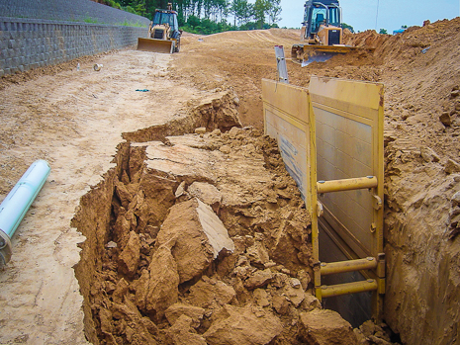
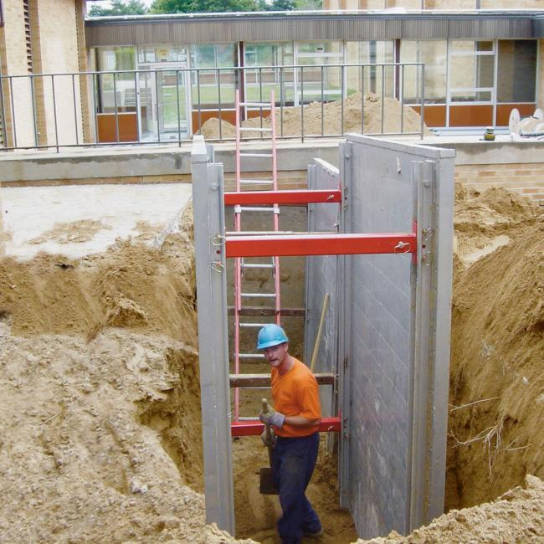
Trench Shield
A trench shield is utilized in this work location
Provide employee protection from cave in hazards
Notes:
Discuss that the top of the trench box must extend at least 18 inches above the top of the excavation when adjacent to sloping.
This allows the top of the shield to act as a type of “toe board” to keep objects from rolling into the excavation and possibly striking employees working in the trench.
Also discuss the excavation cannot extend more than two feet below the bottom of the trench box unless the competent person determines that there is not hazard to employees working in the trench.
The ends must be protected as well, and this must be planned for since a standard shield does not come with end protection.
Trench boxes or shields are engineered to predetermined stresses.
They come with data from the manufacturer about the stresses they can withstand safely.
Some can be stacked.
They can be drug along a trench for continuous operations.
These units can be large thus making them difficult to transport.
Normally these are used on long term jobs instead of short duration jobs.

Slide 8
Adequate Protective System
Must not only protect the sides of the trench but the end of the trench as well
Notes:
Where employees are working at the end of the trench box they are exposed to cave-in hazards from the leading end of the trench.
End shield are one method of employee protection for this hazard.

Slide 9
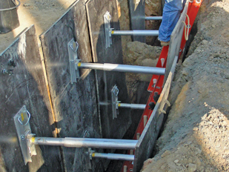
Hydraulic Trench Support
Hydraulic shores exert pressure against the trench bank
Notes:
Hydraulic Shoring. The trend today is toward the use of hydraulic shoring, a prefabricated strut and/or wale system manufactured of aluminum or steel. Hydraulic shoring provides a critical safety advantage over timber shoring because workers do not have to enter the trench to install or remove hydraulic shoring. Other advantages of most hydraulic systems are that they:
Are light enough to be installed by one worker;
Are gauge-regulated to ensure even distribution of pressure along the trench line;
Can have their trench faces "preloaded" to use the soil's natural cohesion to prevent movement; and
Can be adapted easily to various trench depths and widths.
All shoring should be installed from the top down and removed from the bottom up. Hydraulic shoring should be checked at least once per shift for leaking hoses and/or cylinders, broken connections, cracked nipples, bent bases, and any other damaged or defective parts.
Trench walls must be relatively vertical to prevent hydraulic shoring from migrating from the narrow portion of the trench up to the wider portion, thus removing the pressure being exerted on the trench wall.

Slide 10
Cave-in Hazard
Example of an inadequate shoring system
This excavation has inadequate support posts and egress access
Notes:
These hydraulic shores are not installed level.
Designs for aluminum hydraulic shoring shall be in accordance with the manufacturer’s specifications, but if manufacturer's tabulated data cannot be utilized, designs shall be in accordance with tables found in the OSHA standards.
Employees exposed to potential cave-ins must be protected by sloping or benching the sides of the excavation, by supporting the sides of the excavation, or by placing a shield between the side of the excavation and the work area.

Slide 11
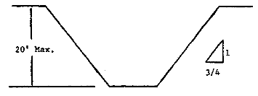
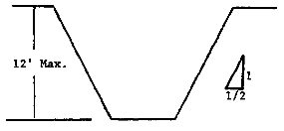
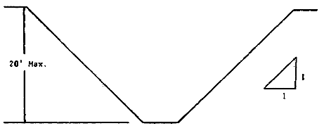
Simple Slope by Soil Types
A
A
<24 Hours
B
C
Notes:
[Illustrated example.]
Explain that these are examples of employee protection.
Note: A SIMPLE SLOPE - GENERAL
Exception: Simple slope excavations which are open in type A soil and are going to open 24 hours or less (short term) and which are 12 feet or less in depth may have a maximum allowable slope of 1/2:1.
The competent person must evaluate the soil type to determine the slope angle.

Slide 12
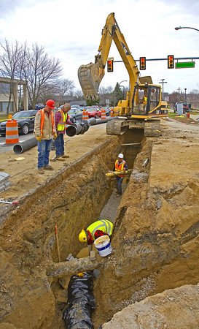
At Risk?
Workers in a trench with no protective system
Slope
Bench
Shore
Shield
No means of egress
Suspended loads
Equipment
Fall Hazard
Notes:
Discussion
How many violations to the excavation standard can you find?
No protective system
No means of egress
Spoils are not 2 feet or more from the edge of the excavation

Slide 13
Materials and Equipment
Inspected by a competent person
Free of damage or defects that impair function
Must be compatible when used as a system or stacked
Notes:
Materials and equipment used for protective systems shall be free from damage or defects that might impair their proper function.
This equipment shall be used and maintained in a manner that is consistent with the recommendations of the manufacturer, and in a manner that will prevent employee exposure to hazards.
When material or equipment is damaged, a competent person shall examine it and evaluate its suitability for continued use.
If the competent person cannot assure the material or equipment is able to support the intended loads or is otherwise suitable for safe use, then such material or equipment shall be removed from service, and shall be evaluated and approved by a registered professional engineer before being returned to service.
Must assure all parts are compatible when used as a system such as stacking.

