Slide 1
Hazardous Energy Release Session Three
Notes:
Explain that the following section will Explain “Energy Release Hazards”

Slide 2
Two Basic Types
Energy in motion is Kinetic Energy
Radiant
Thermal
Electrical (Light)
Mechanical
Energy that is stored is Potential Energy
Coiled spring
Raised weight
Water behind a dam
Snow pack
Stretched rubber band
Notes:
Explain that Objects can have stored, or potential, energy when work has been done (such as raising an object in the air) or by virtue of their position (such as sitting at the top of a hill). Potential energy changes to kinetic energy when the object moves. Kinetic energy is a form of energy that results from an object's motion. An example of kinetic energy is an airplane in flight. The airplane has a large amount of kinetic energy due to its large mass and fast velocity. When an object moves, it possesses kinetic energy. There are five types of kinetic energy - radiant, thermal, sound, electrical (light) and mechanical (motion). Potential energy is the energy an object has because of its position, rather than its motion. An object held in a person's hand has potential energy, which turns to kinetic energy, the energy of motion, when the person lets it go, and it drops. In every scenario, usually both forms of energy are present.

Slide 3
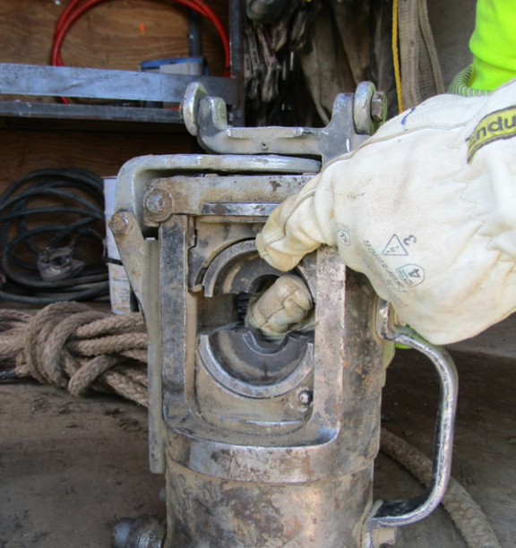
Hydraulic
Force created by liquid under pressure
Liquids cannot be compressed
They transmit force to surrounding areas
Notes:
State that hydraulic pressure is the force that liquid is acting on some area. This pressure results due to an existing property in liquid, which is called compressibility. Liquids are incompressible, so they transmit force across their molecules to the surrounding or contacting area. We must be aware of paths where energy passes from one location to another. This energy may be in the form of something under tension, hydraulic, pneumatic, pressure, flying parts, or whipping air lines

Slide 4
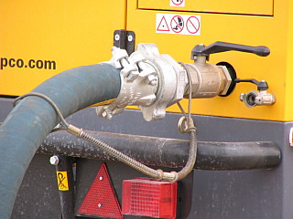
Pneumatic
Air hose may uncouple or a fitting may fail
Rapid expansion of air causes the hose to whip violently
Can cause a hazardous situation
Whip Check
Notes:
Explain that when a pressurized air hose becomes accidentally uncoupled or a hose or fitting failure occurs, the rapid expansion of air causes the hose to whip violently creating a potentially lethal situation. Use whip checks to help prevent injuries or accidents resulting from hose or coupling failure. A whip check extends across the hose fittings to give standby safety for hose. Simply pull back the spring and slip the loops on the whipcheck over each hose before connection to provide State that whip checks on air line hoses are easy to use, low cost, safety cables to help prevent injury if a hose connection separates. They can attach hose to hose or hose to equipment. They are highly resistant to rust and corrosion and do not require any tools to install.

Slide 5
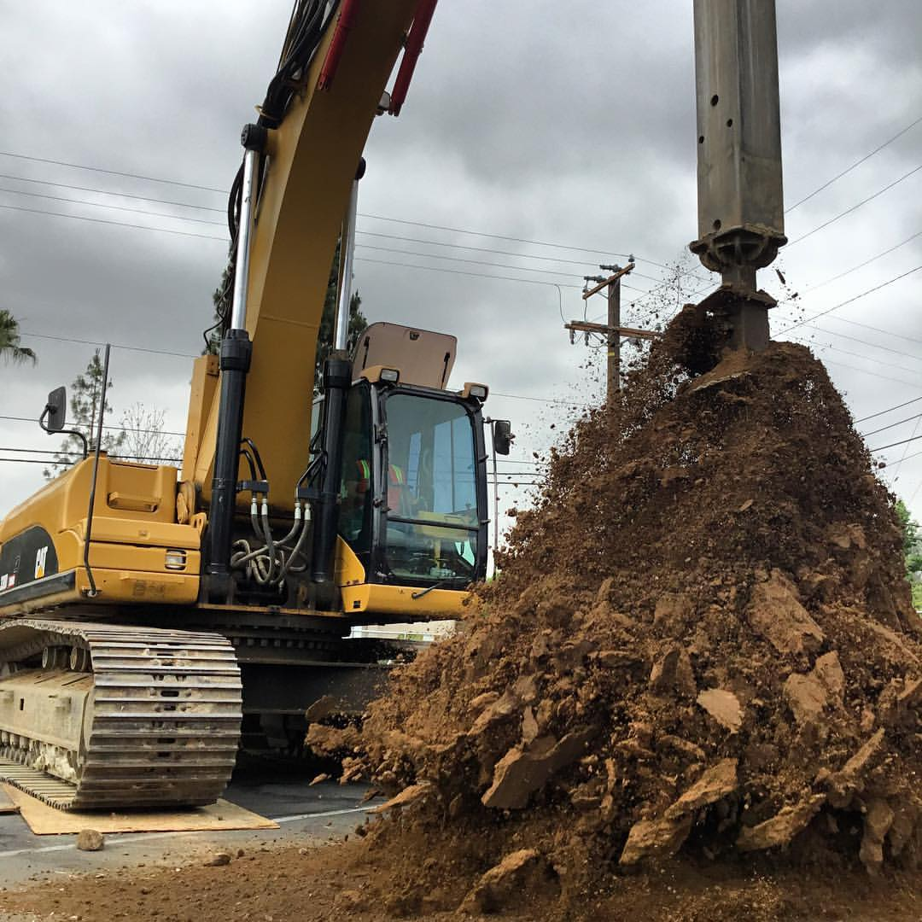
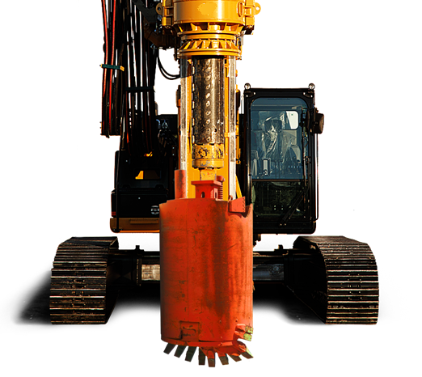
Rotating Machinery
-Auger Spinoff-
Potential or Kinetic?
Hazards created by rotating parts & high pressure hydraulics
Stay away
Rotating parts can snag lose clothing
Failure of hydraulic hoses can cause injury
Notes:
State that a wide variety of mechanical motions and actions may present hazards to the worker. These can include the movement of rotating members, reciprocating arms, moving belts, meshing gears, cutting teeth, and any parts that impact or shear.

Slide 6
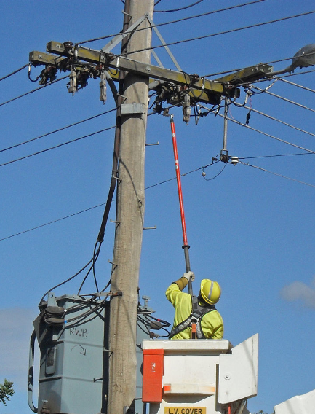
Electrical
Voltage is form of pressure
Electromagnetic pressure
Qualified Electrical workers use Minimum Approach Distances for protection
Wear protective clothing and personal protective equipment
Notes:
Explain that voltage is the pressure from an electrical circuit's power source that pushes electrons (current) through a conducting loop. This enables work to occur. In brief, voltage = pressure, and it is measured in volts (V). One method of protection from voltage is to maintain the minimum approach distance for that voltage. Minimum approach only applies to qualified electrical workers. Non-electrically qualified workers must maintain 10 feet of clearance from any exposed parts energized at 50,000 volts or less. This spacing increases if the voltage is or could be higher than 50,000 volts.

Slide 7
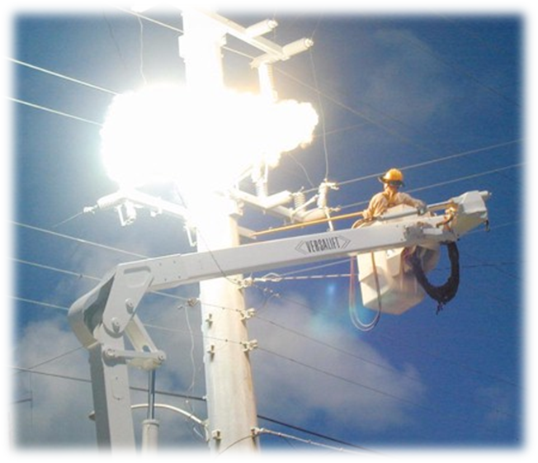
Electrical Arc
Release of stored energy
Always identify Line of Fire before starting the task
In an arc flash metal is liquefied and vaporized
Projected with large amounts of force
At very high speeds
Notes:
Discuss the importance of position and distance when conducting a critical tasks. Explain that we should never work in a position where we are directly below the work area. If there is an equipment such as a switch or cut-out breaking, we could be struck by the projectiles. Also state that in an arc metal liquefies into molten droplets which can ignite clothing and cause sever burns. Two or three drops of molten metal are unlikely to cause a clothing fire, and an individual "spot fire" can be easily patted out if it occurs. However, real-world arc flashes create thousands or tens of thousands of molten metal projectiles, meaning a worker is likely to be hit with 2,000 or 3,000 drops, not two or three. That quantity of molten metal can easily cause a large, aggressive clothing fire the victim cannot pat out. Ask attendees for additional examples. An electric arc, or arc discharge, is an electrical breakdown of a gas that produces an ongoing electrical discharge. The current through a normally nonconductive medium such as air produces a plasma; the plasma may produce visible light.

Slide 8
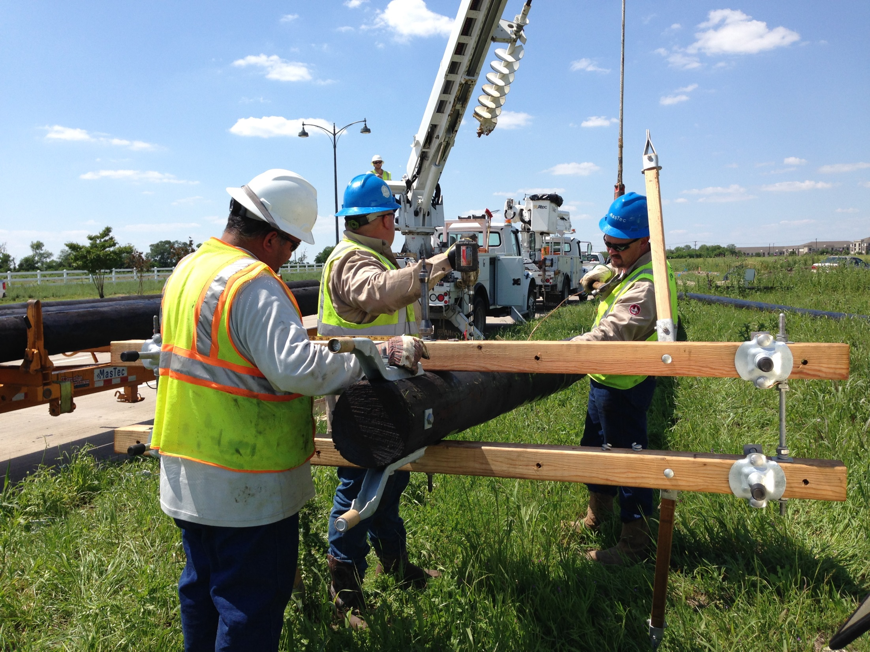
-Suspended Pole-
Potential or Kinetic?
-Stowed Auger-
Potential or Kinetic?
Notes:
Show the two pictures. Ask the group if the first picture, if the suspended pole is kinetic or potential energy. The desired answer is “Potential” energy. Then ask the group if the energy classification would change if the pole fell? The answer is “Yes” because the pole is energy in potion. The moving pole is an example of kinetic energy. Then show the group the picture of the arc flash explosion. Ask them to identify the energy classification. The desired answer is kinetic energy because electricity and light are both examples of kinetic energy.

Slide 9
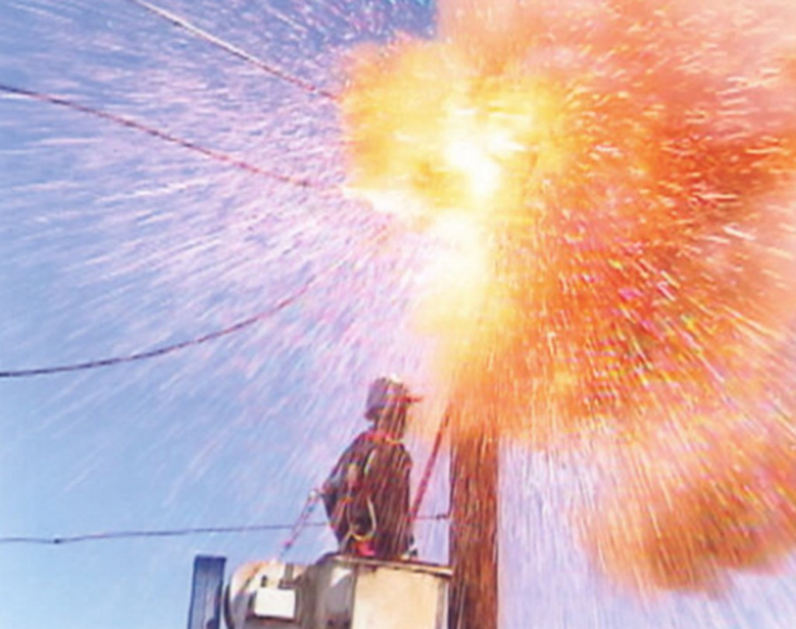
-Electrical Arc Flash-
Potential or Kinetic?
Notes:
Show the two pictures. Ask the group if the first picture, if the suspended pole is kinetic or potential energy. The desired answer is “Potential” energy. Then ask the group if the energy classification would change if the pole fell? The answer is “Yes” because the pole is energy in potion. The moving pole is an example of kinetic energy. Then show the group the picture of the arc flash explosion. Ask them to identify the energy classification. The desired answer is kinetic energy because electricity and light are both examples of kinetic energy.

Slide 10
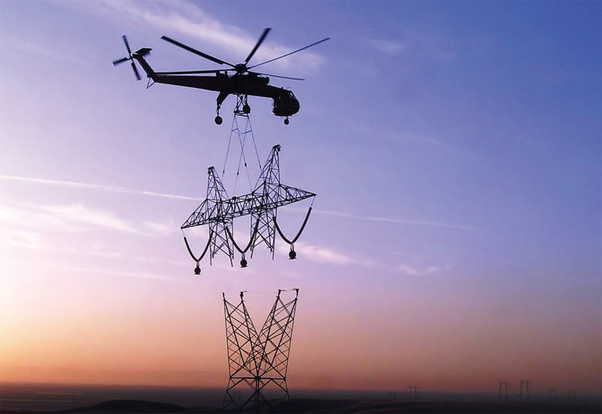
-Suspended Load-
Potential or Kinetic?
Notes:
Ask the group if this picture illustrates kinetic or potential energy. This one can be tricky. When the helicopter and load are moving the energy is kinetic. The load under the helicopter is part of the total mass. When the helicopter moves the suspended tower moves. Once the tower is placed, and the helicopter cuts the tower loose, the stationary tower now represents a potential energy source.

Slide 11
Summary
Because our work is dynamic, Line-of-fire hazards are also dynamic
Critical Questions:
Are we or will we be placing ourselves in Harm’s Way?
Are we or will we be placing someone else in Harm’s Way?
What could hit me, us, or them?
How are we going to eliminate or control the hazard?
Each person’s position with respect to line-of-fire must constantly be assessed
Notes:
State that everyone on the jobsite must ask him/herself the question, "what could hit me?" It is crucial for worker and civilian safety that we ask these questions and involve everyone in the process. This awareness of each person’s position with respect to the line-of-fire must be reassessed regularly, as the line-of-fire can change its position every time the person does, and also every time the work moves.

Slide 12
Key Points-Session Three
Energy in motion is kinetic energy.
True
False
Voltage is an example of pressure.
True
False
An important part of job planning is to identify possible sources of stored energy and determining if workers may be injured if there is a release of that energy.
True
False
During the job planning stage it is determined that workers may be exposed to hazardous energy sources, the best protection is to when possible, eliminate the hazard.
True
False
Notes:
Energy in motion is kinetic energy.
True
False
Voltage is an example of pressure.
True
False
An important part of job planning is to identify possible sources of stored energy and determining if workers may be injured if there is a release of that energy.
True
False
During the job planning stage it is determined that workers may be exposed to hazardous energy sources, the best protection is to when possible, eliminate the hazard.
True
False

Slide 13
Review
Notes:
Ask for questions. Once complete thank the attendees and close the session.

