Slide 1
Line of Fire Continuing Education First Quarter 2019
Notes:
Introduce the module. Explain that the intent of this presentation is as a continuing education training topic related to certain aspects from the ET&D 10-Hour OSHA training class, the OSHA Partnership Best Practices, and/or incident trending analysis. OSHA has determined that there are four main safety hazards, excluding transportation incidents, that account for a majority of all construction worker deaths each year on the jobsite. Dubbed the “Fatal Four” by OSHA, they include falls, electrocutions, struck-by, and caught-in or between hazards. In 2016, 63.7% of all fatalities at construction sites were from one of OSHA’s Fatal Four. This training focuses on struck-by and caught-in/between hazards and how to prevent and protect against them. Caught-in/between hazards are caused when a worker is compressed between or gets caught in equipment or objects. It also includes when a worker is killed by getting caught, struck or crushed from materials, equipment or a collapsing structure. According to OSHA, accidents caused by getting caught in or between objects accounted for 72 construction worker deaths in 2016, which is 7.3% of the 991 fatalities that occurred on construction sites.

Slide 2
Objectives
Upon completion of this continuing education module you should be able to:
Define Line of Fire injury and hazard types
Describe how to identify hazards associated with Line of Fire
Describe how to eliminate Line of Fire hazards whenever possible
Describe how to identify and control Line of Fire hazards
Describe ways to use effective methods to minimize Line of Fire hazards
Notes:
5
5
5
5
5
Explain that this is the Q1 topic. Explain the objectives of this course and the duration.

Slide 3
Line of Fire Session One
Notes:
State that the following section will discuss struck-by hazards.

Slide 4
What is the “Line-of-Fire”?
A simple definition
“Being in Harm’s Way”
Line of fire injuries can occur when the path of a moving object intersects with an individual’s body
Notes:
4
4
4
4
4
A simple definition of “line of fire” is being in harm’s way. Line of fire injuries occur when the path of a moving object intersects with an individual’s body. Three major categories of line of fire incidents are caught-in or between incidents, struck-by incidents, and released energy incidents. There are many specific examples of hazards for each of these categories.

Slide 5
Primary Types
Struck-by Hazards
Occurs if a person is struck by an object
Caught-in or Between Hazards
Occurs if a person is caught inside of, or in between different objects
Energy Released Hazards
Occurs if a person is in the path of and suffers the consequences of released energy
Notes:
Explain that it is important to always remember that Line-of-Fire hazards are one of the most deadly hazards found in Construction, second only to Slips, Trips and Falls. A few quick examples for each category:
Caught-in or between- A person is standing between a wall and an excavator. When the excavator spins around the counter weight pins the worker against the wall. Another example would be a worker placing his hand too close to a rotating gear and gets it pulled into the gear.
Struck-by- A pedestrian struck-by a moving vehicle. An object falling from a higher level striking a person at a lower level.
Released energy- A pipe releasing hot steam from a valve that is being removed, metal banding snapping back at a worker after being cut, current flow through the body are examples of released energy.

Slide 6
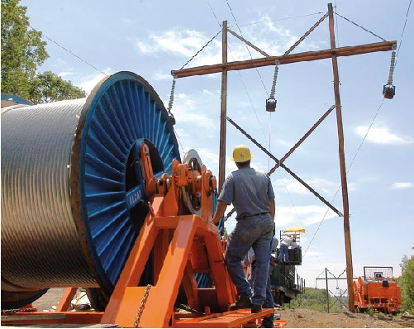
Before Starting Work
Look for Line of Fire Hazards
Line-of-Fire is the path of a moving object or,
Path of an object that could move and,
An injury may occur as a result of that movement
Notes:
Explain that at its most basic level, the Line-of-Fire is the path of a moving object that could potentially injure you, or the potential path of an object that may move. Explain how important job planning and a thorough job brief is when identifying Line of Fire hazards. Explain and discuss ways to identify Line of Fire hazards on the job before work begins. Ask the group to discuss the first time they may have performed an unfamiliar activity. Ask them if while learning the steps to perform safely that activity, they allowed themselves the time to make sure the task was performed safely.

Slide 7
Questioning Attitude
Teamwork
Is what
makes the
Dream Work
Steps
What are we going to do?
Hazards
What is the worst thing that can happen?
Safe Guards
If it all goes South, are we protected?
Self Check
&
Peer Check
?
?
Notes:
Ask the group if they have ever seen the “Steps”, “Hazards”, “Safeguards” model before? The desired answer is “yes”. These are the three basic steps to a job hazard analysis. Explain that a questioning attitude helps to prevent “group think” by encouraging diversity of thought and intellectual curiosity. It challenges the entire group to get clarification when something comes up that doesn't seem right. Check yourself and have someone else check your conclusions. Remember, two heads are always better than one. Teamwork makes the Dream work!

Slide 8
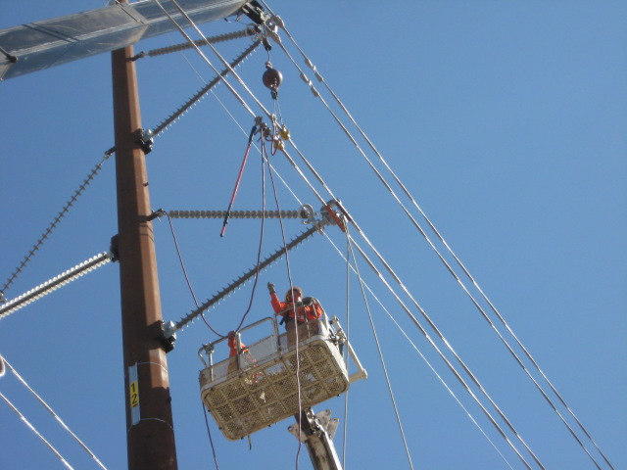
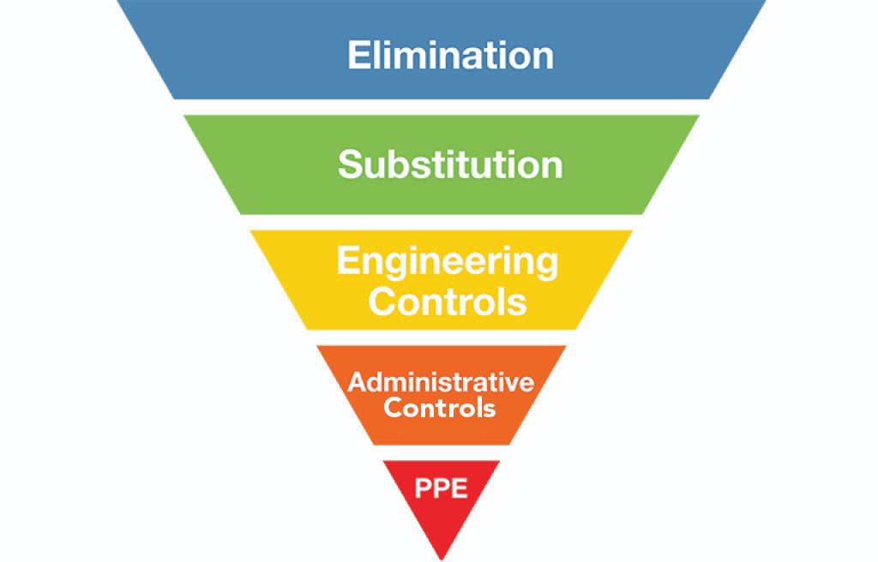
Eliminate the Hazard
Once identified
Take steps to eliminate the Hazard(s)
Elimination of the Hazard should always be the First Consideration
Notes:
5
5
5
5
5
Explain that there are many Line of Fire hazards out there that are easy to identify. The longer we work around a hazard (or in this case the more we place ourselves in the Line-of-Fire) and suffer no negative consequences the less we respect a hazard’s ability to harm us. The best way to avoid line of fire incidents is to eliminate the hazards that cause these incidents whenever possible. By totally eliminating the hazards there is no chance that you or anyone else in the work area can be injured by that hazard.

Slide 9
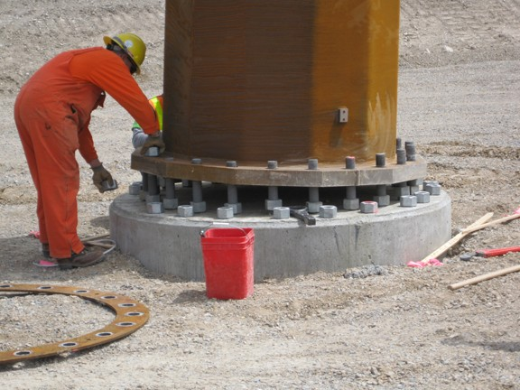
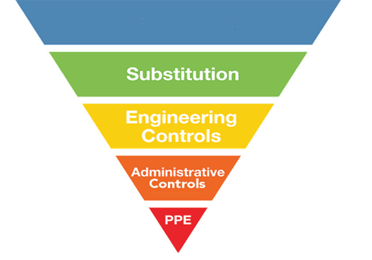
Control
If the hazards cannot be eliminated
Effectiveness
Notes:
5
5
5
5
5
State that if it is not possible to remove the hazards, we must mitigate them. Explain the hierarchy of controls. State that elimination is the most effective. For example, use proper personal protective equipment to avoid exposure. Explain that PPE is the last line of defense. Do not rely just on your PPE to avoid injury. Think about the L.O.F. hazard and how to mitigate. State that some great questions to ask are: Where is my body located in relation to the hazard? What is the worst-case scenario of my task? How can I protect myself from the hazard? When elimination is not possible, engineering controls are the next best choice in protecting yourself from line of fire incidents. Some engineering controls that could protect you from line of fire incidents include physical barriers, guarding around moving parts, and toe boards on elevated work platforms to prevent objects from falling to the area below. There are many other possible engineering controls that could be used depending on the specific hazard. Total elimination of hazards is not always possible and engineering controls may not be feasible or they can fail.

Slide 10
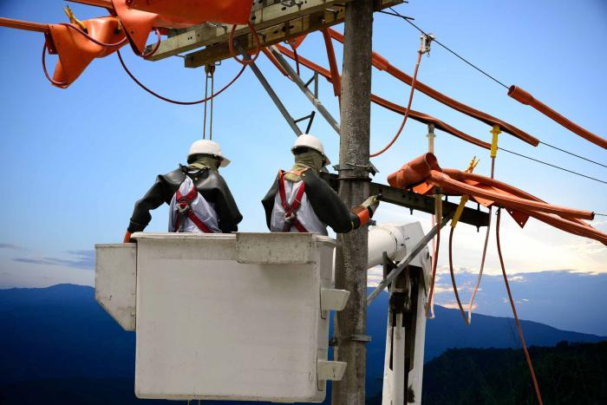
Minimize Line of Fire Hazards
Be aware of the hazards
We must understand
The Steps
The Hazards
The Safe Guards
Take time to think about the consequences
Notes:
5
5
5
5
5
Ask the question: “Can all hazards be eliminated?” Most of the group will answer “No”. Explain that almost all hazards can be eliminated if we choose to do absolutely nothing. Then state that if we choose to live and function in this world we must accept the fact that we will be exposed to hazards. Because of this reality, it is important to decrease your chance of being a victim of line of fire injuries by not putting yourself in harm’s way in the first place. Understand the work tasks that are going on around you and the associated hazards. Ask yourself what is the worst that can happen or what will happen if a certain safeguard fails. Recognize line of fire hazards and act accordingly. Explain the importance of body position when line of fire hazards exist. Explain that organizing the jobsite and providing unobstructed and easy access to equipment can prevent Line of Fire hazards.

Slide 11
Struck-By Hazards
Notes:
Explain that the following section will review “Struck-by Hazards”

Slide 12
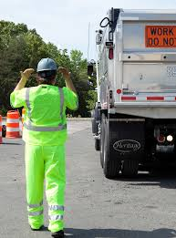
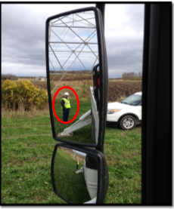
Equipment Hazards
If no Spotter
360° walk-around before first move
If using a Spotter
They can be seen
Never stand directly behind equipment
Lose sight of each other, STOP!
Notes:
Explain that anyone around moving vehicles has the potential of becoming struck-by. Be sure spotters stay off to the side of trucks and never put themselves directly behind a reversing vehicle. If you do not have a spotter, the driver must perform a 360 walk-around prior to first move from park. Anytime a blind spot appears during moving a vehicle, the driver must stop and walk around or ask for assistance.

Slide 13
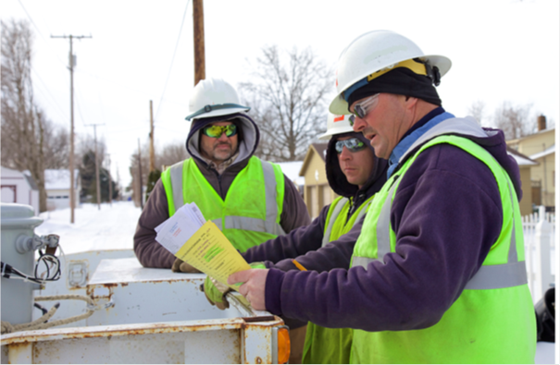
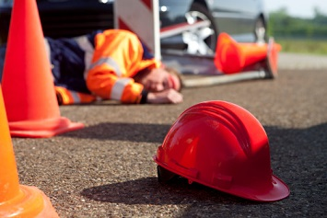
Work Practices
During the job planning phase, ask the “What If” questions
Am I or will I be in harm’s way?
Will someone else be in harm’s way?
Avoid This!
Notes:
STOP, THINK, ACT, REVIEW (STAR Principle): Ensure that you and others do the right thing BEFORE taking action. Consider “what can happen”. Place yourself in a safe working position when conducting your task. Always ask yourself, "Am I or is someone else in harms way"? Have a questioning attitude: consider the “what if’s” prior to taking any action or making any decision. During job briefing, discuss proper distances and identify all pinch points and line of fire. Understand and know when to use Stop Work Authority.

Slide 14
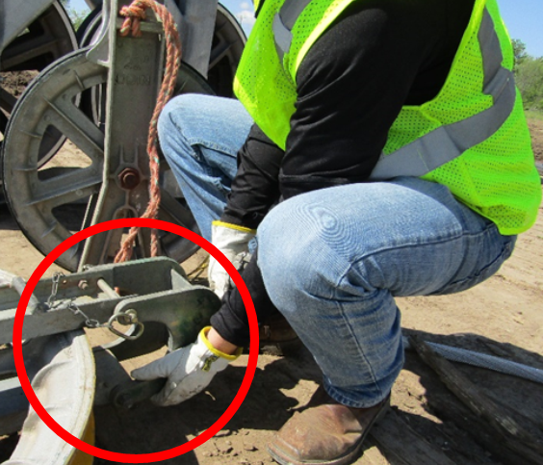
Hand Position
Be cognizant of hand placement
Look for pinch points
What if it moves
Unexpected release of energy
Notes:
State the necessity of being aware of hand placement, especially the non-dominant hand. Identify possible pinch points and other “Line of Fire” hazards. Ask yourself, what will happen when or if this moves? Will I be in the path of movement.
Think about the consequences of where you place all or part of your body at all times.
• Fingers/Hands in Pinch Points
• Under suspended loads
• Struck by hand tools
• Electrical contact

Slide 15
Key Points-Session One
Body position is a key component when identifying struck–by type line of fire hazards.
True
False
A good example of when to use Stop Work Authority (SWA) is if you lose sight of your spotter when backing a vehicle or piece of equipment.
True
False
If a spotter is not available, it is OK to back up as long as you sound the horn first.
True
False
A person that is in a position that allows them to be struck and injured if there is a movement of an object is exposed to a ___________ injury.
Struck-By
Caught Between
Notes:
Body position is a key component when identifying struck–by type line of fire hazards.
True
False
A good example of when to use Stop Work Authority (SWA) is if you lose sight of your spotter when backing a vehicle or piece of equipment.
True
False
If a spotter is not available, it is OK to back up as long as you sound the horn first.
True
False
A person that is in a position that allows them to be struck and injured if there is a movement of an object is exposed to a ___________ injury.
Struck-By
Caught Between

Slide 16
Caught-In or Between Hazards Session Two
Notes:
Explain that the following section will Explain “Caught Between Injuries”

Slide 17
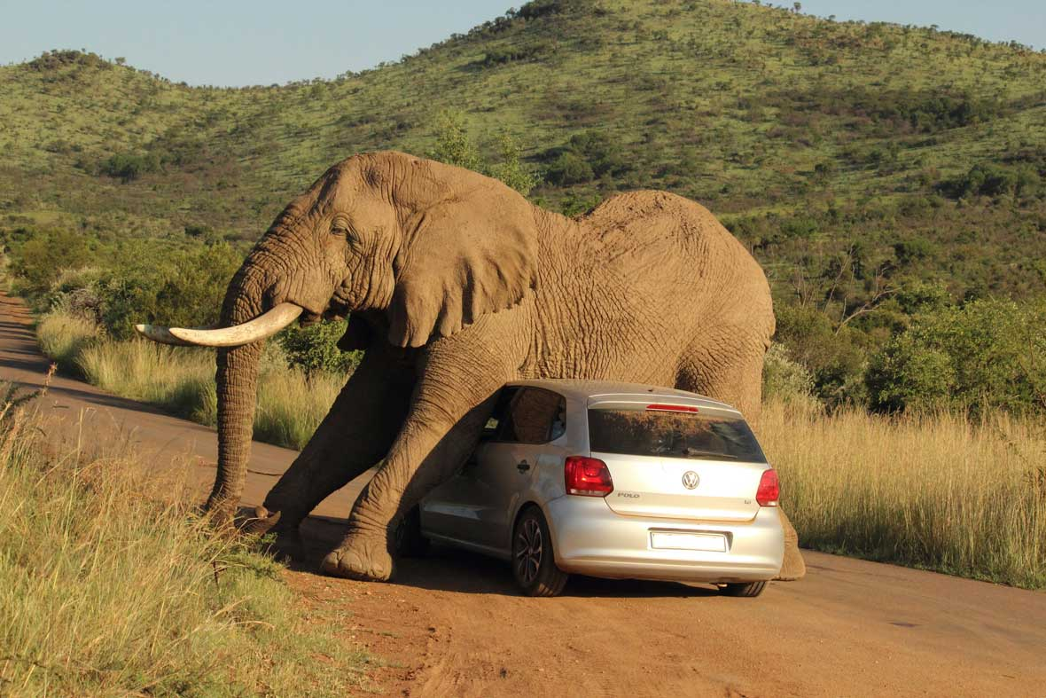
Definition
A crushing injury
Occurs as a result of being caught between objects
Notes:
The key factor in making a determination between a Caught-in or between event and a Struck-by event is whether the impact of the object alone caused the injury. When the impact alone creates the injury, the event should be considered a Struck-by event. When the injury is created more as a result of crushing injuries between objects, the event should be considered as a Caught-in or between event.

Slide 18
2017 Partnership Injuries
Caught-in or Between injuries
Accounted for 11% of all ET&D Partner Company OSHA Recordable injuries
69 of 644
Does not include non-recordable injuries
Notes:
Explain that of the 644 ET&D Partner OSHA recordable injuries in 2017, 69 were reported as caught-in or between incidents.

Slide 19
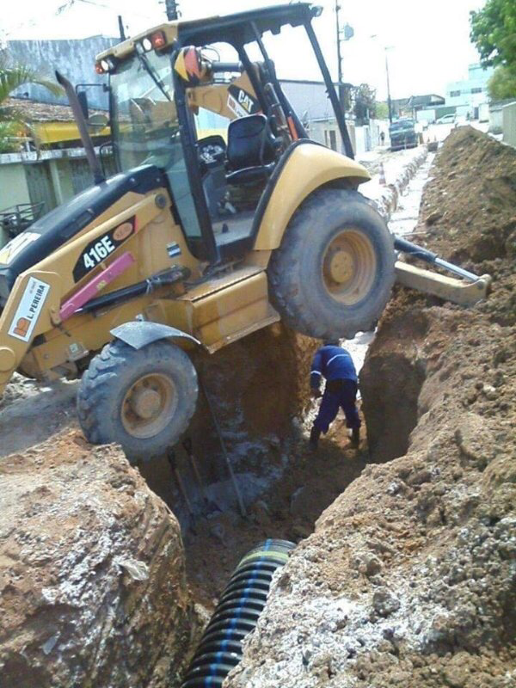
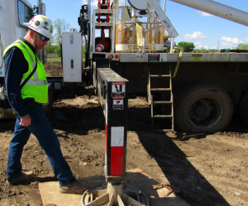
Crushing Injury
Stand clear when outriggers are being deployed
Communication
Do not take unnecessary risks
Notes:
Explain that communication is key to prevent struck by injuries when deploying outriggers. Assign spotter to ensure outrigger area is clear. Use outrigger pads. That way a person is more aware that they may be placing their foot in the danger zone. Explain that the second picture illustrates a totally unnecessary risk.

Slide 20
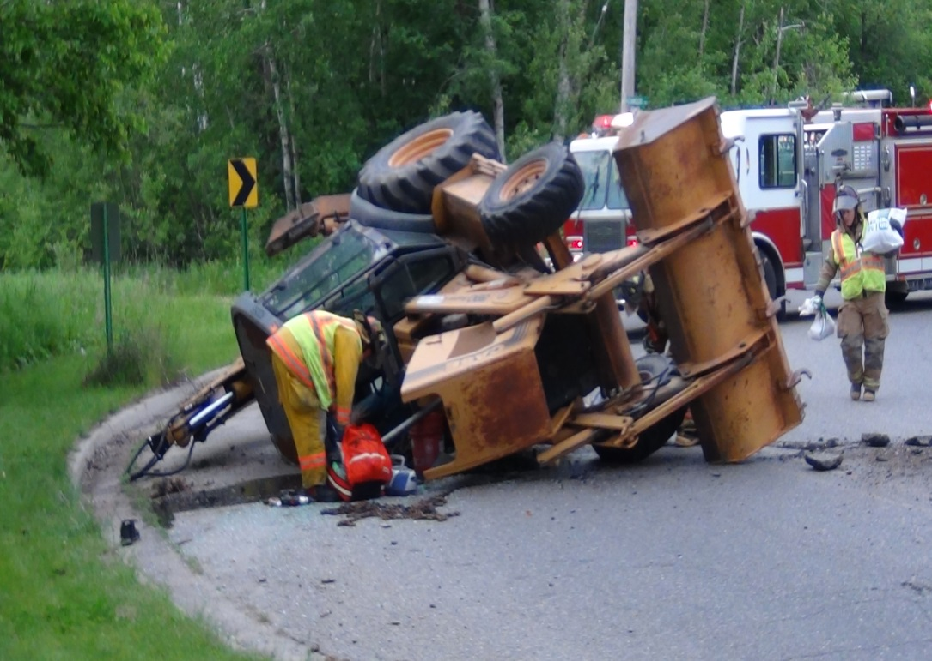
Crushing Injury
Equipment with Rollover Protection Systems or ROPS
Wear seatbelts
Mandatory requirement
Notes:
Seatbelts must be worn by operators using equipment that has rollover protection. A National Institute for Occupational Safety and Health (NIOSH) review of the Bureau of Labor Statistics (BLS) Census of Fatal Occupational Injuries (CFOI) data identified 346 deaths associated with excavators or backhoe loaders during 1992-2000 [NIOSH 2002]. Review of these data and of NIOSH Fatality Assessment and Control Evaluation (FACE) cases [NIOSH 2000, 2001] suggests two common causes of injury: (1) being struck by the moving machine, swinging booms, or other machine components; or (2) being struck by quick-disconnect excavator buckets that unexpectedly detach from the excavator stick. Other leading causes of fatalities are rollovers, electrocutions, and slides into trenches after cave-ins.

Slide 21
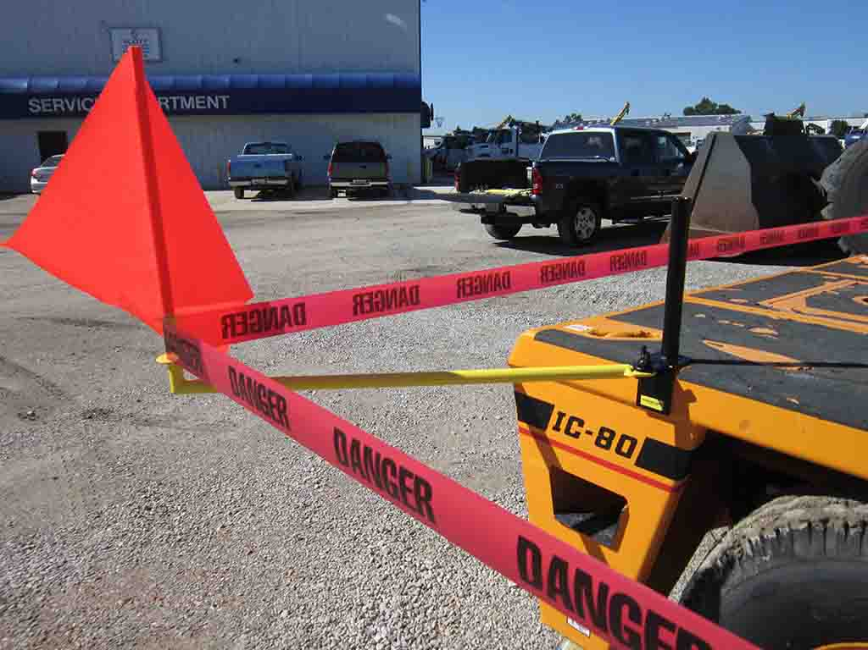
Rotating Equipment
Accessible areas within the swing radius of the rotating superstructure
Barricaded
Training is required
Inform the operator before entry
Prevents crushing injuries
Notes:
According to the OSHA crane standard 1926.1424 where there are accessible areas in which the equipment's rotating superstructure (whether permanently or temporarily mounted) poses a reasonably foreseeable risk of striking and injuring an employee or, pinching/crushing an employee against another part of the equipment or another object, to prevent employees from entering these hazard areas, the employer must train each employee assigned to work on or near the equipment ("authorized personnel") in how to recognize struck-by and pinch/crush hazard areas posed by the rotating superstructure. The employer must also erect and maintain control lines, warning lines, railings or similar barriers to mark the boundaries of the hazard areas. Exception: When the employer can demonstrate that it is neither feasible to erect such barriers on the ground nor on the equipment, the hazard areas must be clearly marked by a combination of warning signs (such as "Danger--Swing/Crush Zone") and high visibility markings on the equipment that identify the hazard areas. In addition, the employer must train each employee to understand what these markings signify. In addition, before an employee goes to a location in the hazard area that is out of view of the operator, the employee (or someone instructed by the employee) must ensure that the operator is informed that he/she is going to that location. Where the operator knows that an employee went to a location the operator must not rotate the superstructure until the operator is informed in accordance with a pre-arranged system of communication that the employee is in a safe position. Where any part of a crane/derrick is within the working radius of another crane/derrick, the controlling entity must institute a system to coordinate operations. If there is no controlling entity, the employer (if there is only one employer operating the multiple pieces of equipment), or employers, must institute such a system.

Slide 22
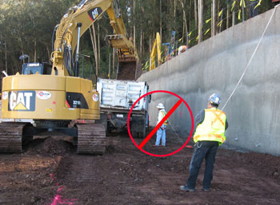
Moving Equipment
Caught between moving equipment/vehicle and another object
Spotters
Unaware co-workers
During maintenance
Failure to secure vehicle in place
Notes:
Explain that anyone around moving or improperly secured equipment and vehicles has the potential of becoming caught between it and a stationary object. Stop operation if spotter cannot be seen or anyone walks into hazardous area. Explain that thie picture shows the potential for an injury. The one worker may not be in plain view of the operator.

Slide 23
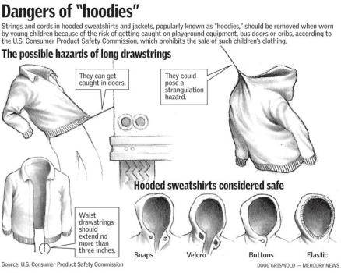
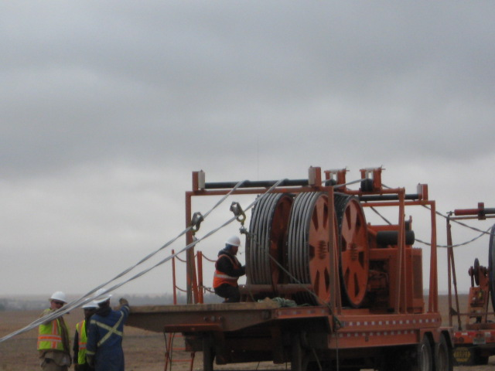
Snags
Being pulled into or caught in machinery and equipment
Strangulation
Amputations
Fractures
Death
It is not just a “work” safety issue
Notes:
State that almost all sites use machinery that has moving or rotating parts. All of that equipment, at some time requires maintenance or repair. If machinery is not properly guarded or de-energized during maintenance or repair, injuries from caught-in or between hazards may result. These injuries range from amputations and fractures to death. When machines or power tools are not properly guarded, workers can get their clothing or parts of their body caught in the machines. If machines are not de-energized (locked-out) when they are being repaired, they may cycle or otherwise start up and catch a worker’s body part or clothing and cause injury or death. State that we should never wear loose clothing around moving machinery. A simple thing like the hood string on a sweatshirt or coat could cause a severe and even fatal injury. Cable pullers offer multiple opportunities for crushing injuries, often resulting in amputations due to the extent of the damage caused to bone and tissue. State that safety is not just an “at work” issue. Safety at home is as critical as safety at work. Think about your children as well.

Slide 24
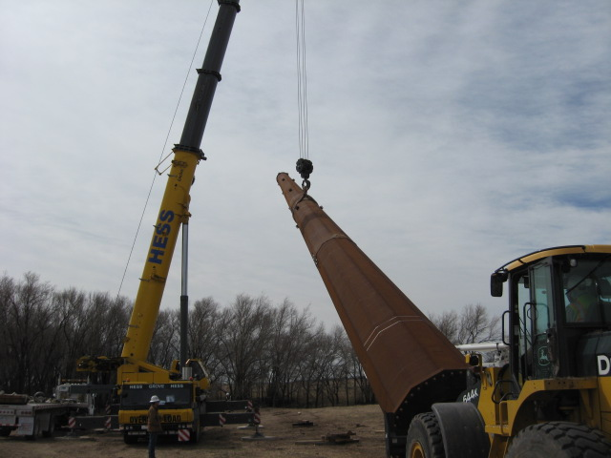
Material Handling
Moving loads may create hazards
Shifting poles can cause an injury
Workers may be struck by objects falling from the structure
Rigging failure
Caught-between the pole and a machine
Notes:
State that everyone must maintain proper distance during pole handling tasks. Always chock/block downhill side of staged poles. Be aware of the Line of Fire hazards. Discuss the policies and procedures your company has in place to prevent the various types of crushing injuries mentioned. Make sure that your crew has received the appropriate training in order to identify these hazards and correctly implement site and task specific protective measures to eliminate them. Areas of concern here are the possible loss of the load, possible crushing injury from being caught-between the pole and the crane or other equipment, and possible struck-by injuries resulting from objects falling from the pole. This could include tools that were left behind, loose hardware, and/or dirt clods falling from the elevated structure.

Slide 25
Key Points-Session Two
In 2017, over 10% of OSHA recordable injuries experienced by ETD partnership company employees were a result of caught-in or between injuries.
True
False
A caught-in or between injury is a crushing injury?
True
False
The best time to identify struck-by and/or caught-between hazards and develop a control is during the job planning phase.
True
False
If you could be hit by a moving object or an object that has the potential to move, you are in the line-of-fire.
True
False
Notes:
In 2017, over 10% of OSHA recordable injuries experienced by ETD partnership company employees was a result of caught-in or between injuries.
True
False
A caught-in or between injury is a crushing injury?
True
False
Personal Protective Equipment should always be the first consideration for worker protection.
True
False
If you could be hit by a moving object or an object that has the potential to move, you are in the line-of-fire.
True
False

Slide 26
Hazardous Energy Release Session Three
Notes:
Explain that the following section will Explain “Energy Release Hazards”

Slide 27
Two Basic Types
Energy in motion is Kinetic Energy
Radiant
Thermal
Electrical
Light
Current flow
Mechanical
Energy that is stored is Potential Energy
Coiled spring
Raised weight
Water behind a dam
Snow pack
Stretched rubber band
A capacitor bank
Notes:
Explain that Objects can have stored, or potential, energy when work has been done (such as raising an object in the air) or by virtue of their position (such as sitting at the top of a hill). Potential energy changes to kinetic energy when the object moves. Kinetic energy is a form of energy that results from an object's motion. An example of kinetic energy is an airplane in flight. The airplane has a large amount of kinetic energy due to its large mass and fast velocity. When an object moves, it possesses kinetic energy. There are five types of kinetic energy - radiant, thermal, sound, electrical (light) and mechanical (motion). Potential energy is the energy an object has because of its position, rather than its motion. An object held in a person's hand has potential energy, which turns to kinetic energy, the energy of motion, when the person lets it go, and it drops. In every scenario, usually both forms of energy are present.

Slide 28
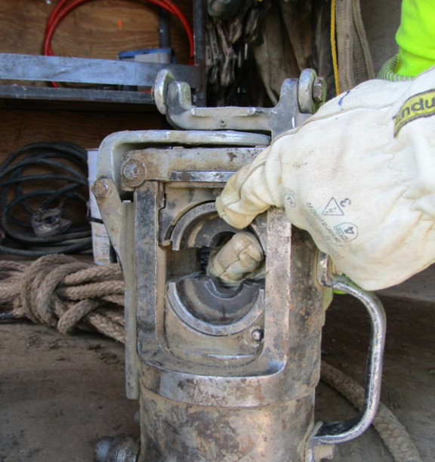
Hydraulic
Force created by liquid under pressure
Liquids cannot be compressed
They transmit force to surrounding areas
Notes:
State that hydraulic pressure is the force that liquid is acting on some area. This pressure results due to an existing property in liquid, which is called compressibility. Liquids are incompressible, so they transmit force across their molecules to the surrounding or contacting area. We must be aware of paths where energy passes from one location to another. This energy may be in the form of something under tension, hydraulic, pneumatic, pressure, flying parts, or whipping air lines

Slide 29
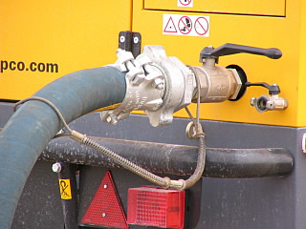
Pneumatic
Air hose may uncouple or a fitting may fail
Rapid expansion of air causes the hose to whip violently
Can cause a hazardous situation
Whip Check
Notes:
Explain that when a pressurized air hose becomes accidentally uncoupled or a hose or fitting failure occurs, the rapid expansion of air causes the hose to whip violently creating a potentially lethal situation. Use whip checks to help prevent injuries or accidents resulting from hose or coupling failure. A whip check extends across the hose fittings to give standby safety for hose. Simply pull back the spring and slip the loops on the whip-check over each hose before connection to provide a safety backup in the event of a hose connection failure. State that whip checks on air line hoses are easy to use, low cost, safety cables to help prevent injury if a hose connection separates. They can attach hose to hose or hose to equipment. They are highly resistant to rust and corrosion and do not require any tools to install.

Slide 30
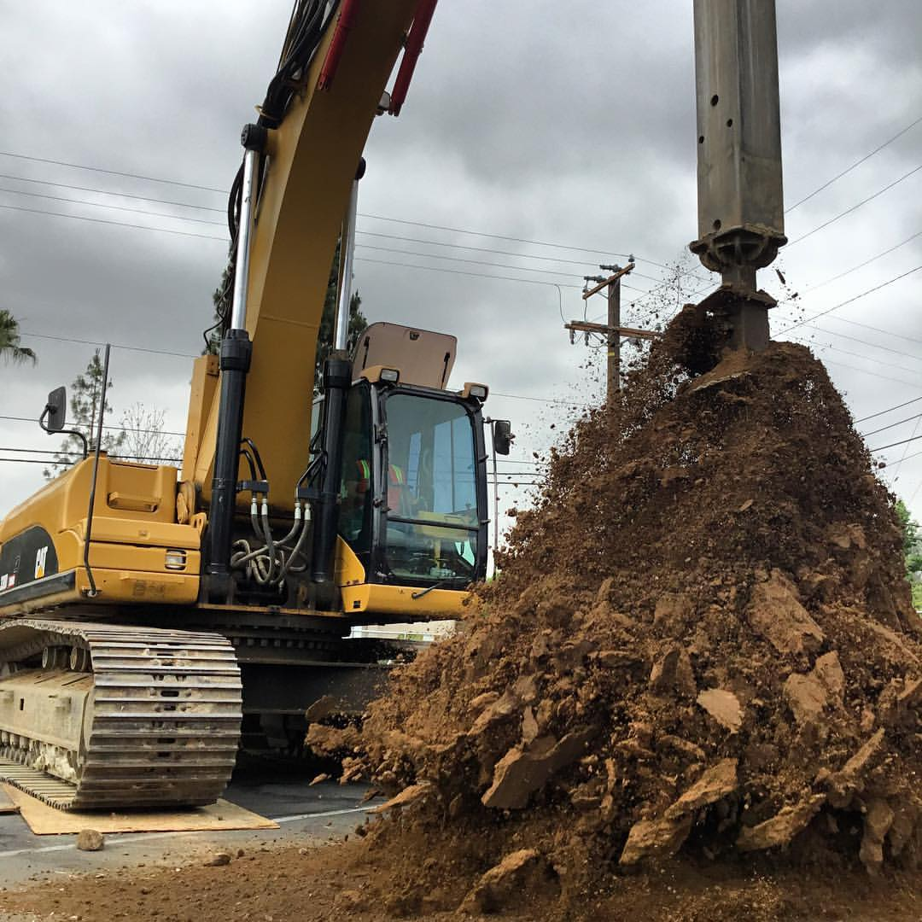
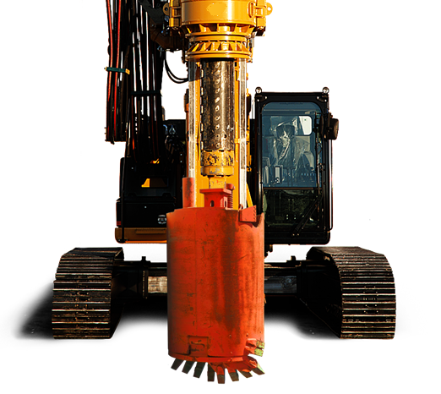
Rotating Machinery
-Auger Spinoff-
Potential or Kinetic?
Hazards created by rotating parts & high pressure hydraulics
Stay away
Rotating parts can snag lose clothing
Failure of hydraulic hoses can cause injury
Notes:
State that a wide variety of mechanical motions and actions may present hazards to the worker. These can include the movement of rotating members, reciprocating arms, moving belts, meshing gears, cutting teeth, and any parts that impact or shear.

Slide 31
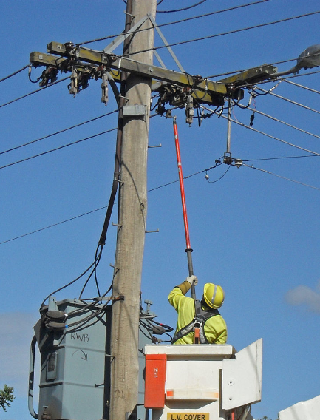
Electrical
Voltage is form of pressure
Electromagnetic pressure
Qualified Electrical workers use Minimum Approach Distances for protection
Wear protective clothing and personal protective equipment
Notes:
Explain that voltage is the pressure from an electrical circuit's power source that pushes electrons (current) through a conducting loop. This enables work to occur. In brief, voltage = pressure, and it is measured in volts (V). One method of protection from voltage is to maintain the minimum approach distance for that voltage. Minimum approach only applies to qualified electrical workers. Non-electrically qualified workers must maintain 10 feet of clearance from any exposed parts energized at 50,000 volts or less. This spacing increases if the voltage is or could be higher than 50,000 volts.

Slide 32
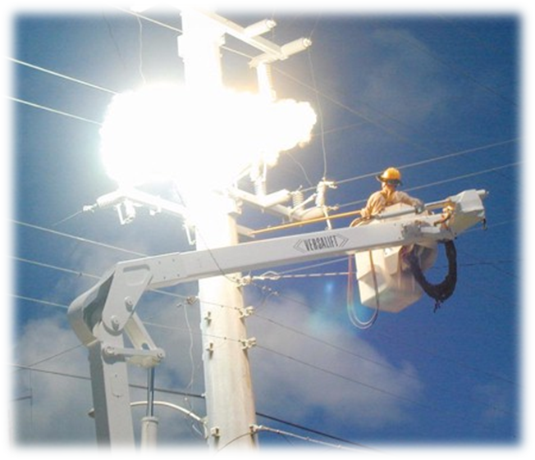
Electrical Arc
Release of stored energy
Always identify Line of Fire before starting the task
In an arc flash metal is liquefied and vaporized
Projected with large amounts of force
At very high speeds
Notes:
Discuss the importance of position and distance when conducting a critical tasks. Explain that we should never work in a position where we are directly below the work area. If there is an equipment such as a switch or cut-out breaking, we could be struck by the projectiles. Also state that in an arc metal liquefies into molten droplets which can ignite clothing and cause sever burns. Two or three drops of molten metal are unlikely to cause a clothing fire, and an individual "spot fire" can be easily patted out if it occurs. However, real-world arc flashes create thousands or tens of thousands of molten metal projectiles, meaning a worker is likely to be hit with 2,000 or 3,000 drops, not two or three. That quantity of molten metal can easily cause a large, aggressive clothing fire the victim cannot pat out. Ask attendees for additional examples. An electric arc, or arc discharge, is an electrical breakdown of a gas that produces an ongoing electrical discharge. The current through a normally nonconductive medium such as air produces a plasma; the plasma may produce visible light.

Slide 33
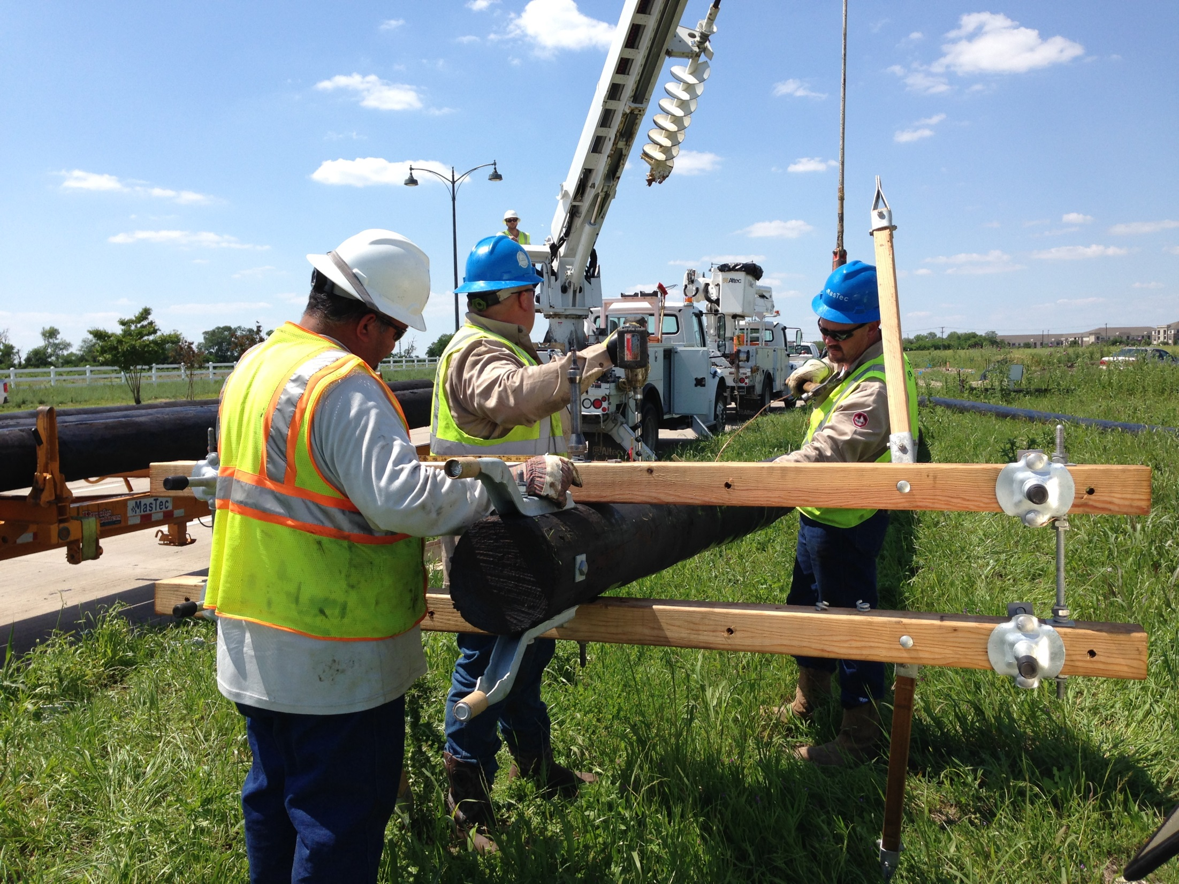
-Suspended Pole-
Potential or Kinetic?
-Stowed Auger-
Potential or Kinetic?
Notes:
Show the two pictures. Ask the group if the first picture, if the suspended pole is kinetic or potential energy. The desired answer is “Potential” energy. Then ask the group if the energy classification would change if the pole fell? The answer is “Yes” because the pole is energy in motion. The moving pole is an example of kinetic energy. Then show the group the picture of the arc flash explosion. Ask them to identify the energy classification. The desired answer is kinetic energy because electricity and light are both examples of kinetic energy.

Slide 34
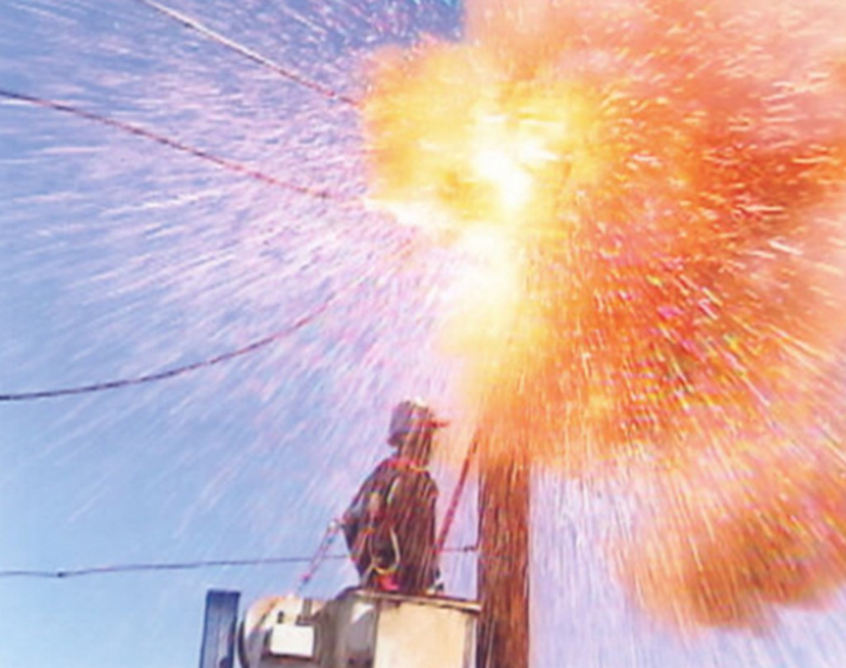
-Electrical Arc Flash-
Potential or Kinetic?
Notes:
Show the two pictures. Ask the group if the first picture, if the suspended pole is kinetic or potential energy. The desired answer is “Potential” energy. Then ask the group if the energy classification would change if the pole fell? The answer is “Yes” because the pole is energy in potion. The moving pole is an example of kinetic energy. Then show the group the picture of the arc flash explosion. Ask them to identify the energy classification. The desired answer is kinetic energy because electricity and light are both examples of kinetic energy.

Slide 35
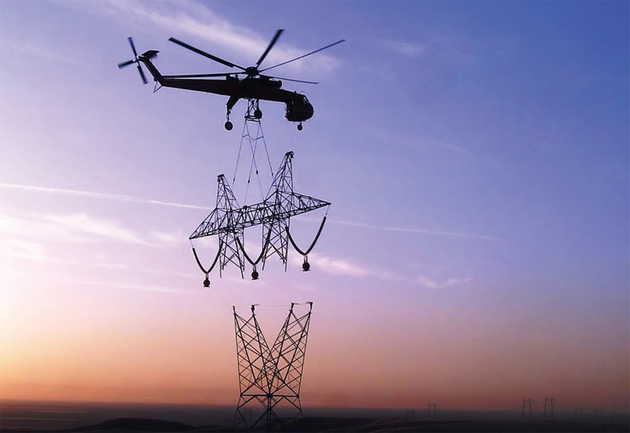
-Suspended Load-
Potential or Kinetic?
Notes:
Ask the group if this picture illustrates kinetic or potential energy. This one can be tricky. When the helicopter and load are moving the energy is kinetic. The load under the helicopter is part of the total mass. When the helicopter moves the suspended tower moves. Once the tower is placed, and the helicopter cuts the tower loose, the stationary tower now represents a potential energy source.

Slide 36
Summary
Because our work is dynamic, Line-of-fire hazards are also dynamic
Critical Questions:
Are we or will we be placing ourselves in Harm’s Way?
Are we or will we be placing someone else in Harm’s Way?
What could hit me, us, or them?
How are we going to eliminate or control the hazard?
Each person’s position with respect to line-of-fire must constantly be assessed
Notes:
State that everyone on the jobsite must ask him/herself the question, "what could hit me?" It is crucial for worker and civilian safety that we ask these questions and involve everyone in the process. This awareness of each person’s position with respect to the line-of-fire must be reassessed regularly, as the line-of-fire can change its position every time the person does, and also every time the work moves.

Slide 37
Key Points-Session Three
Energy in motion is kinetic energy.
True
False
Voltage is an example of pressure.
True
False
An important part of job planning is to identify possible sources of stored energy and determining if workers may be injured if there is a release of that energy.
True
False
During the job planning stage it is determined that workers may be exposed to hazardous energy sources, the best protection is to when possible, eliminate the hazard.
True
False
Notes:
Energy in motion is kinetic energy.
True
False
Voltage is an example of pressure.
True
False
An important part of job planning is to identify possible sources of stored energy and determining if workers may be injured if there is a release of that energy.
True
False
During the job planning stage it is determined that workers may be exposed to hazardous energy sources, the best protection is to when possible, eliminate the hazard.
True
False

Slide 38
Review
Notes:
Ask for questions. Once complete thank the attendees and close the session.

