Slide 1
Cradle to Cradle and Lock to Lock Use of Insulating Rubber Gloves and Sleeves Continuing Education 1st Quarter 2022
Notes:
Introduce the module…
Explain that the intent of this presentation is as a continuing education training topic related to certain aspects from the ET&D 10-Hour/20-Hour OSHA training class, the OSHA Partnership Best Practices, and/or incident trending analysis.

Slide 2
Best Practices
Electrical Transmission & Distribution Partnership has developed several effective safety and health Best Practices.
The Partnership has also developed Frequently Asked Questions (FAQs) for each safety and health Best Practice.
All have been approved and posted on the official OSHA website for use by all employers.
Notes:
The ET&D partnership has created the best practices to help prevent serious injuries and fatalities in the electrical industry as well as to create uniform guidelines to the industry.
To see all the ET&D best practices, visit https://www.neca-neis.org/powerlinesafety/best-practices

Slide 3
Benefits of Best Practices
Cradle to Cradle and Lock to Lock
Provides specific use requirements that are proven methods for reducing electrical contact injuries and fatalities.
Provides for uniform use guidelines that can be applied industry wide.
Notes:
Benefits of this best practice include providing specific use required that are proven methods for reducing electrical contact injuries and fatalities.
Provides for uniform use guidelines that can be used industry wide.

Slide 4
Objectives
Upon completion of this training, you should be able to:
Define the meaning of Cradle to Cradle
Define the meaning of Lock to Lock
Define Effective Cover Up
Define Extended Reach
Notes:
Review the objectives.

Slide 5
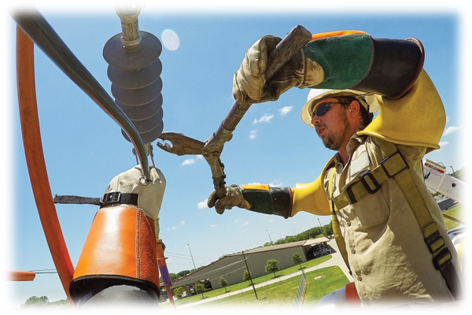
Best Practices Definition
Protocols related to the effective use of insulating rubber gloves and sleeves with cradle to cradle and lock to lock task.
Notes:
This purpose of this best practice is to ensure that workers understand protocols related to effective use of insulating rubber gloves and sleeves.

Slide 6
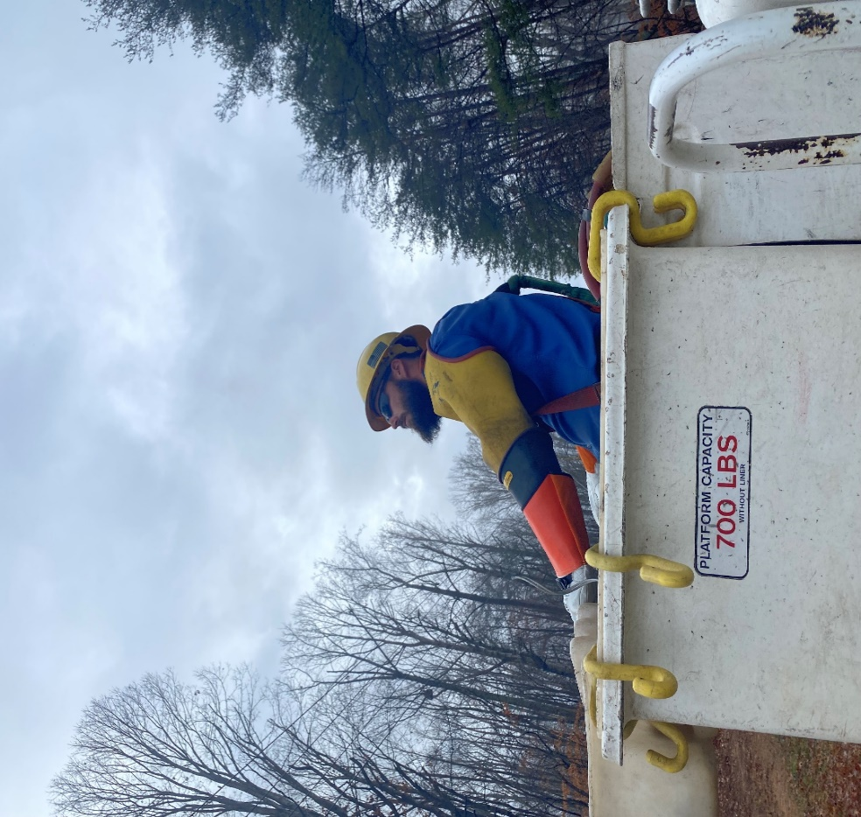
Cradle to Cradle

Slide 7
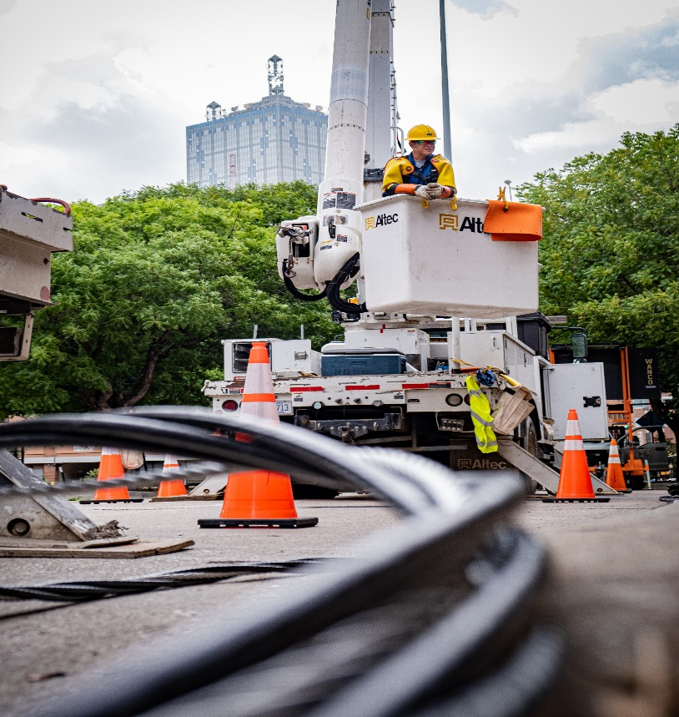
Practice Description
Cradle to Cradle
When workers are performing work on energized circuits or equipment using the rubber glove method, insulating rubber gloves and sleeves rated for the exposure at the highest nominal voltage shall be worn cradle-to-cradle when working from an aerial platform.
Notes:
Before leaving the cradle, when the plan is to work on energized equipment rubber gloves and sleeves must be worn before the boom leaves the cradle.

Slide 8
Electrical Class Rating
Gloves and Sleeves
Electrical class rating of the insulating rubber sleeves shall meet or exceed the electrical class rating of the insulating rubber gloves when working on primary conductors.
Notes:
Glove class rating: explain to workers that the electrical class rating of rubber gloves and sleeves shall at minimum meet the electrical class rating of the gloves when working on energized primary conductors.

Slide 9
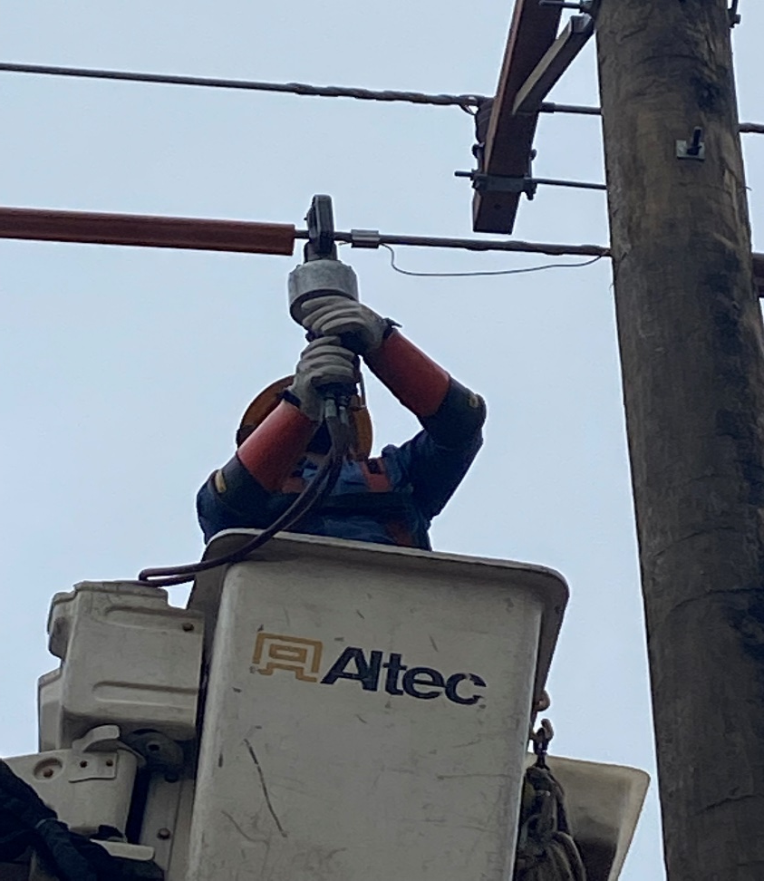
Exception
Insulating rubber sleeves are not required when:
Employees are working circuits with a potential of 600 volts or less
If there is no upper arm exposure and,
The worker will not encroach the 5-foot primary zone.
Notes:
Rubber sleeves must be worn when the employee is within reaching distance, located above, or moving past equipment energized at 600 volts or above.

Slide 10
Practice Description
Company Policies and Job Briefings
Company policies shall be applied when the conditions cannot be met.
Alternative work methods ensuring worker safety shall be identified and communicated.
Alternative work methods must be included, implemented, and documented as part of the job briefing.
Notes:
Company policies and Job Briefings both must reflect the most effective way for utilization of the best practice. Given work conditions and environment, it is understandable and recognized alternative work methods will have to be implemented. All alternative work methods must be effectively communicated and documented in the job briefing.

Slide 11
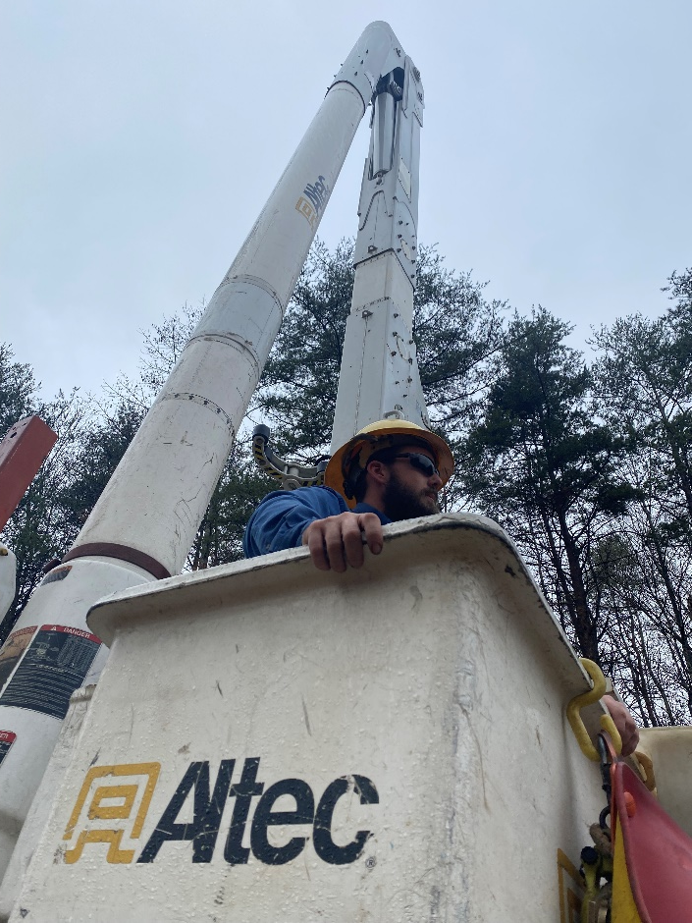
FAQ’S- Cradle to Cradle
Can I swing the bucket out of the energized zone and remove Gloves and Sleeves in order to drink water, take a break, etc.?
NO, The upper boom section shall be lowered to its lowest possible elevation or be repositioned to the cradle before gloves and sleeves may be removed.
Notes:
FAQ’s for those questions that often come up about use of the best practice during certain activities.

Slide 12
FAQ’S- Cradle to Cradle
Are there instances when gloves and sleeves may be removed when working in a bucket (cradle-to-cradle)?
YES, examples include:
The upper boom section has been lowered to its lowest possible elevation or when the bucket has been repositioned to the cradle.
When the circuit has been de-energized, grounded, and an EPZ has been established. (see company policies)
Refer to company policies for specific work procedures (terminations)
Notes:
There are instances when gloves and sleeves may be removed, but each of those circumstances should be fully vetted before that process is followed. This should also be documented in your job briefing and clearly communicated with all workers.

Slide 13
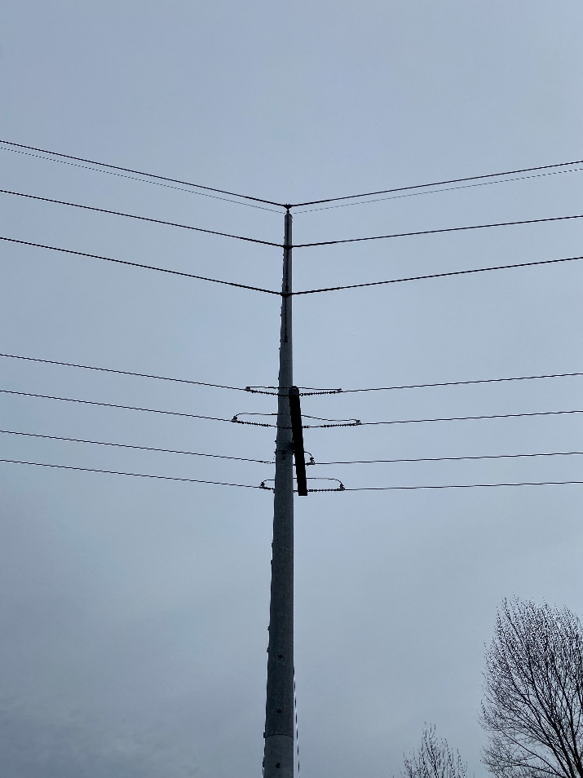
FAQ’S- Cradle to Cradle
When ascending to perform work on a transmission line with energized under build, do I need gloves and sleeves while moving over/past the energized under build?
NO, as long as the 5-feet primary zone is not encroached. ( see company policy)
Notes:
Ensure workers understand that as long as the five foot MAD is not encroached while accessing the energized transmission above the distribution under build, gloves and sleeves would not be required.

Slide 14
Review
When is cradle-to-cradle used?
Are there any exceptions to this? If so, what are those exceptions?
Are work methods including how to implement cradle-to-cradle required to be documented and communicated in job briefings?
While performing work on transmission with energized under build, what is the minimum approach distance where gloves and sleeves aren’t required?
Notes:
When is cradle-to-cradle used?
When working energized circuits from an aerial platform-minus exceptions which are clearly defined in the Best Practice.
Are there any exceptions to this? If so, what are those exceptions?
Yes, when working 600 volts or less if there is no upper arm exposure and the MAD (5 ft.) will not be encroached.
Are work methods including how to implement cradle-to-cradle required to be documented and communicated in job briefings?
Yes
While performing work on transmission with energized under build, what is the minimum approach distance where gloves and sleeves aren’t required?
5 feet

Slide 15
Lock to Lock
Notes:
Lock-to-Lock is used to describe the utilization of rubber gloves and sleeves, when required, prior to the time the pad mounted equipment is unlocked until work is complete and the pad mounted equipment is relocked.

Slide 16
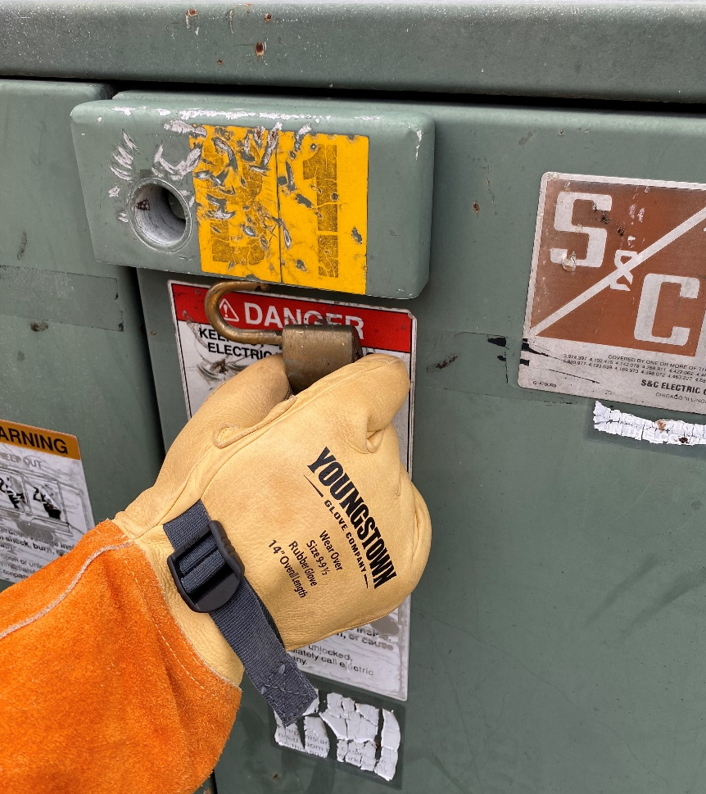
Practice Description
Lock to Lock
When employees are working on energized circuits or equipment, rubber protective-insulating gloves and sleeves rated for the exposure of the highest nominal voltage shall be worn “lock to lock” when employees are working on underground electrical equipment.
This includes when the employee manipulates the enclosure’s door.
Notes:
This purpose of this best practice is to ensure that workers understand protocols related to effective use of insulating rubber gloves and sleeves.

Slide 17
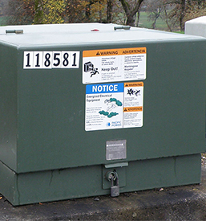
Practice Description
A complete, thorough inspection of exterior
Hazard assessment must be conducted prior to any action
Manipulation of locking mechanism being performed.
This hazard assessment could include
Visible damage
Hinge condition
Foundation (stability and general condition)
Rust
Site conditions (landscaping)
Noise in the enclosure
Oil present in and around enclosure
Wildlife concerns (bees, snakes, etc.)

Slide 18
Exception
If no physical, sensory or environmental condition is present during the hazard assessment that would necessitate the use of gloves and sleeves to unlock the lock, gloves and sleeves may be omitted for unlocking.
Gloves and sleeves are required for lock removal without exception.

Slide 19
Practice Description
Rubber gloves and sleeves shall be worn when working on or within the extended reach of the conductor or piece of equipment.
Electrical class rating of the insulating rubber sleeves shall meet or exceed the electrical class rating of the insulating rubber gloves.
Notes:
Extended Reach is used to describe being within five feet of energized conductors and/or equipment or having a conductive object within five feet of energized conductors and/or equipment.

Slide 20
Defining Extended Reach
Extended Reach
Is used to describe being within five feet of energized conductors and/or equipment or having a conductive object within five feet of energized conductors and/or equipment.
When working with any tools or equipment, the employee’s extended reach would be the workers reach plus the length of that tool or piece of equipment/material plus the applicable M.A.D. distance.
Notes:
Electrical workers need to take into consideration that any conductive object in the hands will extend the reach.

Slide 21
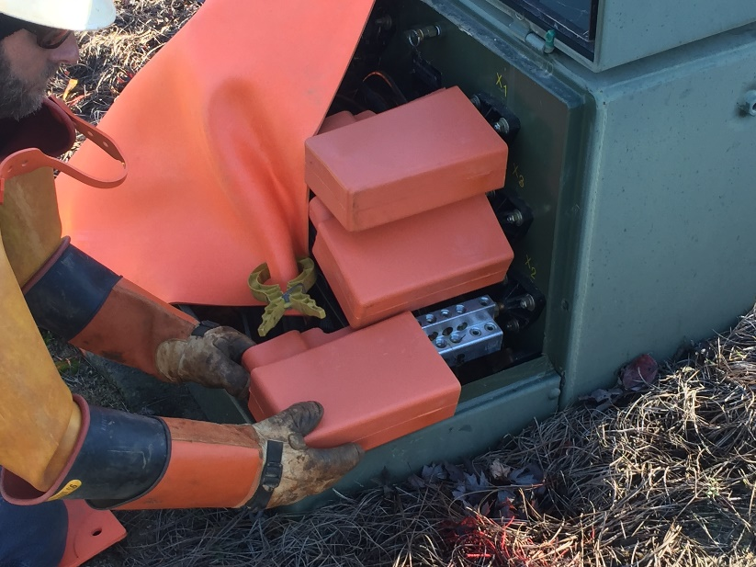
Defining/Utilizing Effective Cover Up
Effective Cover Up
We describe effective cover up as the strategic installation of phase-to-phase rated insulating protective cover on energized conductors and/or equipment with different potentials.
Difference of potentials is defined as when a lineman is within reaching distance or in areas extended by handling conductive objects.
Grounds, opposing phases
Notes:
Effective cover up is used to describe the installation of phase-to-phase rated insulating protective cover on energized conductors and/or equipment of different potentials when the lineman is within reaching distance or in areas extended by handling conductive objects. Cover up is only designed for brush contact. Cover up is not designed for direct contact between differences of potential.

Slide 22
FAQ’S- Lock to Lock
If I’m walking past the back of an open pad mounted transformer, do I need rubber insulating gloves and sleeves?
No, there is no exposure as long as the employee does not touch the cabinet.
Qualified Worker Within 5’ = Gloves & Sleeves

Slide 23
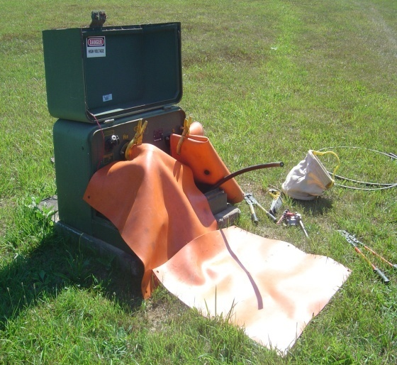
FAQ’S- Lock to Lock
Can insulating rubber gloves and sleeves be removed when terminating primary cable?
YES, under the following conditions:
After secondary bushings and primary terminations have been effectively covered
The cable being terminated has been tested & grounded on other end, or is not inside of an energized cabinet or transformer
The cable then can be pulled beyond the face of the transformer and rubber gloves and sleeves may be removed.

Slide 24
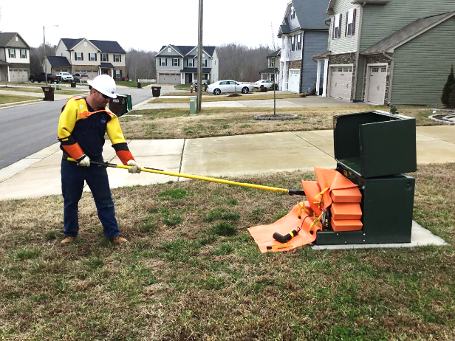
FAQ’S- Lock to Lock
Can I pull elbow terminations off by hands if I wear insulating rubber gloves and sleeves.
No, Live line tools shall be used for pulling elbows and switching in underground primary enclosures.

Slide 25
FAQ’S- Lock to Lock
Does this best practice apply when work will be performed with live line tools?
Yes, Insulating rubber gloves and sleeves shall be worn when opening and closing the padmount equipment regardless of the work practice to be conducted.
Additionally, if the initial assessment identifies noticeable hazards, gloves and sleeves shall be worn when unlocking the enclosure.

Slide 26
Review
When is lock to lock used?
Are there any exceptions to lock to lock? If so, what are those exceptions?
3. Are work methods including how to implement lock to lock required to be documented and communicated in job briefings?
4. When working in an energized padmount transformer, what conditions must be in place prior to terminating a primary cable?
Notes:
When is lock to lock used?
When employees are working on underground electrical equipment. This includes when the employee manipulates the enclosure’s door.
2. Are there any exceptions to lock to lock? If so, what are those exceptions?
If no physical, sensory or environmental condition is present during the hazard assessment that would necessitate the use of gloves and sleeves to unlock the lock, gloves and sleeves may be omitted for unlocking.
3. Are work methods including how to implement lock to lock required to be documented and communicated in job briefings?
Yes.
4. When working in an energized padmount transformer, what conditions must be in place prior to terminating a primary cable?
The secondary bushings and primary terminations have been effectively covered and the cable being terminated has been tested & grounded and the cable has been pulled beyond the face of the transformer.

