Slide 1
Isolate & Insulate
Continuing Education
1st Q 2023
Notes:
Introduce the module. Explain that the intent of this presentation is as a continuing education training topic related to certain aspects from the ET&D 10-Hour OSHA training class, the OSHA Partnership Best Practices, and/or incident trending analysis
As an organization we are dedicated to safety and the value it has on one’s livelihood of themselves and their families. It is important that “we” plan out and even rehearse (in our head) what our job responsibilities are before we do them to ensure we have thought of all the “what if this happens?” questions and implemented ways to eliminate and/or mitigate the potential for an injury or incident.
In August of 2021, the OSHA Partner Members conducted an injury analysis with the goal of investigating trends to eliminate fatal incidents occurring within the Electrical Transmission and Distribution Industry. Without going into many of the specifics:
They looked at 697 recordable events which is a 6% increase from the previous year in 2020.
Of these 697 cases it was found that Electrical Contact Events increased 130% from 2020 to 2021.
The two main areas identified as a potential failures or areas of improvement which resulted in these Electrical Contact Events were identified as; Insulate & Isolate Safety Performance Check & Insulate & Isolate Techniques for the Rubber Glove Method.

Slide 2
Never Second Guess Electrical Hazards! If there is any doubt,
STOP!
Consult a Supervisor, Journeyman and/or a Safety Professional
Notes:
4
4
4
4
4
There is always time to do the job the right way the first time.

Slide 3
Objectives
Upon completion of this continuing education module, you should be able to:
  Describe the difference between Isolate and Insulate
  Describe how current flowing through the body can cause injury
  Describe testing requirements for rubber goods and live-line tools
  Describe Minimum Approach Distance (MAD)
  Describe ways to Isolate and/or Insulate workers from electrical hazards
Notes:
5
5
5
5
5
Explain that this is the 1st Quarter 2023 topic. Explain the objectives of this course and the duration.

Slide 4
Key Safety Fundamental
To avoid hazardous differences in electrical potential:
Isolate yourself from the hazard
Insulate yourself from the hazard
Notes:
Explain that this is 1st Quarter 2023 Continuous Education topic. Explain that two methods of electrical protection are “insulate” and “isolate” with the third method of protection being equal potential grounding and bonding. This topic references the ET&D Insulate & Isolate Best Practice. Explain the intent is to provide information and aid workers, which may be exposed to hazardous differences in electrical potential in selecting protective measures.

Slide 5
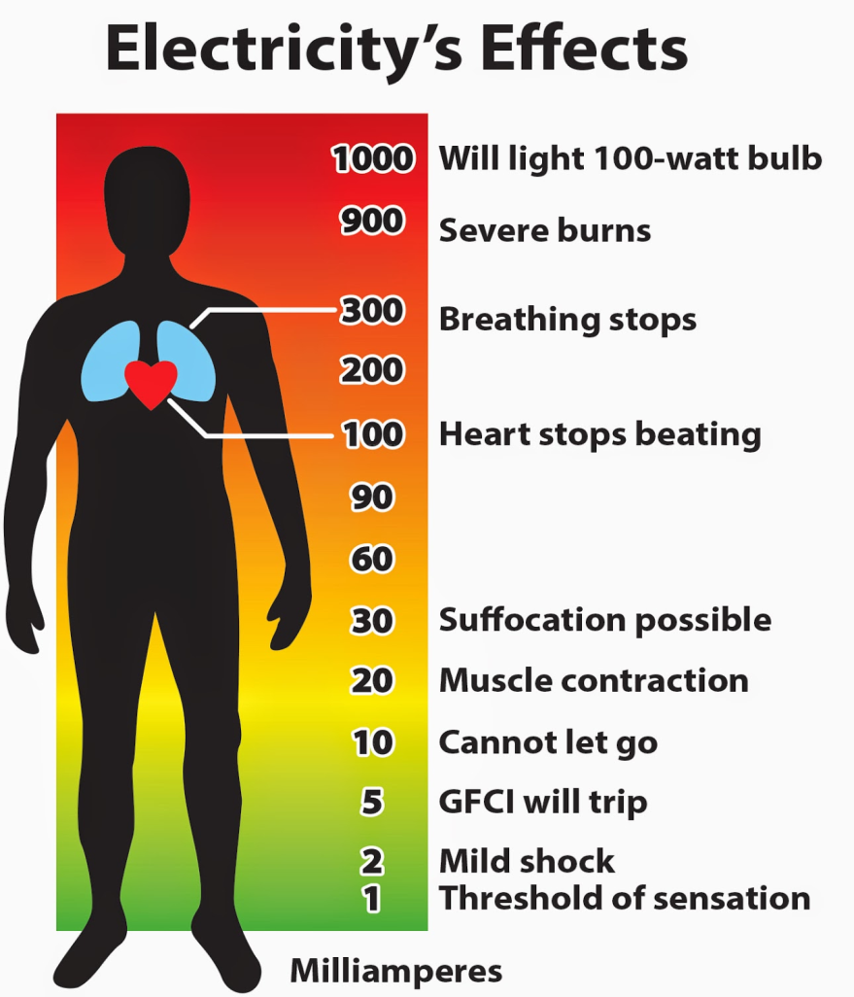
Facts
Each year workers are killed or seriously injured due to current flowing through their body
Notes:
Explain how increasing levels of current flow through the human body can have devastating results. As little as 100 milliamps (1/10 of an amp) can cause the heart to stop or go out of its normal rhythm.

Slide 6
Insulate
Notes:
Explain that the following section will Explain “Insulate”

Slide 7
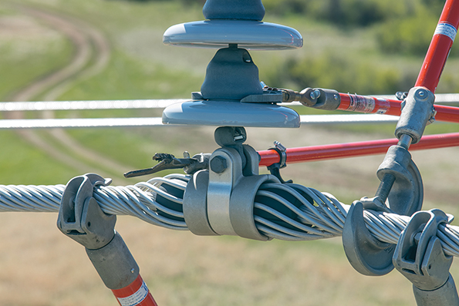
Insulated Defined
The IEEE defines Insulated as:
Separated from other conducting surfaces by a dielectric substance or air space permanently offering a high resistance to the passage of current
Live-line tools “insulate” the worker from the energized part
Notes:
5
5
5
5
5
Explain that insulated (from the IEEE dictionary) means: Separated from other conducting surfaces by a dielectric substance or air space permanently offering a high resistance to the passage of current and to disruptive discharge through the substance or space.
Note: The Institute of Electrical and Electronics Engineers (IEEE, pronounced I triple E) is a professional association formed in 1963 from the amalgamation of the American Institute of Electrical Engineers and the Institute of Radio Engineers. Today, it is the world’s largest association of technical professionals with more than 400,000 members in chapters around the world.

Slide 8
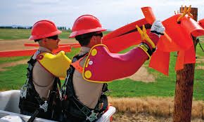
Insulated Defined
OSHA defines Insulated as:
Material relied upon to insulate the conductor from other conductors or conducting parts or from ground
Rubber goods “insulate” the worker from the energized part
Notes:
5
5
5
5
5
Explain that insulated (from 29 CFR Subpart V, §1926.968) means: Insulation (cable). Material relied upon to insulate the conductor from other conductors or conducting parts or from ground.
Explain that rubber goods insulate the worker from the energized part.

Slide 9
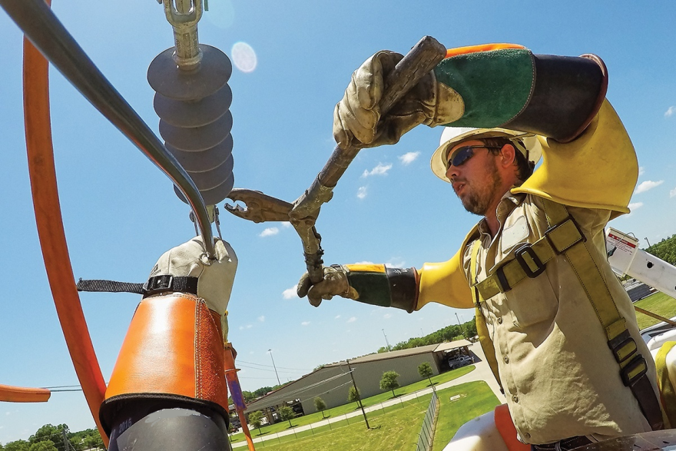
ET&D Best Practice
When working on primary conductors utilizing the Gloving Method:
The worker wears insulated rubber gloves and sleeves
Notes:
5
5
5
5
5
Explain that when working on primary conductors utilizing the “Rubber Gloving Method”, the line worker has a double insulation system built into the safe work practices with a “Best Practices” system.

Slide 10
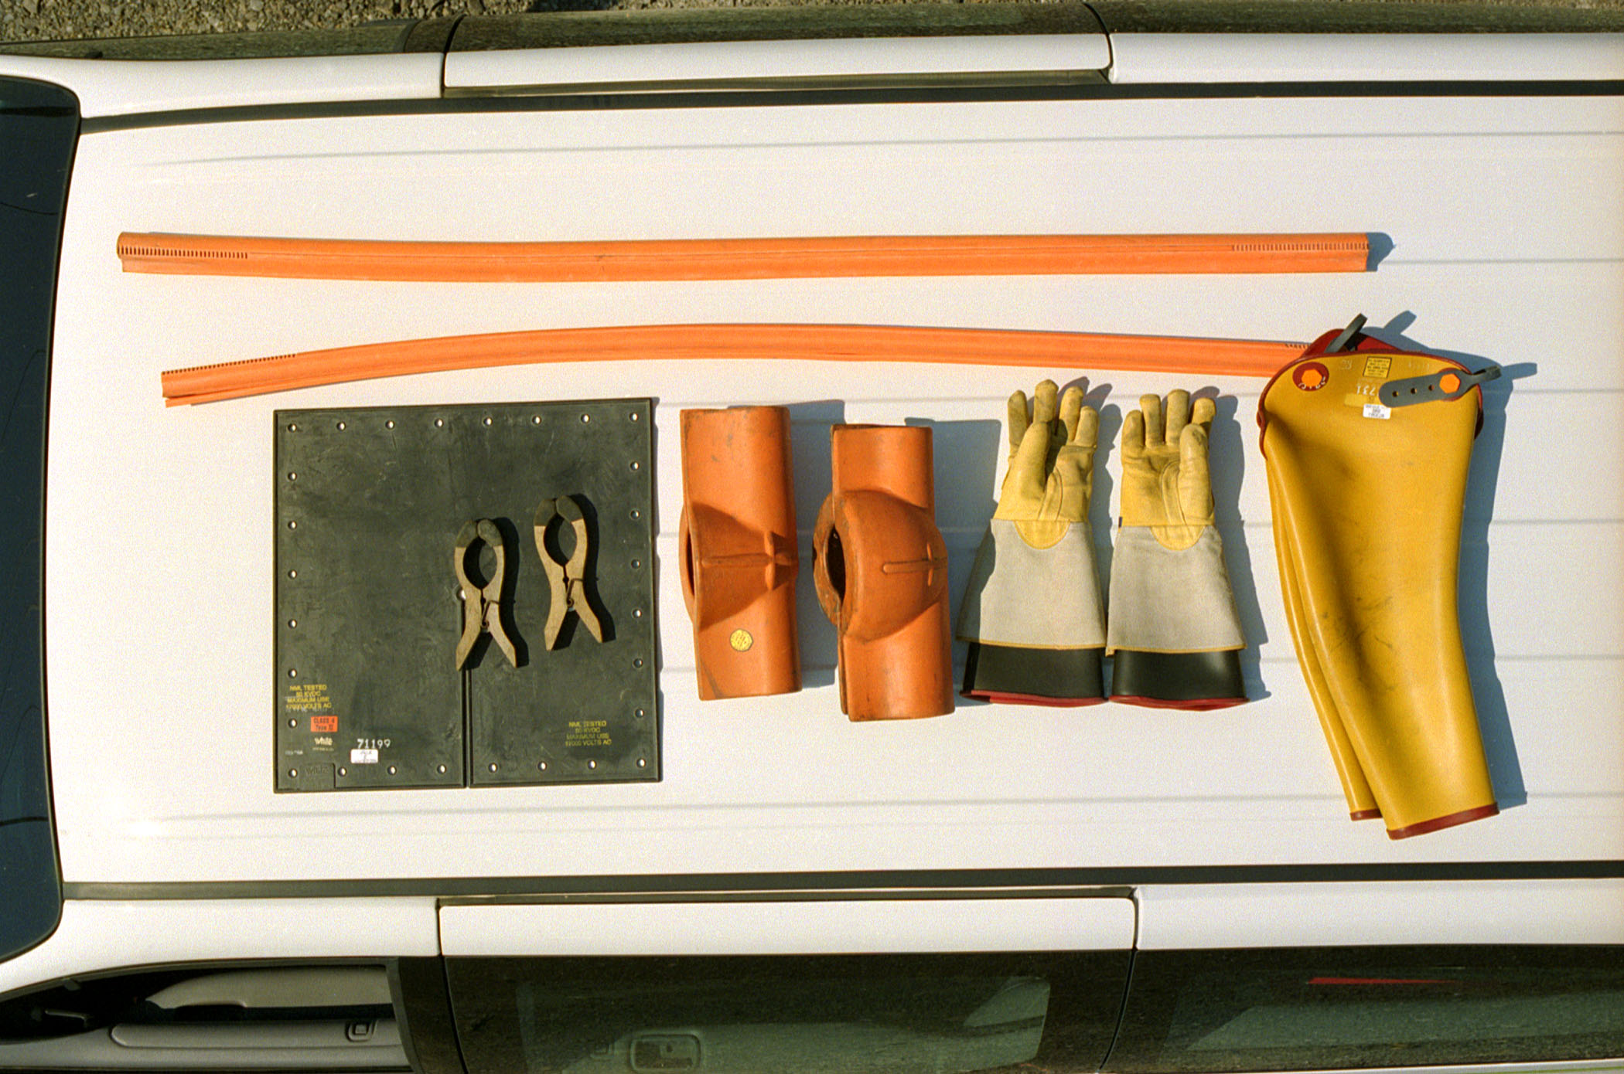
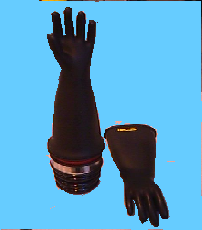
Rubber Gloves and Rubber Sleeves
Rubber gloves must be worn when working on equipment energized at 50 volts or more.
Rubber Glove ratings:
  Class 0 -up to 1,000V AC and 1,500V DC
  Class 1 protects workers up to 7,500V AC and 11,250V DC
  Class 2 protect workers up to 17,000V AC and 25,500V DC
  Class 3 protects workers up to 26,500V AC and 39,750V DC
Sleeves shall be worn in the primary area.
Notes:
Sleeves shall be worn by workers in the primary zone and in any situation where arm contacts with energized conductors or equipment are possible while reaching into congested areas, or where suitable barriers cannot be provided while working on energized conductors or equipment.

Slide 11
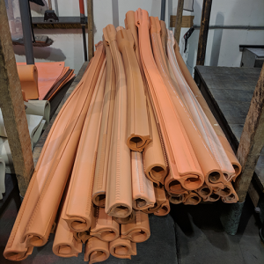
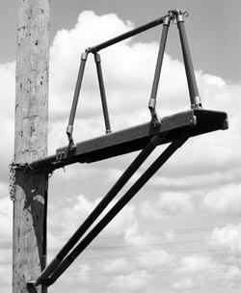
Insulate Defined
The “back-up” systems to a lineworker's insulated rubber gloves are:
  An insulated platform
  An insulated boom
  Insulated covering material
Notes:
5
5
5
5
5
Explain that the ET&D “Insulate & Isolate” Best Practice states the following:
Insulated: (1) The use of Insulated Protective Equipment (IPE) to protect the line worker while gloving energized lines/equipment.
Insulating Personal Protective Equipment (IPPE): Rubber Gloves and Sleeves.
Insulating Protective Equipment (IPE): rubber blankets, rubber line hose, rubber hoods, plastic covers, etc.

Slide 12
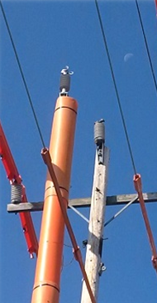
Benefit
Insulating tools, equipment, and safe work practices allow a worker to safely work on, and around energized equipment and conductors
Notes:
5
5
5
5
5
Explain that Insulating tools, equipment, and work methods allow a worker to work safely on, and around energized equipment and conductors
End of session 1

Slide 13
Key Points-Session one
Define Insulate.
  To cover with a material relied upon to insulate the conductor from other conductors or conducting parts or from ground.
  To remove the system from normal potentials.
  To remove the person from the exposure.
As little as ______________ milliamps can cause the heart to stop or go out of its normal rhythm.
  10
  100
  1,000
Never Second Guess Electrical Hazards.
  True
  False
Notes:
5
5
5
5
5
The presenter should have touched on the following items when Explaining session one:
1. Define Insulate.
a. To cover with a material relied upon to insulate the conductor from other conductors or conducting parts or from ground.
b. To remove the system from normal potentials.
c. To remove the person from the exposure.
As little as ______________ milliamps can cause the heart to stop or go out of its normal rhythm.
a. 10
b. 100
c. 1,000
3. Never Second Guess Electrical Hazards.
a. True
b. False

Slide 14
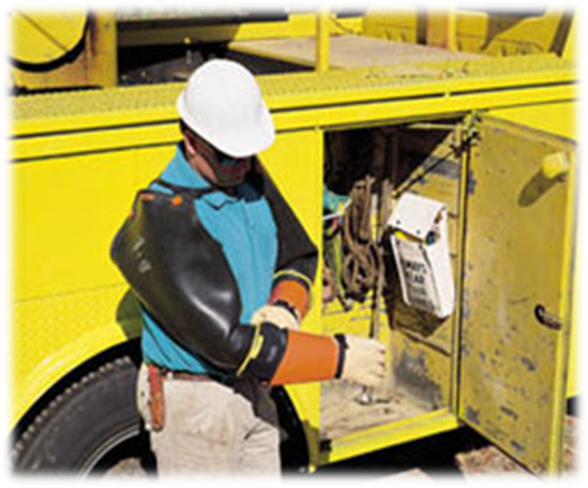
Insulating Personal Protective Equipment (I.P.P.E.)
Shall be inspected prior to each use
Applicable service dates and voltage rating shall be observed
Insulating rubber gloves shall be given an air test by a qualified user
Insulating rubber sleeves shall be inspected by a qualified user
Gloves shall be air tested prior to each use.
Notes:
5
5
5
5
5
Explain that when inspecting rubber gloves and sleeves one must look for any/all the following possible issues:
Holes
Tears
Cuts
Punctures
Crazing
Ozone damage
Cracking
Deformation
Petroleum damage
Current inspection date
Any condition that may cause the user to be suspect of the insulating value of the gloves or sleeves. Explain that inspecting the leather protectors is equally as important as inspecting the rubber gloves. Protectors that may contain embedded splinters or metal slivers can damage the rubber glove. In addition, protectors that are soaked or impregnated with a petroleum product can cause damage as well.

Slide 15
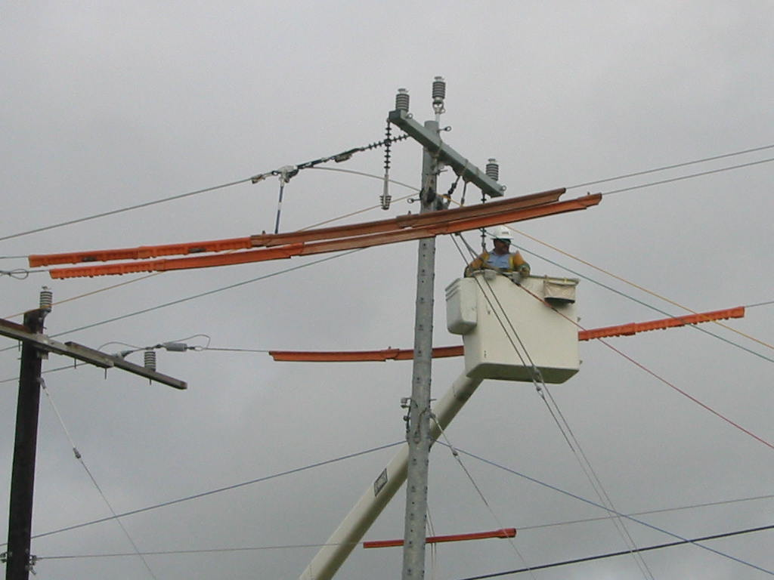
Insulating Equipment
Secure the work area
Remove all hazards
Protect workers from those hazards that cannot be eliminated
Notes:
Explain that protective cover should be installed to provide protection from accidental contact. All the areas that the conductor tails could contact are protected by line cover material.

Slide 16
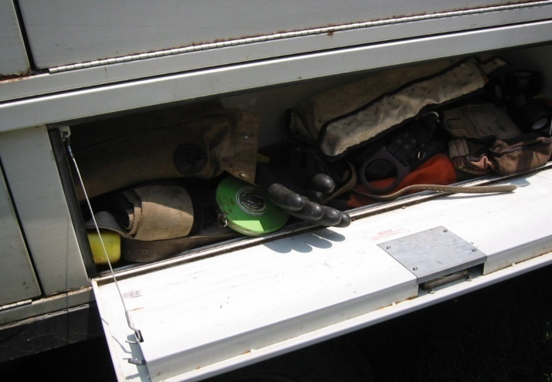
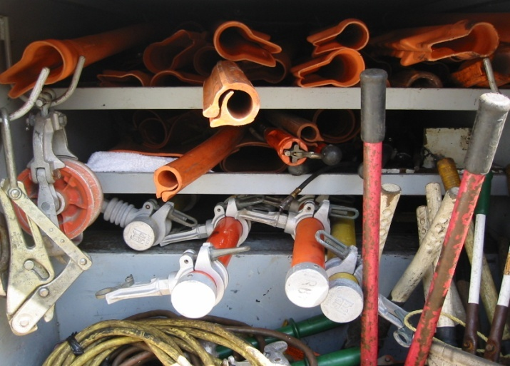
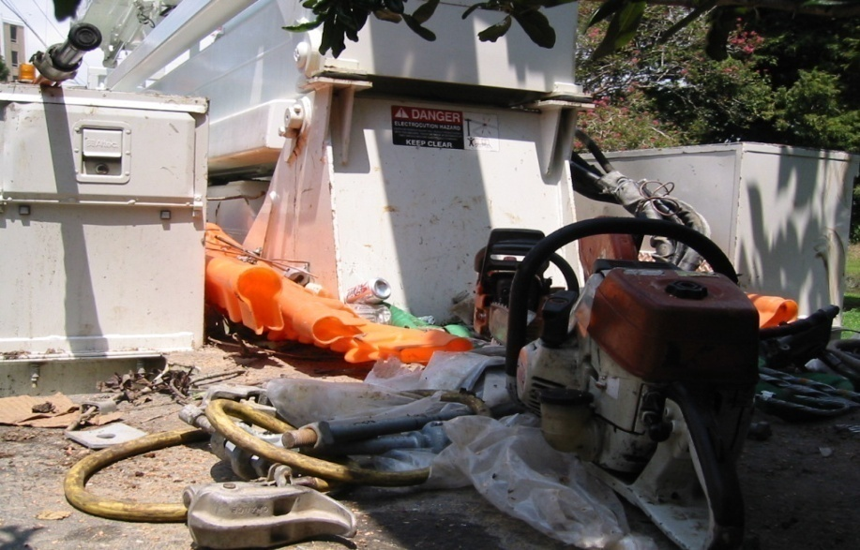
Proper Care & Storage
Rubber insulating equipment and hot line tools must be stored in a manner that they cannot be damaged
Ø
Notes:
Explain that the OSHA standards require that we store protective equipment in a way it cannot be damaged. Gloves should be stored cuff first in protective bags. Hot sticks should be stored in bags or tubes to prevent them from being damaged.

Slide 17
Dielectric Test
Equipment | Inspection | Die-Electric Test
Rubber Glove | Prior to Use | Once Every 6 Months
Rubber Sleeve | Prior to Use | Once Every 12 Months
Rubber Blanket | Prior to Use | Once Every 12 Months
Rubber Hose, Hoods etc. | Prior to Use | When there is reason to suspect integrity
These are the minimum requirements required by OSHA. Company policy, client and/or contract requirements may mandate shorter inspection cycles
Notes:
5
5
5
5
5
Explain that these are the minimum requirements required by OSHA. Company policy, client, and/or contract requirements may exceed these inspection cycles. Explain that if there is any reason to be suspect that the insulating ability of any rubber protective equipment is suspect, remove the equipment from service, and have it dielectrically tested.

Slide 18
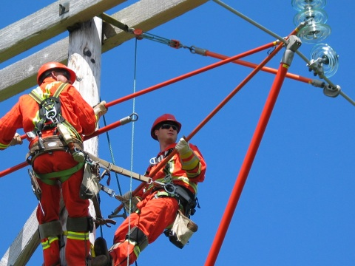
Live-Line Tools
Minimum approach distance must be maintained
The worker’s hand
The hot end of the stick
Notes:
Explain that the key to live-line tools is the minimum approach distance, cleanliness and tested tools. The minimum approach distance shall always be observed. Live line tools are built to a standard of 100,000 volts per foot of fiberglass stick. The OSHA standards require that all sticks pass a wet test.

Slide 19
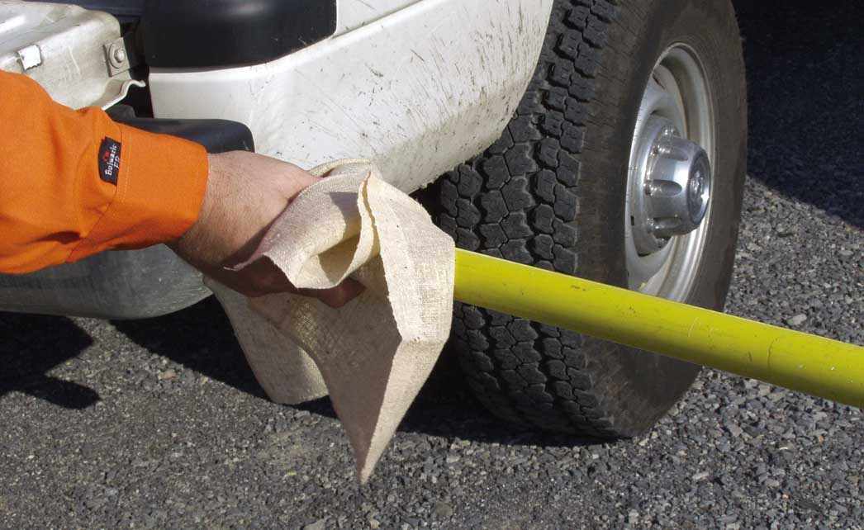
Live-Line Tools
Live-line tools shall be removed from service every 2 years for examination, cleaning, repair, testing and labeling
Notes:
Explain that all live-line tools must be checked for proper test date, physical wear, and be wiped down prior to use.

Slide 20
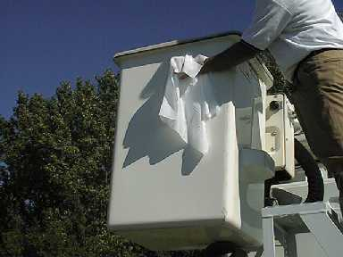
Live-Line Tools
Each live-line tool shall be wiped clean and visually inspected for defects before use each day
Would you do hot work with dirty sticks?
Is an insulated boom any different?
Notes:
Explain that the boom of an insulated aerial lift should be wiped down and clean. This helps insure the insulating value of the boom.

Slide 21
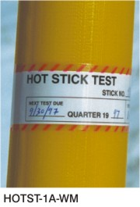
Live-Line Tools
Test the tool's integrity along its entire working length
If the tool is made of fiberglass-reinforced plastic, test its integrity under wet conditions
Notes:
Explain that the OSHA standards require that at a minimum live-line tools used for primary employee protection shall be removed from service every 2 years, for examination, cleaning, repair, and testing as follows:
Each tool shall be thoroughly examined for defects.
If a defect or contamination that could adversely affect the insulating qualities or mechanical integrity of the live-line tool is found, the tool shall be repaired and refinished or shall be permanently removed from service.

Slide 22
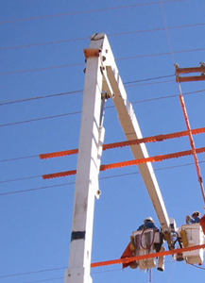
Second Point of Contact
If any part of a boom can contact an energized phase, cover the phase
Notes:
This is a great example of covering the area below the bucket. Booms should not contact energized parts.

Slide 23
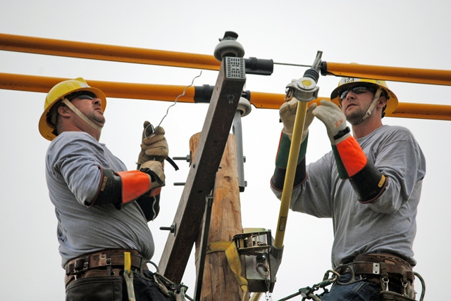

Second Point of Contact
Eliminate second point of contact hazards
  Cross arm not covered
  Workers not wearing sleeves
  Minimum approach distance violation on tie-wire
Notes:
Explain that in this picture there are numerous concerns. The cross arm is not covered. The arm represents a second point of contact. Neither line worker is wearing rubber insulating sleeves.
The ET&D Best Practice states in regards to Worker Positioning for I&I Techniques:
Correct positioning of the worker when applying rubber goods is of utmost importance. You cannot work near or adjacent to a conductor that is uncovered if it is within your extended reach until it is covered. For determining correct position, an employee can use their rubber-gloved hand as a measuring device. An employee shall NEVER turn his or her back on an uncovered energized conductor or any energized part of equipment when they are within extended reach of that equipment.

Slide 24
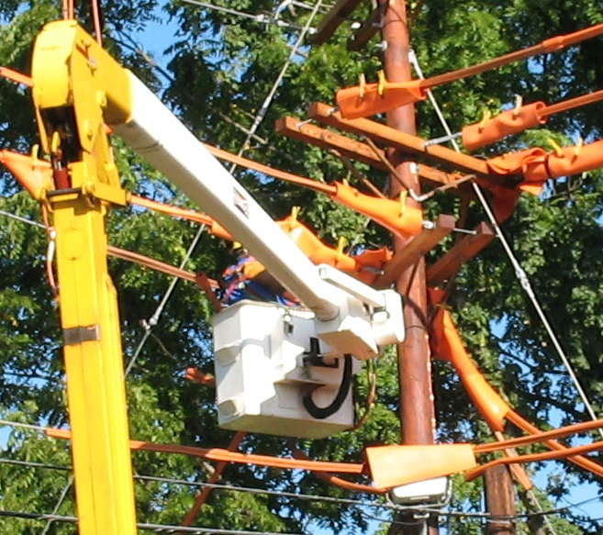
Second Point of Contact
Second points of contact include:
Pole
Cross arm
Open spot in cover
Guy wires
Other phases/Neutral
Notes:
This is a great example of covering the area below the bucket. Explain that this is an excellent example of using line cover material to secure the work area. Notice that the blankets are wrapped around the energized parts to eliminate any second points of contact.
Key points‐Session two
The presenter should have touched on the following items when Explaining session one:
1. List some items to look for when inspecting rubber gloves and sleeves.
a. Holes e. Ozone damage i. Crazing
b. Punctures f. Deformation
c. Current inspection date g. Cuts
d. Tears h. Cracking
2. According to OSHA, rubber-insulating gloves are required to be electrically tested at least every ______________ months.
a. 3 b. 6 c. 12 d. 24
3. Live-line tools are required to be removed from service and inspected every ____________
a. Month b. Year c. Two years d. Five years
4. An employee shall NEVER turn his or her back on an uncovered energized conductor or any energized part of equipment when they are within extended reach of that equipment.
a. True b. False

Slide 25
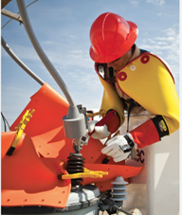
Second Point of Contact
Covering Second Points of Contact when working on energized Overhead Transformers.
Notes:
This is a great example of covering all potential second points of contact when working on energized transformers. Notice that the blankets are wrapped around the energized parts to eliminate any second points of contact.
End session two
Key points‐Session two
The presenter should have touched on the following items when Explaining session one:
1. List some items to look for when inspecting rubber gloves and sleeves.
a. Holes e. Ozone damage i. Crazing
b. Punctures f. Deformation
c. Current inspection date g. Cuts
d. Tears h. Cracking
2. According to OSHA, rubber-insulating gloves are required to be electrically tested at least every ______________ months.
a. 3 b. 6 c. 12 d. 24
3. Live-line tools are required to be removed from service and inspected every ____________
a. Month b. Year c. Two years d. Five years
4. An employee shall NEVER turn his or her back on an uncovered energized conductor or any energized part of equipment when they are within extended reach of that equipment.
a. True b. False

Slide 26
Key Points-Session two
List some items to look for when inspecting rubber gloves and sleeves.
  Holes, Tears, Cuts, Punctures
  Crazing, Ozone damage, Cracking
  Deformation, Petroleum damage, Current inspection date
  All the above
According to OSHA, rubber-insulating gloves are required to be electrically tested at least every ______________ months.
  2
  4
  6
Live-line tools are required to be removed from service and inspected every ____________ years.
  2
  4
  6
Notes:
5
5
5
5
5
The presenter should have touched on the following items when Explaining session one:
List some items to look for when inspecting rubber gloves and sleeves.
a. Holes, Tears, Cuts, Punctures
b. Crazing, Ozone damage, Cracking
c. Deformation, Petroleum damage, Current inspection date
d. All the above
According to OSHA, rubber-insulating gloves are required to be electrically tested at least every ______________ months.
a. 2
b. 4
c. 6
Live-line tools are required to be removed from service and inspected every ____________ years.
a. 2
b. 4
c. 6

Slide 27
Isolate
Notes:
Explain that the following section will Explain “Isolate”

Slide 28
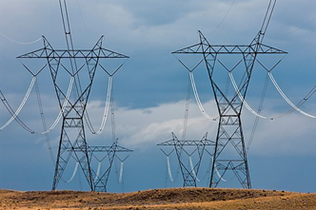


Generally Speaking
You may consider a system, circuit, and/or apparatus isolated when it is physically and mechanically removed from normal sources of potential
The key word here is Normal source
Induction is an Abnormal source
Induction
Notes:
Explain that even though switches may be opened, jumpers may be lifted, and breakers may be open, none of these will prevent induced voltages from parallel or adjacent energized lines, equipment failure, and/or a lightning strike.

Slide 29
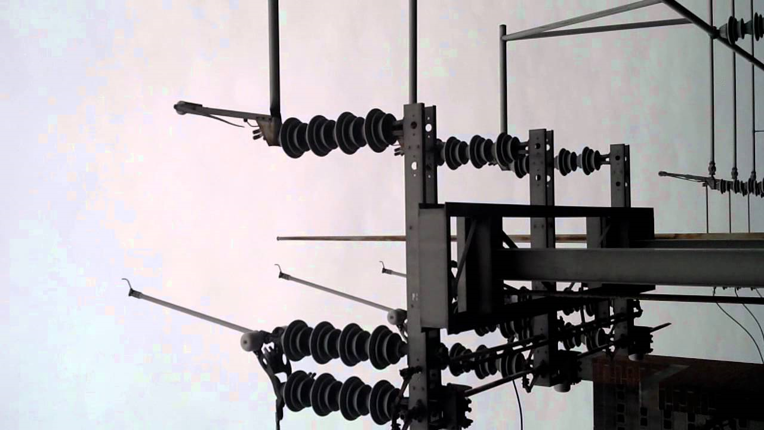
Isolate Defined
Physically separated, electrically and mechanically, from all sources of electrical energy
  Such separation may not eliminate the effects of electrical induction!
Notes:
Explain that according to the IEEE isolated means: (A) physically separated, electrically and mechanically, from all sources of electrical energy. Such separation may not eliminate the effects of electrical induction.

Slide 30
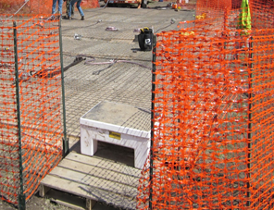
Isolate Defined
Not readily accessible to persons unless special means for access are used
Notes:
Explain that according to the IEEE another aspect of “isolated” means: Not readily accessible to persons unless special means for access are used. In this picture, the two fences (inner and outer) are there to isolate employees on the outside of the fence from contacting people or equipment on the inside of the fence. The dedicated access/egress path shown in the picture limits the entry/exit points.

Slide 31
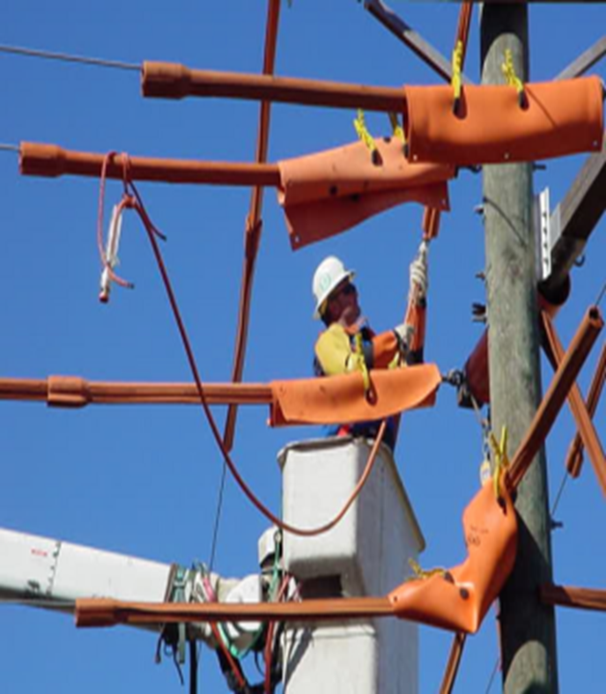
Primary Voltage Rule
Never work on more than one phase at a time
  If you are not working on a adjacent phase or conductor, it should be covered by approved insulating material
Notes:
ET&D Best Practice defines Isolate as:
A primary rule of line work is that a line worker never works on more than one phase at a time (neutral included). Therefore, if you are not working on an adjacent phase or conductor, it should be covered by approved insulating material (line hose, rubber blankets, etc.).
The extent of this covering is defined as Extended Reach. Extended reach is a minimum safe work distance determined by a phase-to-phase voltage range.
When working with jumpers, tools, chains, conduit or cable slings etc., the employee’s reach is extended the full length of the equipment. When employees are handling any such equipment, they shall barricade, properly cover or maintain a safe working distance that will include any tools, material, or equipment that the worker may be holding.
SECONDARY EXTENDED REACH: Secondary voltage is rated at 600 volts and below. Extended reach in this voltage range is the furthest distance that an employee can reach with either the rubber gloved hand, or tools held in that hand.
PRIMARY EXTENDED REACH: Primary voltages typically range between 2.1kV and 35kV, which mandates a minimum safe work distance. This distance is measured from the furthest point an employee can reach to the nearest energized conductor or equipment plus the applicable Minimum Approach Distance (this is based on the voltage classification and phase to ground or phase to phase type of exposure).
When working with any tools or equipment, the employee’s extended reach would be the workers reach plus the length of that tool or piece of equipment/material plus the applicable MAD.

Slide 32
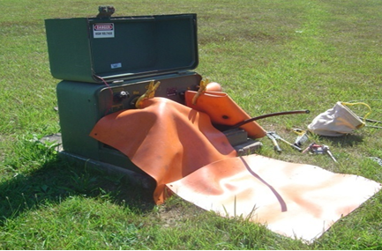
Determine Minimum Approach
The employer must determine minimum approach distance
  Engineering analysis
  Customer requirements
  OSHA tables
Notes:
Explain that OSHA mandates that depending on the voltage involved, workers must maintain certain minimum approach distances from energized parts.

Slide 33
Minimum Approach Distance
MAD
Lineworker’s must maintain the minimum approach distance from exposed energized parts
E
Energized Part
Ergonomic Component
Notes:
Explain that OSHA requires that the employer shall ensure that no employee approaches or takes any conductive object closer to exposed energized parts than the employer's established minimum approach distance, unless:
The employee is insulated from the energized part
The energized part is insulated from the employee and from any other conductive object at a different potential, or
The employee is insulated from any other exposed conductive object in accordance with the requirements for live-line bare-hand work.
Another point to explain is the requirement that the employer ensures that workers do not work in a position that if the worker were to slip and/or fall they could contact an energized part.

Slide 34

Ergonomic Component
Employees should be able to perform all of the following actions without straying into the minimum approach distance:
  Adjust his or her hardhat
  Maneuver a tool onto an energized part with a reasonable amount of overreaching or under reaching
  Reach for and handle tools, material, and equipment passed to him or her
  Adjust tools, and replace components on them, when necessary, during the work procedure
Notes:
Explain that the ergonomic component of the minimum approach distance accounts for errors in maintaining the minimum approach distance (which might occur, for example, if an employee misjudges the length of a conductive object he or she is holding), and for errors in judging the minimum approach distance. The ergonomic component also accounts for inadvertent movements by the employee, such as slipping. In contrast, the working position selected to maintain the minimum approach distance must account for all of an employee's reasonably likely movements and still permit the employee to adhere to the applicable minimum approach distance. Reasonably likely movements include an employee's adjustments to tools, equipment, and working positions and all movements needed to perform the work.
Explain that OSHA requires that the employer shall ensure that no employee approaches or takes any conductive object closer to exposed energized parts than the employer's established minimum approach distance, unless:
The employee is insulated from the energized part
The energized part is insulated from the employee and from any other conductive object at a different potential, or
The employee is insulated from any other exposed conductive object in accordance with the requirements for live-line bare-hand work

Slide 35


Slide 36
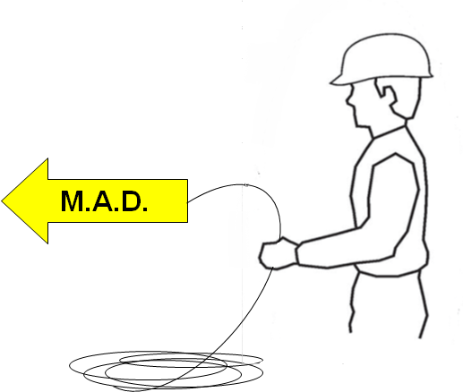
Conductive Objects
Minimum Approach Distance starts at the end of a conductive object held in the hand
Notes:
Explain that line cover must be installed in such a manner that all exposed energized parts are covered so that conductive objects held by the line worker cannot contact the energized part.
Another way to explain Minimum Approach Distance is to change slightly the meaning of M.A.D. One can say that MAD stands for Minimum Air Distance, or the minimum amount of air that needs to be between a conductive object like a worker and an energized part.

Slide 37
Wrap-up
  Isolate workers from hazardous potentials or Isolate hazardous potentials from the worker by:
    Removing the energized part from normal sources of potential via Open Switches, Remove Jumpers, Open Breakers, Maintain Minimum Approach Distance, Limited Access (i.e. Barricades)
To protect workers from hazardous differences in electrical potential a worker can Insulate from the hazard by using:
    Cover up, Insulating Gloves & Sleeves, Live-Line Tools, Insulated Booms
Notes:
Simply stated, the Insulate & Isolate best practice means that you may only have one conductor uncovered at any time. Examples of this are, but not limited to:
If an employee is working on B phase, the neutral, A and C phase, and all grounds in the M.A.D. zone (extended reach) must be covered with insulating cover approved for the given voltage classification.
If an employee is working on a ground or the neutral, all phases within extended reach (in the M.A.D. zone) must be covered with insulating cover approved for the given voltage classification.

Slide 38
Key Points-Session three
Define Isolate.
  Physically separated physically and mechanically, from all sources of electrical energy.
  Grounded and de-energized.
  Covered with line hose.
To what does the “Ergonomic Component” of minimum approach distance (MAD) refer?
  A comfortable working position.
  Necessary movements required to perform a job task.
  To use vibration resistant tools.
Employers must ensure that employees do not work in a position that if the worker slipped or fell the worker could contact an energized part.
  True
  False
Notes:
Key points‐Session three
The presenter should have touched on the following items when Explaining session one:
Define Isolate.
Separated physically and mechanically, from all sources of electrical energy.
Grounded and de-energized.
Covered with line hose.
To what does the “ergonomic component” of minimum approach distance (MAD) refer?
A comfortable working position.
Necessary movements required to perform a job task.
To use vibration resistant tools.
Employers must ensure that employees do not work in a position that if the worker slipped or fell the worker could contact an energized part.
True
False

