Slide 1
Qualified Observer Continuing Education 2ND Quarter 2022
Notes:
Introduce the module. Explain to the group that this module will address the definitions and best practices within the role of “Qualified Observer” and “Critical Task”.

Slide 2
INTRODUCTION
Across our industry, a wave of unfortunate incidents has been piling up, many of which could have been avoided with proper use of a Qualified Observer.

Slide 3
PURPOSE
This presentation is designed to clearly outline the roles, responsibilities, and expectations of the Qualified Observer, for employees engaged in power transmission and distribution work.
Students will define qualified observer and identify the key characteristics of this role. Trainees will evaluate qualified observer actions in several situations. Finally, trainees will recognize how to schedule critical tasks in a manner that supports the key duties of a qualified observer.

Slide 4
Objectives
Define the role of a Qualified Observer
Who can be a Qualified Observer?
When is a Qualified Observer required?
What is a Critical Task?
Plan for critical tasks as a qualified observer (roles and responsibilities)

Slide 5
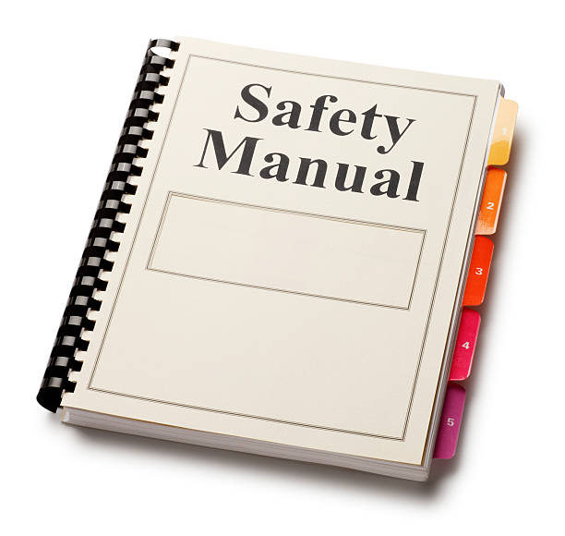
ET&D Partnership Best Practices
While most companies cover this within their corporate safety manuals, the content included herein is considered “industry best practices” by the ET&D Partnership.

Slide 6
ET&D Partnership Best Practices
The Partnership is committed to defining roles, responsibilities and expectations for the Qualified Observer (QO).
The material presented here will include the Partnership’s assessment of industry-wide “best practices”, not associated with any particular company policy.

Slide 7
What is a Qualified Observer?
An electrically qualified worker that can identify all hazards present to the crew working energized conductors. The Qualified Observer shall be capable of:
Distinguishing exposed live parts.
Identify nominal voltages
Determine minimum approach distances
Knowing safe work practices for working on, or near, energized lines and equipment
Recognize electrical hazards to which workers will be exposed and skills and techniques to control those hazards
Rendering immediate assistance in case of an accident

Slide 8
What is a Qualified Observer?
The list of capabilities of the Qualified Observer is dynamic and could change depending on the unique factors of a given scenario.
A qualified observer shall not have/conduct any other duties or be distracted unless the crew being observed has stopped work and is outside MAD.

Slide 9
“Qualified Observer” Versus “Spotter”
Recent incidents within our industry have indicated that there exists a degree of confusion between the roles of a Qualified Spotter and a Qualified Observer.
The next slide shows a simple definition which separates the two roles:

Slide 10
“SPOTTER”
A spotter is an employee that serves as an extra set of eyes to assist and direct drivers, equipment operators and individual workers. Besides making sure that a piece of equipment or vehicle that's moving doesn't run into anything or anyone, spotters may also pay attention to personnel, cranes and other equipment in tight spots, or when there is poor visibility.
A spotter is not to be confused with a Qualified Observer.

Slide 11
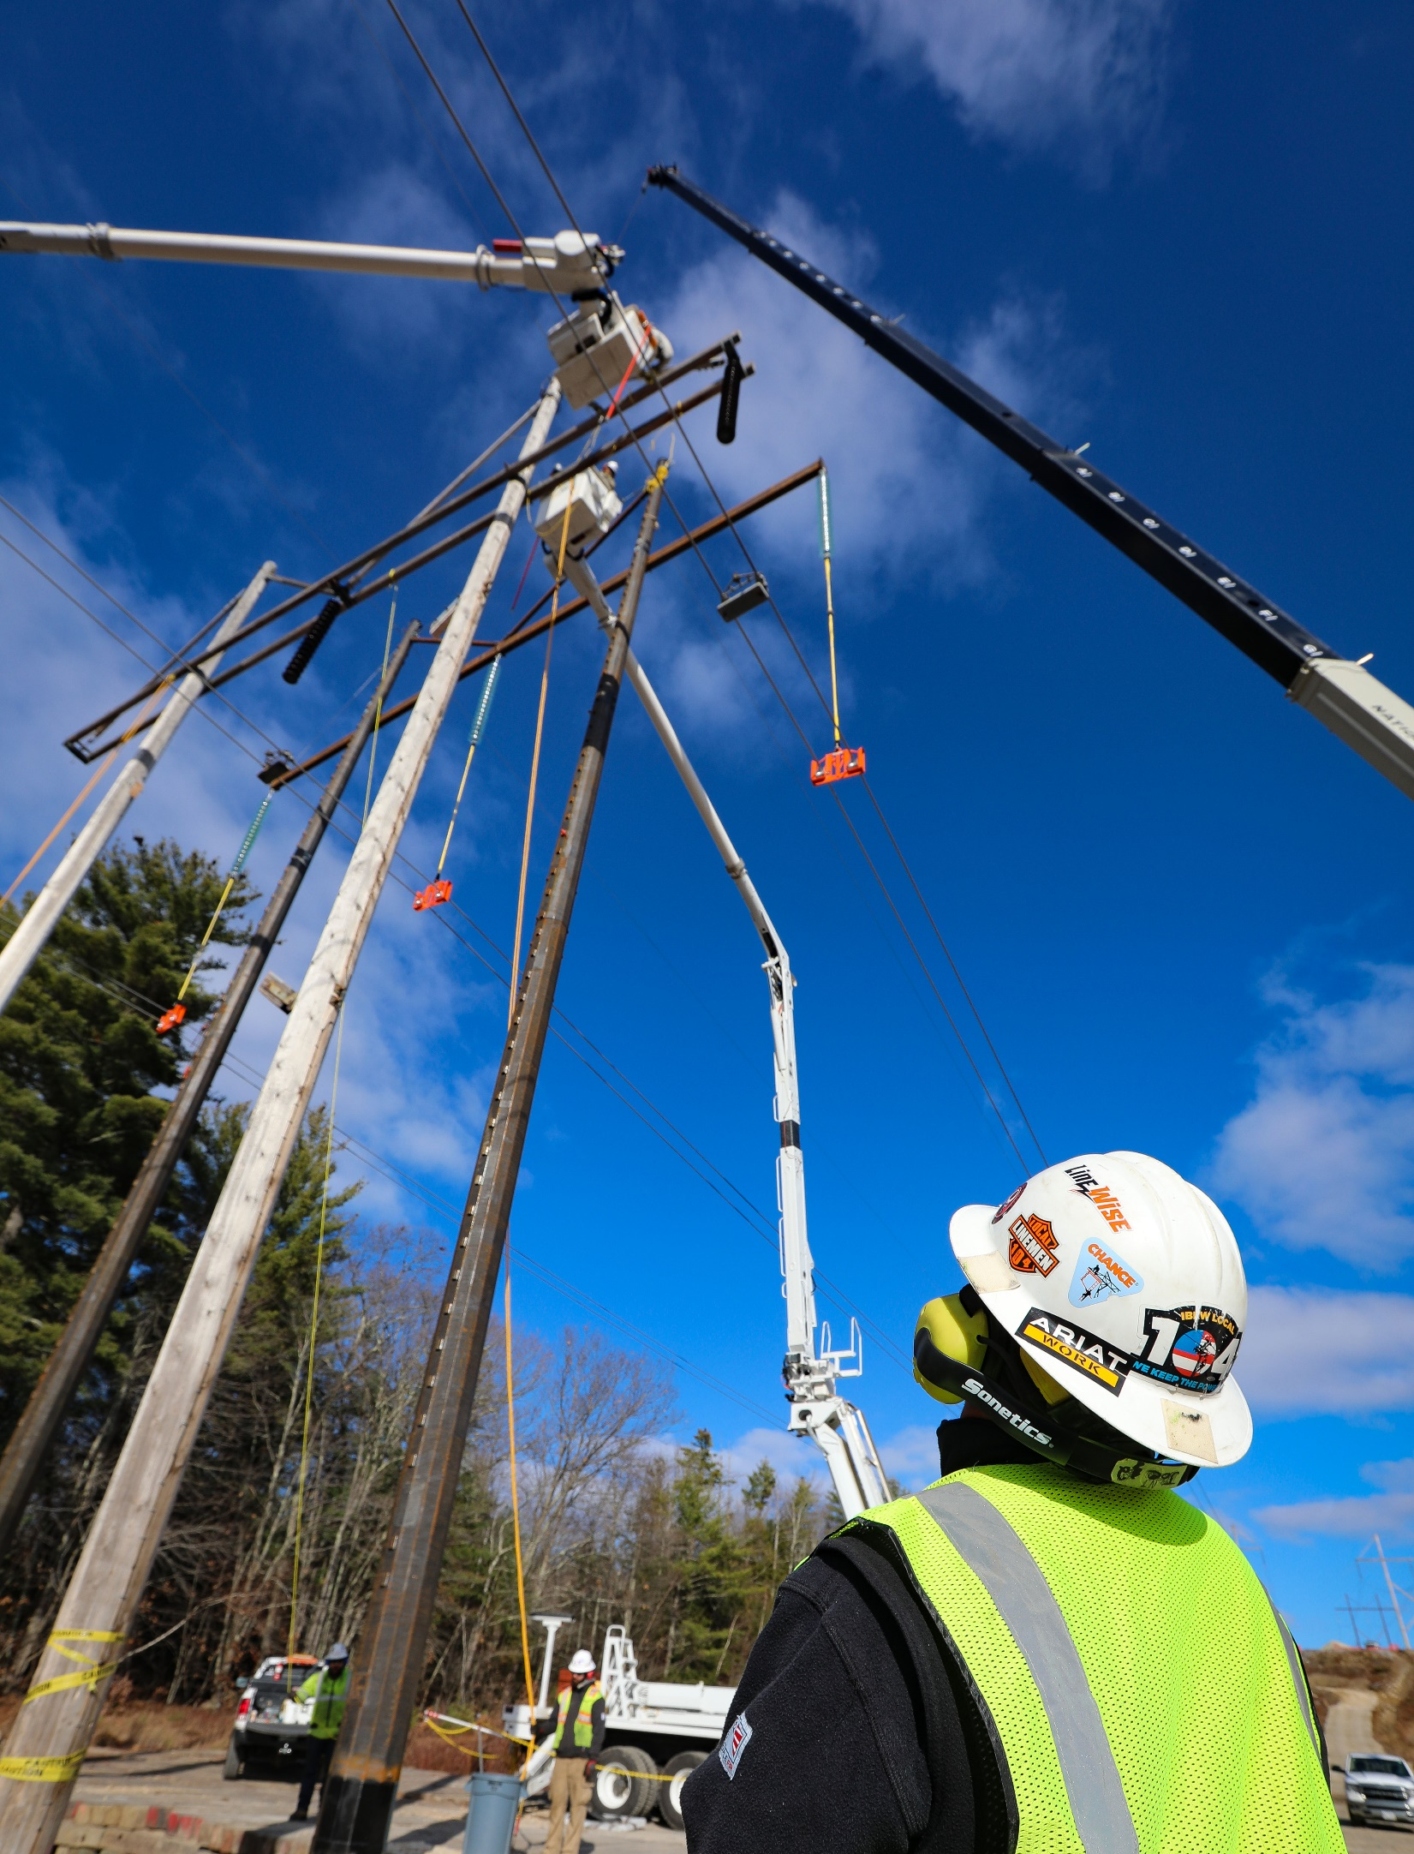
Who can be a Qualified Observer?
An experienced and competent person on the crew can serve as Qualified Observer. Usually, senior Journeyman Lineman make the best observers.
Any crew member that meets the criteria of qualified observer may fulfill the duty of the Qualified Observer.

Slide 12
Criteria of a Qualified Observer:
The Qualified Observer shall be capable of:
Distinguishing exposed live parts.
Identify nominal voltages
Determine minimum approach distances
Knowing safe work practices for working on, or near, energized lines and equipment
Recognize electrical hazards to which workers will be exposed and skills and techniques to control those hazards
Rendering immediate assistance in case of an accident

Slide 13
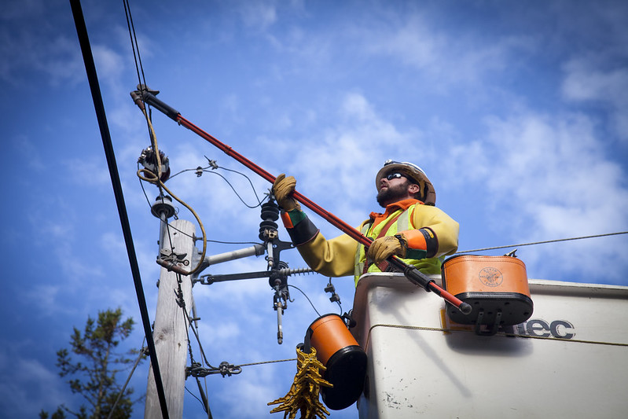
When is a Qualified Observer Required?
Any time we are performing a Critical Task.
Critical Task can be thought of as a task involving a Critical Step.
Critical Step: A step or action that must be performed correctly to avoid adverse consequences or cause irreversible harm to equipment or people (the point of no return)

Slide 14
Critical Task vs. Critical Step
In the same way that the definition of “Qualified Observer” may differ between companies, the idea of a “Critical Task” may also depend on interpretation or specific scenarios. For purposes of establishing “when” a Qualified Observer is needed, it’s important to emphasize that this usually falls into play when a step or action must be performed correctly to avoid adverse consequences or cause irreversible harm to equipment or people. In other words, ‘’the point of no return”.
Therefore, as a recognized industry best practice, performing a Critical Step should require a Qualified Observer.

Slide 15
Defining Critical Task
There might be scenarios where defining the “Critical Task” is subjective.
However (generally speaking) the examples on the next slide should serve as a baseline for identifying “critical tasks”.
NOTE: THIS IS NOT AN ALL-INCLUSIVE LIST; THESE ARE EXAMPLES.

Slide 16
Critical Task – (8) Examples
Activities with Critical Steps as defined on the Foreman’s Daily Job Briefing (DJB)
Installing I&I cover prior to commencing energized work.
Handling and moving energized conductors, including mechanical bypass jumpers.
Installing grounds and establishing EPZ (when in proximity to energized circuits)

Slide 17
Critical Task – (8) Examples
For all Live Line Bare Hand work (Transmission voltages)
For all Hot-Stick work (Transmission voltages).
Wire Stringing (where standard spotters may be inadequate, such as stringing over energized substations).
When approaching MAD clearances with non-insulated equipment (i.e. boom, drillers, winch lines)
REMINDER: THIS IS NOT AN ALL-INCLUSIVE LIST; THESE ARE EXAMPLES.

Slide 18
ROLES & RESPONSIBILITIES of the QUALIFIED OBSERVER
The Q.O. must act primarily as an observer for the purpose of preventing an accident. This includes:
Verifying Daily Job Briefings include clear identification of critical task to be observed.

Slide 19
ROLES & RESPONSIBILITIES of the QUALIFIED OBSERVER
The Q.O. must act primarily as an observer for the purpose of preventing an accident. This includes:
Assuring procedure adherence:
Insulate & Isolate procedures followed (Effective cover-up on energized conductors or equipment, correct PPE is used).
Proper clearances are being observed, correct tools are used.
Assurance that systematic installation procedures are followed.
Proper rigging protocols are in place.

Slide 20
ROLES & RESPONSIBILITIES of the QUALIFIED OBSERVER
The Q.O. must act primarily as an observer for the purpose of preventing an accident. This includes:
Preparation and willingness to Stop Work immediately if necessary.

Slide 21
ROLES & RESPONSIBILITIES of the QUALIFIED OBSERVER
The Qualified Observer must carefully watch equipment in MAD space and facilitate excellent communication:
Ensure safe movement, positioning and clearance of power equipment such as digger derricks, bucket truck boom elbow, cranes and other equipment within the work zone.

Slide 22
ROLES & RESPONSIBILITIES of the QUALIFIED OBSERVER
The Qualified Observer must carefully watch equipment in MAD space and facilitate excellent communication:
The Q.O. must ensure clear communication with all personnel working within MAD is established at all times. Three-way communication will be utilized for all communication between the qualified observer and personnel performing the work in the energized zone.

Slide 23
ROLES & RESPONSIBILITIES of the QUALIFIED OBSERVER
The Qualified Observer shall have no other duties that will take away from their ability to identify and correct hazards!
There may be distractions arising (phone calls, visits from personnel, etc.) during Critical Task. The Qualified Observer must stop work if other matters require attention.

Slide 24
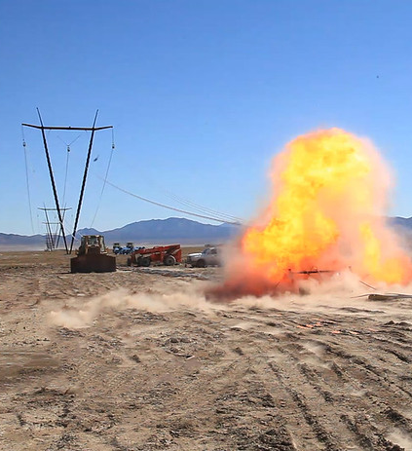
ROLES & RESPONSIBILITIES of the QUALIFIED OBSERVER
The Qualified Observer must have the willingness to stop work immediately when necessary.

Slide 25
Review
A qualified observer shall not have/conduct any other duties or be distracted unless the crew being observed has stopped work and is outside MAD.
A spotter is not to be confused with a Qualified Observer.
Critical Step: A step or action that must be performed correctly to avoid adverse consequences or cause irreversible harm to equipment or people (the point of no return)
The Q.O. must act primarily as an observer for the purpose of preventing an accident.
The Qualified Observer must carefully watch equipment in MAD space and facilitate excellent communication
The Qualified Observer shall have no other duties that will take away from their ability to identify and correct hazards!
The Qualified Observer must have the willingness to stop work immediately when necessary

