Slide 1
Collision Avoidance Session Three
Notes:
Announce that this final section will address the topic of accident avoidance by addressing ways to prevent backing crashes, hit other in rear crashes, sideswipe crashes, and intersection crashes.

Slide 2
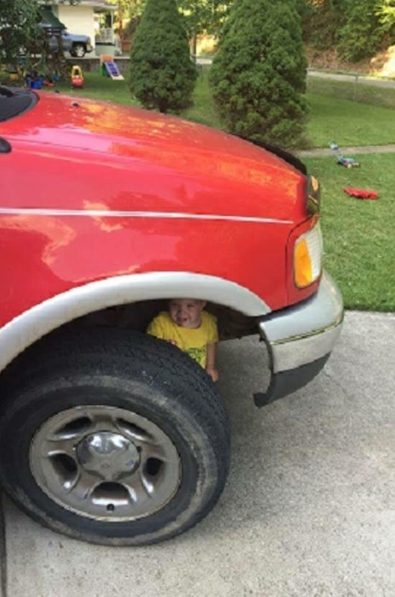
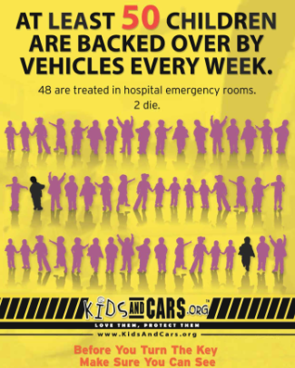
Preventing Backing Crashes
Use the “GOAL” observation method
-Get
-Out
-And
-Look
Do a 360 walk-around
Look for people and stationary or overhead objects
Along with mirrors, use rear-vision camera if available
Never move the vehicle without making sure the path is clear
Notes:
Before you back, there are some principles to keep in mind: Be sure to use all of your mirrors to help judge distances and watch for hazards, Back-up cameras and other vehicle technologies are just driver aids. If there are store windows available, make use of them to help judge distances and any new hazards, which might develop. Learn to watch for moving shadows, which may represent vehicles or pedestrians moving behind your unit. Keep your window rolled down to make it easier to hear shouts, whistles, horns, or other unusual noises. In addition to windows down, radios off! Remember, if it is an alley delivery, back in not out.

Slide 3
Preventing Backing Incidents
Avoid backing if possible
Use a spotter
Keep spotter in sight
Keep speed low
Cover the brake
Use mirrors
Listen
Notes:
Explain the steps to follow to signal your intention to back: tap horn or rev engine, activate back-up alarm or four way flashers, be prepared to stop at all times… the situation may suddenly change so be aware. Ask if there are any questions or comments on “Preventing Backing Crashes” before moving on. Be sure to mention the following issues: Keep speed low. Keep your foot above the brake so you can stop instantly. Use mirrors frequently. Be alert for loud yells, frantic horn-blowing and unusual noises. Always be prepared to stop.

Slide 4
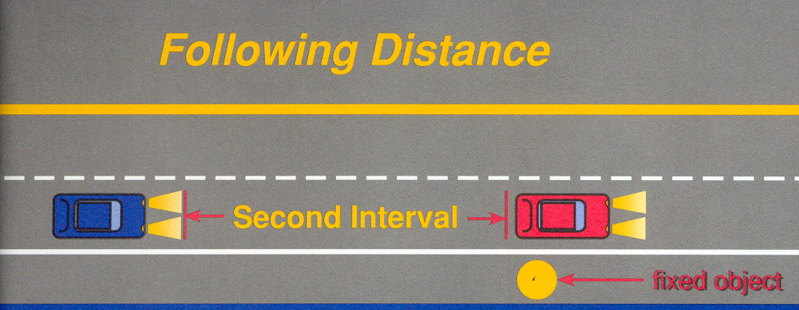
Rear Crashes
Look ahead 8 to 12 seconds
Look two blocks ahead in residential areas and city streets
Look as far as you can see on highways
Look for construction zones, traffic backing etc.
Notes:
Explain the statement “Expand Your Look-Ahead Capacity”. This is the habit of looking beyond the present. The future is not a closed book. It is influenced by what is happening right now and where you will be in eight to ten seconds. Have foresight and know that present action can eliminate future trouble and crashes. This is the art of good timing. It helps you to center the vehicle properly in the driving lane. It also allows more time for the selection of the proper lane. It helps control speed and helps to adjust your following distance. It enables you to blend into the traffic pattern smoothly. As the rear of the vehicle ahead of you passes any fixed reference point - a tree, a sign, a pole - begin counting until the front of your vehicle reaches the same point. Count "One thousand one, one thousand two, one thousand three”, etc.

Slide 5
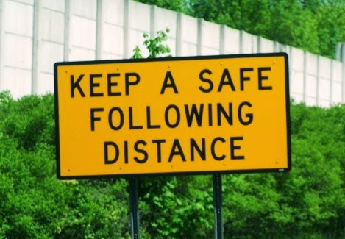
Preventing Rear-End Crashes
Following distance on length of your vehicle
Use at least one (1) second for every 10 feet of vehicle length
Use a minimum 3 to 4 seconds of following distance between your car and vehicle ahead
Use the timed interval rule to measure following distance
Maintain a 3 to 4 second following distance
Notes:
Explain the need to stay out of tail gating traps. Following the vehicle ahead too closely is setting up a trap without an escape path. This is especially true if the vehicle behind is tail gating you and you are "boxed-in" by cars on both sides. The vehicle ahead jams on the brakes and you are sandwiched -- no escape path --- BAM! --- DISASTER! Give yourself time, space, and visibility. Maintain a decision space around you.

Slide 6
Decision Space
Notes:
Explain the scenario. As you pull up behind another vehicle at an intersection, be sure to leave a space between your vehicle and the one in front. This is developed by stopping your vehicle so that you can see their rear tires meet the pavement. This leaves room to go around if the other vehicle stalls. Maintain proper following distance. Slowdown in poor weather and signal your intentions early. Properly adjust and frequently check your mirrors and stay focused on driving. Avoid talking on the cellphone and other distractions.

Slide 7
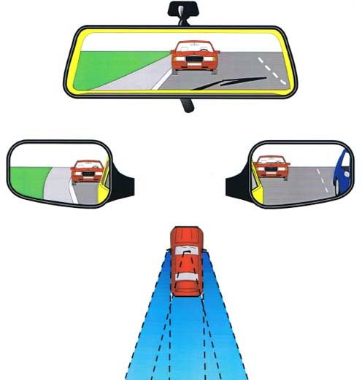
Preventing Sideswipe Crashes
Mirrors help recognize hazards to the sides and behind your car
Check mirrors regularly
Look over your shoulder before changing lanes
Notes:
Explain that mirrors are an extremely important tool to help keep drivers aware of their surroundings. Using mirrors can help develop situational awareness so that you can react to the driving environment. Explain the need to check mirrors regularly while driving (every 5 to 10 seconds). Develop a mirror triangle-viewing pattern. As the vehicle to the rear overtakes and leaves the rearview mirror, it becomes visible in the side view mirrors. As the vehicle passes, when it leaves the side view mirror, the vehicle should now be visible in your side peripheral vision. Ask if there are any questions or comments on “Sideswipe Crashes” before moving on.

Slide 8
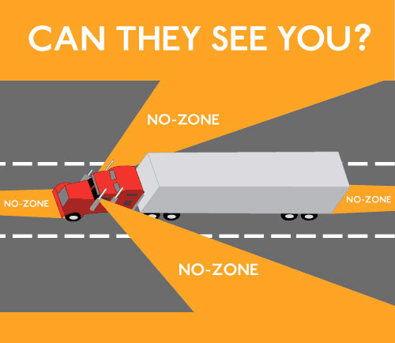
Tractor Trailer Trucks
Never place your vehicle in the “No Go” zone
Notes:
Explain that safe drivers, unless otherwise indicated, enter the first traffic lane moving in the direction you want to go. The Safe Driver is aware that drivers of large units such as tractor-trailers might need to make a wide swing to complete the right turn. Never place your vehicle in the “NO GO” zone.

Slide 9
Preventing Intersection Crashes
Adjust speed
Consider posted speed limit, weather and road conditions and other traffic
When entering an intersection
Look left, Look right, then left again
Covering the brake pedal be ready to react
Notes:
Engage the attendees on how they approach intersections. Discuss the bullet points. It takes about 3/4 of a second to react to an emergency. In a car moving at 15 miles per hour, you travel a full vehicle length before you can get your foot on the brake. You need another vehicle length for braking distance. Your total stopping distance is two vehicle lengths. When you approach an intersection first look left toward the traffic you will meet, then right, then left again. Come up to blind corners with your foot positioned above the brake pedal, ready for an emergency. At intersections controlled by signals, do not race to get through on the yellow light, or jump the gun on the green. Do not be so sure that the other driver will obey stoplights and signs. He may have other ideas. Be ready to yield to avoid a collision. It may bruise your ego, but that is not bad when you consider the other possibilities.

Slide 10
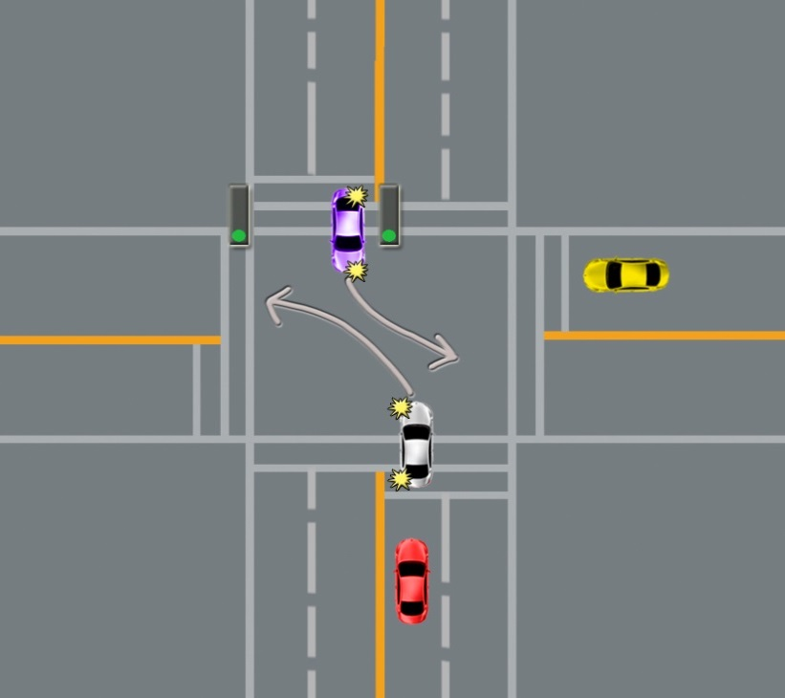
Intersection Crashes
Position yourself in the proper lane
Reduce speed before reaching the intersection
Signal at least five to eight seconds prior to the turn
Notes:
Explain that safe drivers position themselves for a right-turn from the proper lane before they reach the intersection, signaling well in advance. The driver that makes the turn correctly is helping to keep themselves and other drivers safe. Explain that for Left-Turning and Through Traffic be ready for unexpected turns by on-coming traffic, and control your speed accordingly. When making a left turn, remember that approaching traffic has the right of way. Wait for left turn arrow, or if none, a gap in traffic and pedestrian lanes to complete your turn safely. Keep your wheels straight while waiting to turn. Check to the rear before turning left in case someone is about to pass you on the left.

Slide 11
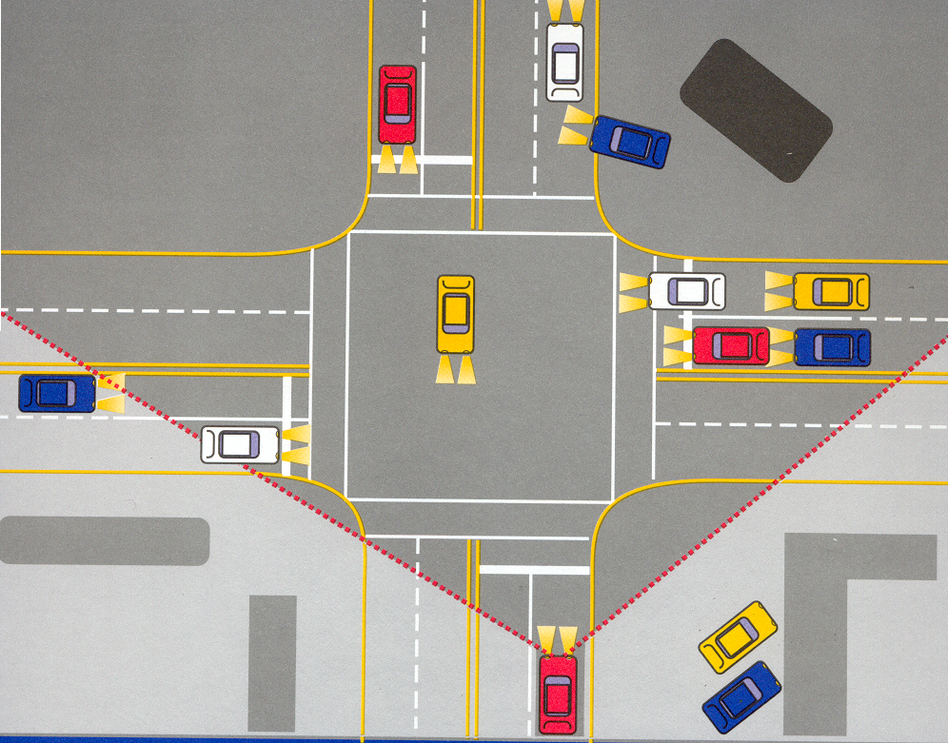
Notes:
Engage the attendees. Explain that this exercise is to discuss how they approach intersections. Explain that they are the driver at the bottom center of the picture and are approaching the intersection. The light in your lane is green. Ask them to point out potential problems and how to avoid them.
Some of the desired responses are:
The approaching driver (left from circled vehicle view) may turn left in front of their vehicle
One or more of the parked vehicles to the right may back out and strike their vehicle
One or more of the vehicles approaching from the right may pull out or turn in front of their vehicle
One or more of the vehicles approaching from the left could run the light and pull out in front of their vehicle
The light could change from green to red as the approach the intersection

Slide 12
Key Points-Session Three
When approaching an intersection, the driver should look to the left, then to the right, then to the left again.
True
False
Before moving from park, the driver should do a 360° walk around the vehicle. distracted drivers
True
False
When driving, the driver should check their mirrors every 5 to 10 seconds.
True
False
Notes:
5
5
5
5
5
The presenter should have touched on the following items when discussing session three:
When approaching an intersection, the driver should look to the left, then to the right, then to the left again.
True
False
Before moving from park, the driver should do a 360° walk around the vehicle. distracted drivers
True
False
When driving, the driver should check their mirrors every 5 to 10 seconds.
True
False

Slide 13
Why Safe Driving Is Important?
To get home safely to your family and loved ones!
They Depend On You
Notes:
Conclude and emphasize that it is all about safety for the worker, their families, their co-workers, other drivers on the road and the organization as a whole. So restate the question: “What’s in it for you?” The answer is: “Everything!” Ask if there are any final questions or comments. Thank the attendees for their participation and offer contact information if they want further information.

