Slide 1
Hand Safety Continuing Education Fourth Quarter 2018 Session 1
Notes:
Explain that annually each partner submits their OSHA 300 log data to Task Team One for analysis. The data shows that in 2017, fingers and hands were the most frequently injured body parts. Combined, they accounted for 164 of the 636 (25%) injuries reported by the partners. Of the 164 finger and hand injuries working with knives were the top injury type with 26 events.

Slide 2
Objectives
Upon completion of this continuing education module you should be able to:
Describe the effects of hand injuries
Explain employer responsibilities regarding hand protection
Explain hand injury prevention
Explain workplace hazards that require hand protection
Select appropriate hand protection based on exposure
Notes:
Explain that this continuing education module will discuss the effects of hand injuries, employer responsibilities regarding worker hand protection, how to prevent hand injuries, hazards that require hand protection, and how to select appropriate hand protection.

Slide 3
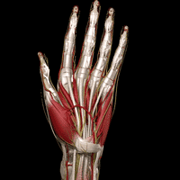
Your Hands
Hands are one of the most complex body parts
They help us to be a skilled, valuable worker
Used in almost everything we do
Notes:
State that our hands are one of the most complex parts of your body. The dexterity of the tendons, bones, and tissue, allows us to manipulate and grip objects. Our hands help make us a skilled, valuable worker. We use our hands for almost everything we do.

Slide 4
Take Care of Your Hands
Use personal hygiene
Small cuts may become infected
Report All Hand Injuries
Wear Your Gloves
Protect your hands
Notes:
Explain that you only have one set of hands. They are one of the most used body parts. Explain that we must use personal hygiene practices to take care of our hands. Small cuts may become infected and require medical treatment. It is critical to wash your hands frequently. Bacterial flourishes in warm, dark, damp environments like the inside of a lineman’s rubber insulating glove. Also, keep your finger nails trimmed as failure to do so can cause discomfort when wearing rubber insulating gloves. Emphasize the importance of reporting all hand injuries, even those that may appear very minor, so that prompt medical treatment may be given if needed. Fast treatment may minimize the severity of an injury. Always wear your gloves!

Slide 5
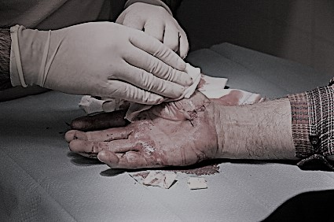
Hand Injury Facts
2nd Leading Cause of Workplace injuries
110,000 lost time hand injuries per year
Average time missed, 6 days
70% of workers that experience hand injuries were not wearing gloves
The average hand injury claim has now exceeded $6,000, with individual workers’ compensation claims reaching nearly $7,500
Notes:
Explain that hand injuries are the second leading cause of workplace injuries. 70% of workers that received a hand injury were not wearing any type of protective glove and the remaining 30% were wearing gloves that were inadequate for the hazard exposure. The average hand injury costs $6,000!
The National Safety Council Guide:
Direct cost of a laceration: $10,000
Stitches: $2,000 plus indirect
Butterfly: $300
Severed Tendon: greater than $70,000
Note: This is a good time to pass out the attached hand injury document.

Slide 6
Bureau of Labor Statistics
Hand injuries accounted for 40 percent of all upper extremity injuries
The most among all upper extremity injuries
Notes:
Explain that in 2014, upper extremities affected by an injury or illness accounted for 346,170 cases, or 32 cases per 10,000 full-time workers. Hands accounted for 40 percent of those cases, the most among upper extremities. See this link https://www.bls.gov/opub/ted/2015/type-of-injury-or-illness-and-body-parts-affected-by-nonfatal-injuries-and-illnesses-in-2014.htm

Slide 7
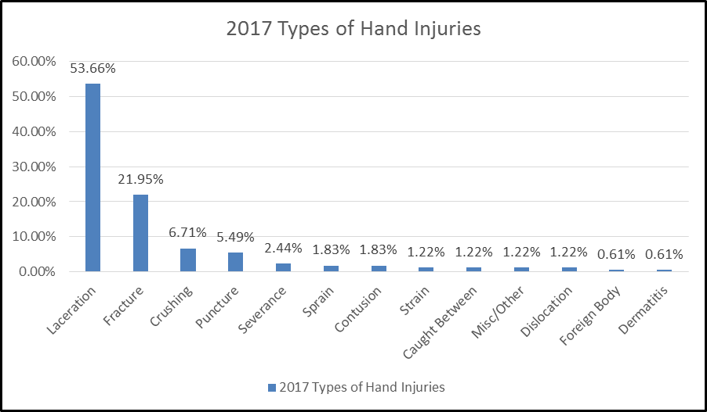
Why the Focus on Hands?
Partnership Total Hand Injury Events 164
Workers on ground level 113
Working in an Aerial Device 16
Working while on a vehicle 12
Lineman 42
Apprentice Lineman 31
Working with knives 26
Notes:
Say that our hands are irreplaceable. No other being in the world has hands that can move, grasp, hold, and manipulate objects like human hands. State that our hands are one of your greatest assets. Of the 164 finger and hand injuries experienced by Partnership Member Companies;
113 occurred to workers on ground level;
16 occurred while aloft in an Aerial Device;
12 occurred while on a vehicle;
Lineman and apprentice Lineman were the job classification with the most injuries 42 and 31 total 73;
Working with Knives is the top injury type with 26 events.
Workers in their twenties (25-29) had the most (28) injuries.

Slide 8
It is a Mind Set
Responsibility
We are all responsible for not engaging in unnecessary risk at work
Accountability
Tools, pinch points and stored energy WILL hold us accountable whether we like it or not
Authority
You are authorized by your company to STOP WORK if necessary to address hazards
Notes:
Discuss and promote a culture where Stop Work is freely exercised, the requests are honored and resolved before resuming work.

Slide 9
Control Hand Injuries
Methods:
Tailboards
JHA’s
Work Practices
Correct Tools
Training
Notes:
Explain that by performing a thorough tailboard to include who is performing what tasks, identify the hazards for each task and document the mitigation to those hazards for each employee. Question your workers and ask do we have the proper tools, hand protection, training to perform the tasks safely?

Slide 10
Impact of Hand Injuries
If you injured or lost your thumb how would you:
Tie Your Shoes
Button Your Shirt
Sign Your Name
Use Silverware
Change a Fishing Lure
Throw a Baseball
Notes:
Ask the group to try and tie their shoes without the use of thumbs. The presenter can use rubber bands to secure the thumb to the hand. Then ask the group to tie their shoes.

Slide 11
Key Points-Session One
Hand injuries account for __________ of all upper extremity injuries.
10%
20%
30%
40%
The average hand injury results in an average ______ lost work days.
3
6
9
70% of people that experienced hand injury were not wearing gloves.
True
False
Notes:
5
5
5
5
5
The presenter should have touched on the following items when Explaining session one:
Hand injuries account for __________ of all upper extremity injuries.
10%
20%
30%
40%
The average hand injury results in an average ______ lost work days.
3
6
9
70% of people that experienced hand injury were not wearing gloves.
True
False

Slide 12
Hand Safety Continuing Education Fourth Quarter 2018 Session 2
Notes:
Explain that in this section the discussion points are to review the possible casual factors that may lead to hand injuries.

Slide 13
Typical Incidents
Hand injuries can be divided into six general categories
Lacerations
Fractures and Dislocations
Soft tissue injuries and Amputations
Infections
Burns
High pressure injuries
Notes:
Explain that intricate in design and function, the hand is an amazing work of engineering. Form follows function in the hand; therefore, any injury to the underlying structures of the hand carries the potential for serious handicap. To reduce this risk, even the smallest hand injuries require proper medical evaluation. The goal with injuries to the hand is a rapid and accurate initial evaluation and treatment. In other words, once an injury occurs, the doctor strives to begin medical treatment quickly so the short- and long-term effects on the hand can be minimized. The hand consists of 27 bones (including the 8 bones of the wrist). When the other associated structures (nerves, arteries, veins, muscles, tendons, ligaments, joint cartilage, and fingernails) are considered, the potential for a variety of injuries exists when trauma involves the hand. The most common cause of the injuries was blunt trauma, followed by injury from a sharp object.
Source: https://www.emedicinehealth.com/hand_injuries/article_em.htm#hand_injury_facts

Slide 14
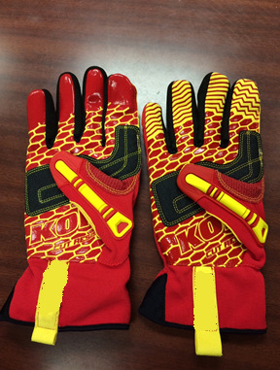
Knives
Avoid use if possible and consider an alternative
Keep blades sharp
Cut away from you
Never pry or twist
Wear cut resistant gloves
Change blades carefully
Close, retract, or sheath when not in use
Notes:
Explain that knife use is a major causal factor leading to hand injuries. Many times, a knife is not the best or proper tool to used for the task at hand. Also, when a knife is the best tool for the task, improper use of the knife may lead to an injury. Even though we may choose to use personal protective equipment (PPE) in the form of cut resistant gloves, they are not designed to prevent a puncture. The term resistant is used to denote that a glove offers extra durability and protection from cuts. Cuts in gloves are still possible and not even the most durable glove is completely cut proof.

Slide 15
Pinch Points
Recognize pinch points
Stay focused
Use tag lines
Stay out of the Bite
Proper LOTO
Use something other than your hands
Notes:
Explain that pinch points are another casual factor for hand injuries. The key to protecting workers from pinch-point hazards is to avoid them completely. In the job task planning stage, all possible pinch-points should be identified. Once identified, the discussion should now be focused toward controlling the hazard. Either eliminate it altogether or use some method that remove the hand or other body part from the danger zone. Taglines to guide loads, tools that can reach into the danger area may be used. Ensure that any machinery is locked out and the possibality of an unintentional operation is removed. Recognize and stay out of the line-of-fire. These are some of the ways our hands and other body parts can be protected from pinch-point hazards.

Slide 16
Chemical Hazards
Chemical exposure
Consult the SDS
Substitute Products
Follow Instructions
Use the Right Protection
Notes:
Explain that another causal factor for hand injuries is exposure to harmful chemicals. In our business we may encounter chemicals that can cause damage to our hands and other body parts if there is a repeated or possibly prolonged exposure. Diesel fuel, hydraulic fluids, battery acid, other lubricants and inhibitor compounds, just to name a few, may cause injury to our hands. Prior to use, always check the Safety Data Sheet (SDS) to determine the sign and symptoms of exposure, medical treatment, and possible required PPE use necessary for personal protection.

Slide 17
Electrical Hazards
Safe Work Practices
Plan the Work
De-energize, Test and Ground
Use Insulated Tools
Maintain Minimum Approach Distance
Insulate/Isolate
Second Points of Contact
Use Rated PPE
Notes:
Explain that as previously discussed, pre-job planning is an essential aspect of worker safety In terms of electrical hazards, always try to eliminate the hazard first! If elimination is not practical or feasible, then our training allows us to use protective equipment such as properly rated insulating protective equipment to safely perform the job task. If possible, de-energize, Test, Ground, and establish an equal potential work space. Another alternative method is to use insulated live-line tools. Always maintain the proper Minimum Approach Distance (MAD) from exposed energized parts. Identify and insulate all second points of contact and where required, use the appropriately rated PPE.

Slide 18
Tools
Identify and Use the Best Tool for the Job
Follow Manufacturer’s Recommendations
Ensure Proper Training
Inspect and Keep Tools in Good Condition
Never Modify a Tool
Maintain Control of Tool
Notes:
Explain that the first step in tool use safety is to select the proper tool for the task. Screwdrivers and not pry bard or punches. Inspect the tool prior to use. If it is damaged discard or repair it. Never modify the tool and be aware of possible slip and puncture injuries.

Slide 19
Repetitive Motion Injuries
Caused By Doing the Same Hand or Wrist Movements for Prolonged Periods
Pain
Numbness
Tingling
Cramping
Loss of Grip Strength
Report to a Supervisor Immediately
Stretching, Icing and Rest may help
Notes:
Explain that repetitive motion injuries can be caused by repeatedly doing the same hand or wrist movements for prolonged periods. The symptoms of these types of injuries may appear as pain, numbness, tingling, cramping or loss of grip strength. Early treatment is important. Explain that if a worker suspects this type of issue they should report the symptoms to a supervisor as medical treatment may be needed. For very minor symptoms stretching, icing and rest will help.

Slide 20
Key Points-Session Two
When using a knife, always cut ___________ from your body.
Toward
Away
The key to avoiding pinch-point injuries is to avoid pinch–points all together.
True
False
Repetitive motion injuries can occur when a person performs the same hand/wrist movements for prolonged periods.
True
False
Notes:
5
5
5
5
5
The presenter should have touched on the following items when Explaining session two:
When using a knife, always cut ___________ from your body.
Toward
Away
The key to avoiding pinch-point injuries is to avoid pinch–points all together.
True
False
Repetitive motion injuries can occur when a person performs the same hand/wrist movements for prolonged periods.
True
False

Slide 21
Hand Safety Continuing Education Fourth Quarter 2018 Session 3
Notes:
Explain that in this section the discussion points are to review the different types of gloves available and their strengths and limitations.

Slide 22
Hand Protection
Planning for Hand Protection
Pre-Bid risk analysis
Perform an analysis of the task
Selection of hand protection
Keep in mind that wearing rings, watches, or bracelets can cut/tear gloves and create other additional hazards
Must be provided by the employer
Notes:
Explain that identifying hand hazards during the pre-bid will assist with giving sufficient time to order the right gloves and make them available for the work. There are many different types of hand protection available that will offer protection for most hand hazards. An analysis of the task and potential hazards will assist in identifying which type of glove will offer the best protection.

Slide 23
Leather Gloves
Provides protection from rough surfaces
Many styles to pick from
Generally available insulated for cold conditions
Very cost effective
Good for most hand hazards
May not provide adequate cut protection
Notes:
Explain that leather gloves offer some protection from rough and abrasive surfaces. They are comfortable and usually easy to put on and take off. There are many styles to pick from that have varying gauntlet lengths. They are generally available insulated styles for cold conditions and can be very cost effective and affordable. These gloves are good for most hand hazards but offer little to no cut protection.

Slide 24
Cut Resistant Gloves
Prevent or reduce cuts from knives or sharp edges.
Cut RESISTANT, not Cut PROOF!
Offer little protection from pinch points or punctures
Available in cut levels 1-5
Level 5 offers best protection
Notes:
Explain that cut resistant gloves help prevent or reduce cuts from knives or sharp edges. The key point here is that these gloves are cut RESISTANT, not cut PROOF! Additionally, these gloves offer little to no protection from pinch points or punctures. These gloves are available in cut levels 1 through 5 with level 5 offering the best protection.

Slide 25
Chemical Resistant
Prevent direct contact with chemicals
No glove will protect from ALL chemicals
Chemicals will break down the glove material over time
The thicker the glove, the more resistant it is to chemicals
Notes:
Explain that chemical resistant gloves help to prevent direct contact with chemicals. It is critical to mention that no glove will protect from ALL chemicals and all chemicals will break down the glove material over time. It is important to mention that the thicker the glove, the more resistant it is to chemicals. Workers must reference the SDS sheet to determine what glove is appropriate for a given chemical.

Slide 26
Anti-Vibration Gloves
Reduce the effects of excessive vibration
Have padding in palms and fingers
Help absorb the vibration
Reduces but does not eliminate
Bulky
Notes:
Explain that anti-vibration gloves will reduce the effects of excessive vibration from hand tools and machinery. These gloves have padding in palms and fingers to help absorb the vibration. These gloves reduce but not eliminate the exposure from vibration. These gloves may be too bulky for regular work.

Slide 27
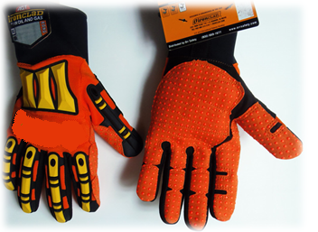
Impact Resistant Gloves
Provide added protection from crushing injuries
Impact absorbing rubber ribs and padding designed into gloves
Usually have a cut resistant rating as well
Provides good dexterity and grip
Best overall option in a glove
Notes:
Explain that impact resistant gloves are impact resistant not impact proof. The key here is to keep your hands out of the line-of-fire. These gloves provide added protection from crushing injuries. They are equipped with impact absorbing rubber ribs and padding designed into gloves. Usually have a cut resistant rating as well. They provides good dexterity and grip. They are generally best overall option in a glove.

Slide 28
Insulated Rubber Gloves
Voltage rated
Must be electrically tested and stamped
Inspected before use
Used in conjunction with leather protective covers
Notes:
Explain that rubber insulating gloves protect only from the voltages for which they are rated. The voltage rating for rubber gloves range from 00 to class 4. These gloves must be electrically tested regularly according to local standards and date stamped. The maximum test interval allowed by OSHA is 6 months. Prior to use these gloves must be inspected for leaks, holes, tears, cuts, and/or ozone damage. These gloves should be used with leather protective covers to help prevent damage.

Slide 29
Class | AC proof test Voltage | Maximum AC Use Voltage
00 | 2,500 | 500
0 | 5,000 | 1,000
1 | 10,000 | 7,500
2 | 20,000 | 17,000
3 | 30,000 | 26,000
4 | 40,000 | 36,000
Notes:
Explain that according to OSHA, all electrical gloves have a test voltage and safe use voltage requirement. All glove manufacturers incorporate some form of production code or date coding to indicate the date of initial testing. In accordance OSHA, gloves must be tested before first issue and at least every six months thereafter. Gloves must also be tested upon indication that the insulating value is suspect. Also, if the insulating equipment has been electrically tested but not issued for service, the insulating equipment may not be placed into service unless it has been electrically tested within the previous 12 months. These testing requirements can sometimes be a little confusing to interpret. Here's an example: You're considering using your electrical gloves for the first time on March 1, 2017, and notice the date stamp is February 27, 2016. Would you need to get the gloves retested before use? Yes, because you haven't put the gloves into service within the allowable 12 month window. But, if the date stamp read March 2, 2016, you could use them and wouldn't need to retest them until six months after you put them into service on March 1, 2017.

Slide 30
Length
One inch of rubber past the top of protector for each kV class rating
Class | Distance
1 | 1 inch
2 | 2 inches
3 | 3 inches
4 | 4 inches
Notes:
Explain that there is a required amount of rubber cuff that extend past the leather protector. The standard distance is one-inch of rubber for each class rating. For example, class 3 gloves must have 3 inches of rubber extending past the leather protector.

Slide 31
Strengths & Limitations
Protective equipment can protect the user
Must inspect it
Must be rated for the hazard
Must be used
Notes:
Explain that all protective equipment, if it is not used or not used properly, it has a diminished ability to protect the user. It is important that we inspect the equipment prior to use, ensure that the equipment is suitable for the identified hazard, and most importantly, that we use the equipment. It cannot protect you in the truck bin.

Slide 32
Key Points-Session Three
Cut resistant gloves are also cut and puncture proof.
True
False
30 kV rated rubber insulating gloves must have ________ inches of rubber past the cuff
2
3
4
Rings, watches, or bracelets can cut/tear gloves and create other additional hazards
True
False
Notes:
5
5
5
5
5
The presenter should have touched on the following items when Explaining session three:
Cut resistant gloves are also cut and puncture proof.
True
False
30 kV rated rubber insulating gloves must have ________ inches of rubber past the cuff
2
3
4
Rings, watches, or bracelets can cut/tear gloves and create other additional hazards
True
False

