Slide 1
Life Changing Events With Serious Injury and Fatality Focus Continuing Education Fourth Quarter 2020
Notes:
Introduce the module. Explain that the intent of this presentation is as a continuing education training topic related to certain aspects from the ET&D 10-Hour OSHA training class, the OSHA Partnership Best Practices, and/or incident trending analysis

Slide 2
Objectives
In this presentation we will be discussing the following:
Life Changing Events caused by serious injuries and fatalities
The use of Partnership Best Practices to eliminate serious injuries and
fatalities
3. Highlight the importance little things play on the success of a task
Notes:
Serious injuries and fatalities can cause life changes for individuals, families, and loved ones.
The fundamental goal of this OSHA Strategic Partnership (OSP) is to reduce the number of serious injuries and fatalities in the Industry. Using the ET&D Best practices can reduce the number of Serious injuries and fatalities.
Little things, such as but not limited to:
Poor communication
Assumptions
Complacency
Incomplete or no job briefing
Not using Stop Work Authority
Wearing Rubber goods when required to avoid injury
The little things missed can and will lead to bigger things, such as accidents and injuries on the job.
What we call “little things” are often much greater than what we call the great ones, and therefore have much larger consequences. Attend to the little things, and we need not be anxious about the greater ones.

Slide 3
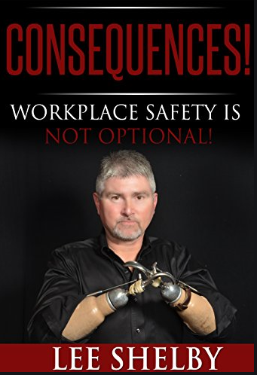
Introduction
Lee Shelby is a Power Lineman from Tennessee and at the age of 28, lost both arms resulting from an occupational injury after he came in contact with more than 12,000 volts while working for a utility company.
Lee returned to work in less than one year with the ambition to be an active part of society. Lee teaches and shares his story of “ The Personal Side of Safety” with thousands across the United States and in other countries - in every industry.
Notes:
Now, let’s listen to Lee as he describes what happened to him

Slide 4
Listen to Lee Shelby’s message on
Life Changing Events
Click on speaker the play button to listen to Lee’s message
Notes:
Lee believes the Best Practices would have prevented his Life Altering Event

Slide 5
Life Changing Events – Four Incidents
Incidents
Induction
URD
Overhead
Aerial Lift Trucks

Slide 6
Description
Each category will have the following information;
Scenario – Task
Consequences – What happened
What should have happened
ET&D Best Practices to avoid a Life Changing Event

Slide 7
Scenario #1

Slide 8
Induction
Scenario
A journeyman Lineman and an Apprentice were in the process of removing a line ground from a 138KV transmission line, when the apprentice came-in contact with the ungrounded switch.
The apprentice received an electrical shock originating from the induced voltage on the 138KV transmission line.
Lee Shelby
Notes:
The crew then proceeded to go up in a Genie aerial lift, to remove the ground from phase 1.
The crew had placed the basket in the center of the “H” structure and rotated the length of the basket parallel to the 138KV line.
The crew ascended to the line maintaining approximately 7 feet below phase 1.

Slide 9
Induction
Consequences – What happened
As the crew approached the structure, the ground cable became caught on the switch near the rotational assembly and top jaw.
To free the ground cable, Apprentice gathered the length of the cable in his left hand. He then proceeded to reach around the switch assembly near the jumper connection, to free the cable. During the process, Apprentice contacted an unknown portion of the lead/switch assembly, causing a flow of induced current to pass through his body to ground.
Notes:
They proceeded to remove the ground head from phase 1 with a 10’ long live line tool and turned to his right with the ground to have apprentice remove the ground head from the live line tool and also to help maintaining control of the ground conductor.
The crew then proceeded to rotate the aerial lift at the base of the machine, so that the crew could access the earth side of the ground that was attached at the steel “H” frame. As the crew approached the structure, the ground conductor became caught on the switch near the rotational assembly and top jaw portion of the switch. Journey lineman then positioned the basket near the phase 1 switch, and the apprentice in an effort to free the ground cable, used his hands to gather the length of the cable in his left hand. He then proceeded to reach around the lead/switch assembly near the jumper connection, to work the length of cable back to the near side of the switch. During the process, Bob (ST-3) contacted an unknown portion of the lead/switch assembly, causing a flow of induced current to pass through his body to ground.

Slide 10
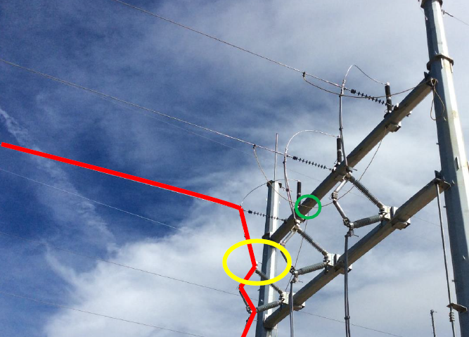
Induction
Consequences – What happened (continued)
Photo illustrates the structure crew was working on at the time of the incident.
The crew was working to remove the ground on phase 1. Phase 1 is indicated in red.
The area (yellow circle in picture) in which the line sector was contacted is indicated at the top side of the switch.
The photo also illustrates in green the location the ground was connected on the steel.

Slide 11
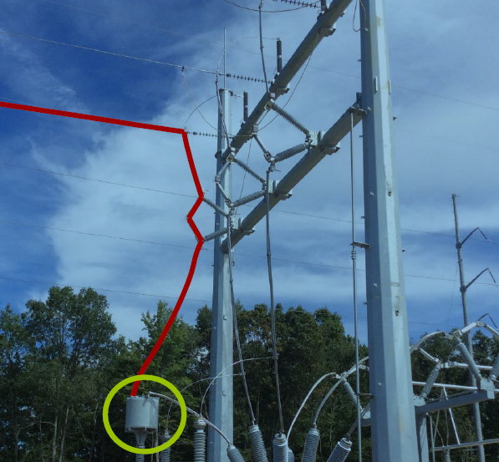
Induction
Consequences – What happened (continued)
Photo illustrates the phase in which the ground was being removed so that the wave trap could be tested by the utility personnel.

Slide 12
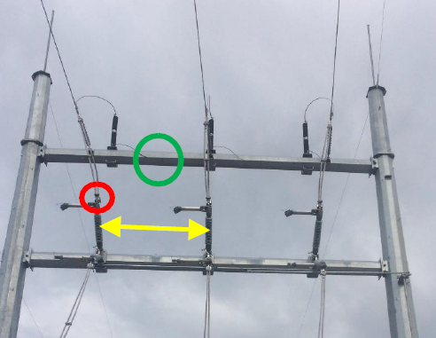
Induction
Consequences – What happened (continued)
Photo illustrates the distance between the phases were 13 feet.
The crew was working their way in to remove the structure side of the ground when the incident occurred.
The structure side of the ground was connected as the same location as the center phase (green circle).

Slide 13
Induction
Consequences – What happened (continued)
Electric current entered the right hand near the index finger and exited the body at the abdomen
Induced current had contracted the muscles of injured worker, not allowing him to release the conductor
Line was calculated to have had approx. 2,000 volts of induction
Received burns to hand and stomach
Notes:
No qualified observer was on the ground.
Ground should have been freed prior to removing the line side

Slide 14
Induction
What should have happened?
When job scope changes, stop work and conduct an additional job brief
No qualified observer was present while workers were aloft
Effective communication before and during work
Notes:
Always have a plan in place and discuss during pre-job briefing
Discuss sequence of tasks to avoid distractions, assumptions, and critical errors.
Use Stop Work Authority when needed to avoid incidents and injuries.

Slide 15
Induction
ET&D Best Practices to avoid a Life Changing Event
Best Practice – Job Briefings
In this scenario, an effective job briefing would have noted the hazards for this task, how to mitigate the identified hazards, proper PPE to wear, and when to stop work when plan changes.
Best Practice – Qualified Observer
A qualified observer could have stopped the work when the ground conductor was caught on the top jaw portion of the switch
Notes:
BEST PRACTICE: JOB BRIEFINGS
PRACTICE STATEMENT: Provides a uniform methodology and outlines key components of job briefings.
PRACTICE DESCRIPTION: Document job sequence, hazards to be encountered, and steps taken to
control/eliminate hazards by doing the following:
A. Define routine and critical tasks.
B. Identify roles & responsibilities.
C. Identify hazards.
D. Determine risk mitigation.
E. Documentation shall include I & I to be used.
F. Personal Protective Equipment to be used.
G. Emergency response information.
H. Number of briefings to be held.
NOTE: Job briefings need to be conducted when work changes significantly.
BEST PRACTICE: QUALIFIED OBSERVER
PRACTICE STATEMENT: Identify and utilize qualified observer for critical tasks.
PRACTICE DESCRIPTION: A member of the crew shall be identified to act as
an observer to ensure clearances are maintained, PPE, and effective cover-up is
installed. The observer shall be capable of the identifying nominal voltages,
energized components, minimum approach distances, and proper safe work
practices while crewmembers are working on energized lines.

Slide 16
Scenario #2

Slide 17
URD
Scenario
A lineman was moving the cable with the pothead around the system neutral. While doing so, the lineman became a path to ground between the pothead stinger and a grounded object. The lineman made electrical contact and received burns to his body.
The URD system at this location was designed as a “Loop System” with an open point. Due to the underground loop circuit not having a normal open as designed, the pothead was energized when the employees began work.
Notes:
No additional information available on the extent of the injuries.

Slide 18
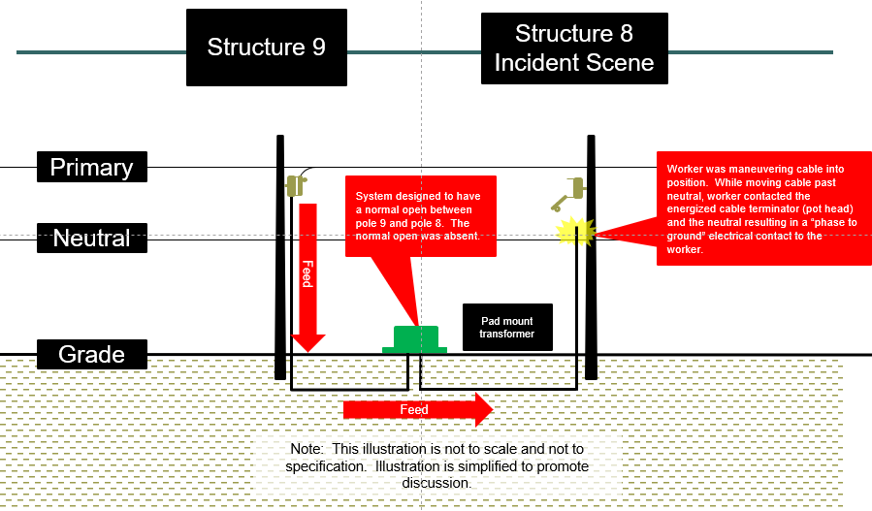
URD
Scenario
Notes:
Worker was maneuvering cable into position. While moving cable past neutral, worker contacted the energized cable terminator (pot head) and the neutral resulting in a “phase to ground” electrical contact to the worker.
System designed to have a normal open point in the pad mount transformer, isolating pole 9 and pole 8. The normal open was absent and not verified.

Slide 19
URD
Consequences – What happened
Electrical contact and burns
Worker was maneuvering cable into position. While moving cable past neutral, worker contacted the energized cable terminator (pot head) and the neutral resulting in a “phase to ground” electrical contact to the worker.
System designed to have a normal open between pole 9 and pole 8. The normal open was absent.

Slide 20
URD
What should have happened?
Layers of protection
Effective job briefing
Check for potential
Verify normal open
Ground Line
Establish EPZ
Wear proper PPE (Class rubber gloves sleeves)
Notes:
GROUND IN TRANSFORMER PARK BUSHING
Non visible ground
Insulate neutral (I&I) neutral

Slide 21
URD
ET&D Best Practices to avoid a Life Changing Event
Best Practice – Job Briefings
In this scenario, an effective job briefing would have noted a discussion to check for potential, verify the normal open, and wearing of proper PPE.
Best Practice – Cradle to Cradle Use of Insulating Rubber Gloves and Sleeves
In this scenario, wearing rubber gloves and sleeves would have prevented this injury.
Notes:
BEST PRACTICE: JOB BRIEFINGS
PRACTICE STATEMENT: Provides a uniform methodology and outlines key components of job briefings.
PRACTICE DESCRIPTION: Document job sequence, hazards to be encountered, and steps taken to
control/eliminate hazards by doing the following:
A. Define routine and critical tasks.
B. Identify roles & responsibilities.
C. Identify hazards.
D. Determine risk mitigation.
E. Documentation shall include I & I to be used.
F. Personal Protective Equipment to be used.
G. Emergency response information.
H. Number of briefings to be held.
NOTE: Job briefings need to be conduct when work changes significantly.
Best Practice: Cradle-to-Cradle Use of Insulating Rubber Gloves and Sleeves Insulated gloves and sleeves are proven methods for reducing electrical contact injuries and fatalities. This Best Practice details the use of such PPE including when it is to be used and the requirements for the gloves and sleeves utilized while working from an aerial platform.

Slide 22
Scenario #3

Slide 23
Overhead
Scenario
A Journeyman Lineman was maneuvering the bucket and placed the upper left side of his body in close proximity to the de-energized 34.5. The JL had a grounding cluster bracket hanging off the outside of his bucket. The cluster bracket chain came into contact with energized 12 kV under build. The apprentices alerted the JL to the chains proximity to the energized 12 kV circuit. The JL reached with his left hand to move the cluster bracket, as he touched the bracket a flash occurred. The JL was not wearing rubber gloves and sleeves at the time of contact.

Slide 24
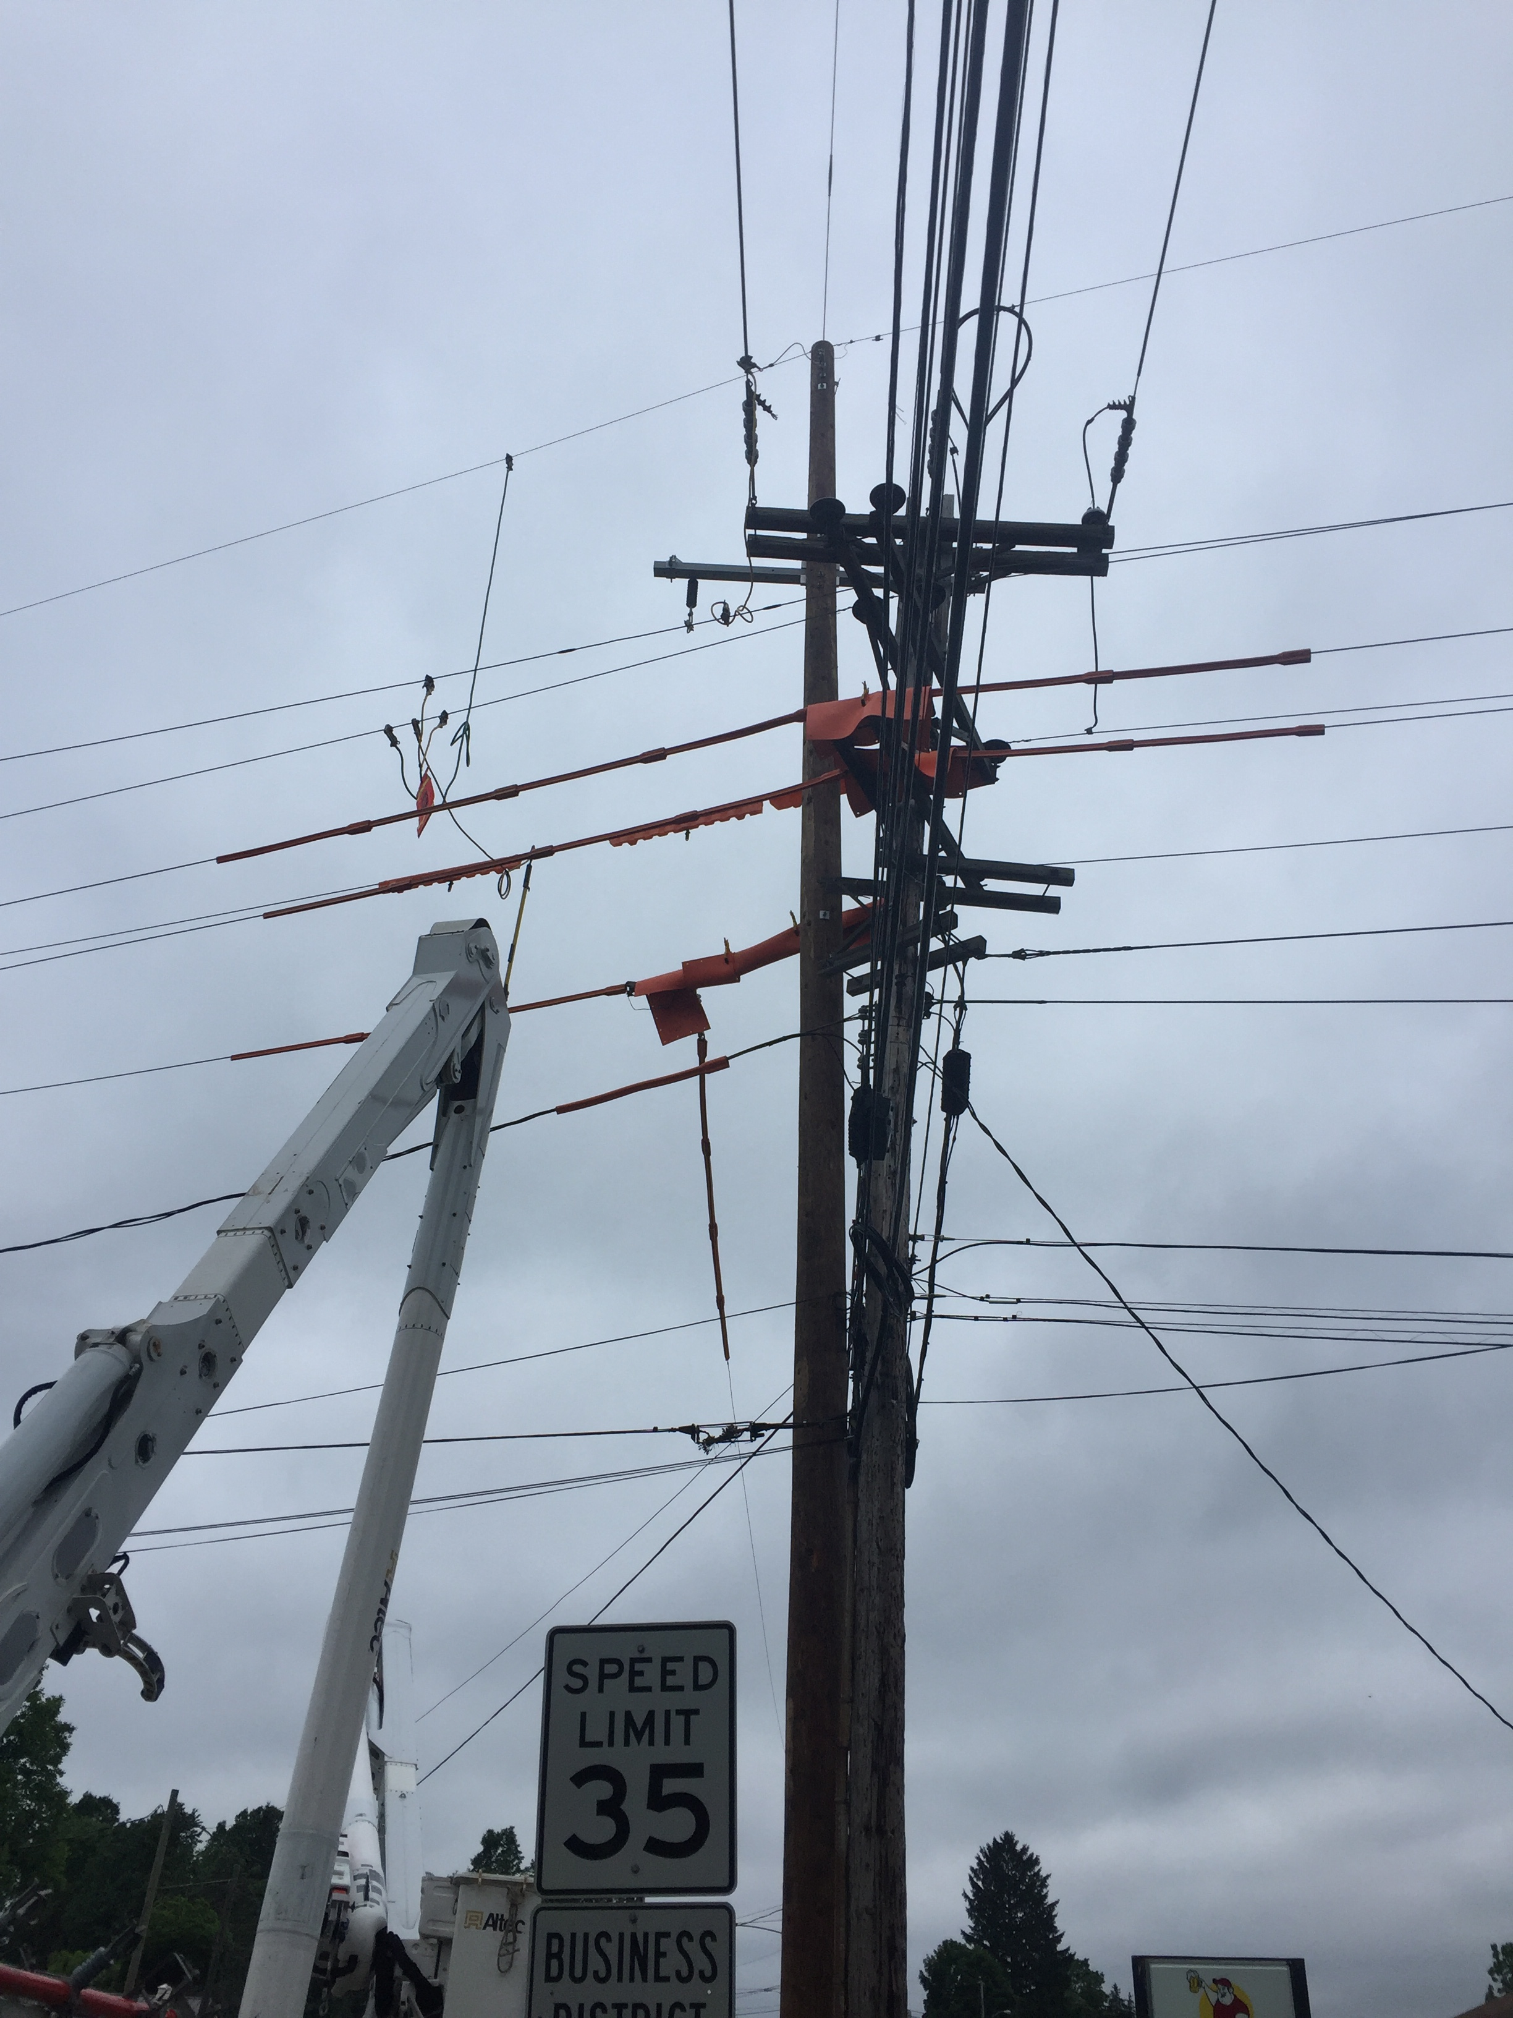
Overhead
Work area where bucket truck was moving when cluster bracket chain contacted 12kv under build
Two bucket trucks were working back to back with Journeyman Lineman in one bucket and two
apprentices in the other.
Notes:
• Situational Awareness: Employee moved outside of work area which had guards in place.
• Violation of minimum approach allowing grounding bracket to make contact with energized conductor beyond the work area which had guards and rubber in place.

Slide 25
Overhead
Consequences – What happened
Burn to finger, which eventually was amputated
Exit burn to pectoral (second point of contact)
Stress on family and crew members close to the employee
Employee was eventually terminated for violating M.A.D. without proper PPE

Slide 26
Overhead
What should have happened?
More rubber cover on circuits
Stop work
Re-Evaluate work method from grounded to rubber glove method
Create adequate clearance between potential differences when possible
Removed conductive parts from hanging over bucket

Slide 27
Overhead
ET&D Best Practices to avoid a Life Changing Event
Best Practice - Insulate & Isolate
In this scenario, additional cover-up and minimum approach distance would have prevented this injury.
Best Practice - Cradle-to-Cradle Use of Insulating Rubber Gloves and Sleeves
In this scenario, use of rubber gloves and sleeves would have prevented this injury.
Notes:
Best Practice: Insulate & Isolate Safety Performance Check
To ensure compliance with Isolate and Insulate procedures, this Best Practice requires a safety review process that includes assurances that company safety rules and proper cover-up procedures are being followed.
Best Practice: Cradle-to-Cradle Use of Insulating Rubber Gloves and Sleeves Insulated gloves and sleeves are proven methods for reducing electrical contact injuries and fatalities. This Best Practice details the use of such PPE including when it is to be used and the requirements for the gloves and sleeves utilized while working from an aerial platform.

Slide 28
Scenario #4

Slide 29
Aerial Lift Trucks
Scenario
A seasoned (30 years experience) signal operator/electrician (victim) was fatally injured when he fell out of a vehicle-mounted aerial lift’s raised bucket
The victim and one co-worker were at a four-way intersection replacing a traffic signal bulb
The victim was inside the raised bucket accessing the cantilevered traffic signal when a tractor-trailer driving through the intersection struck the raised bucket
The victim was ejected out of the bucket and fell approximately 17 feet to the roadway below
A call was placed for Emergency Medical Services (EMS) by the driver of the tractor-trailer
Notes:
It was daylight at the time of the incident. The victim and his co-worker arrived at the intersection at about 1:30 – 1:45 p.m. to perform maintenance on the cantilevered traffic signal.
They each drove a vehicle to the intersection: the aerial lift truck and a van.
Two traffic cones were positioned behind the aerial lift truck to shift eastbound traffic to the north. A third traffic cone was positioned behind the van. All of the traffic cones were 28 inches tall and orange with two white reflective stripes around the tops of the cones. The aerial lift truck had its blue LED strobe lights and two rotating orange beacon lights on while stopped. The van was equipped with a blue light signal bar that was also on

Slide 30
Aerial Lift Trucks
Consequences – What happened
At the time of the incident, the victim was not wearing personal fall protection equipment
The victim climbed into the truck’s bucket and raised and extended the boom and bucket out over the active roadway’s eastbound travel lane
The tractor trailer driver reported that he noticed the aerial lift truck parked on the side of the roadway, but did not notice the raised bucket
When the semi’s trailer section reached the raised bucket, the trailer impacted the bucket causing the bucket to bounce up
The victim was ejected out of the bucket and fell approximately 16 feet to the asphalt roadway below

Slide 31
Aerial Lift Trucks
What should have happened?
Fall protection should be used whenever working from an aerial lift truck’s raised platform
To help ensure employee safety while performing these and other roadway operations, employers should follow the MUTCD minimum standards and guidelines
Temporary Traffic Control Plans that outline the temporary traffic control devices to be used, how they should be set up during roadway work, and proper placement of any work equipment and vehicles
Workers exposed to the risks of moving roadway traffic or construction equipment should wear high-visibility safety apparel
Notes:
CONTRIBUTING FACTORS
Occupational injuries and fatalities are often the result of one or more contributing factors or key events in a larger sequence of events that ultimately result in the injury or fatality. The Massachusetts FACE team identified the following contributing factors in this incident.
No fall protection used when working from a raised aerial lift.
Positioning of the aerial lift truck that allowed vehicles to pass under the raised bucket.
Improper work zone design and set up, including inadequate positioning and quantity of temporary traffic control devices to warn motorists of the work occurring within the roadway.
Employees who are required to complete tasks in and around roadways face multiple hazards, one of which is being struck by oncoming motor vehicles. In this case, two orange traffic cones were placed behind the aerial lift truck to warn approaching vehicles of the work being performed within the roadway. This was not an adequate traffic control measure for this task.
We have all been trained to watch out for the big hazards that could harm us, but the little ones can sometimes cause serious injuries too.

Slide 32
Aerial Lift Trucks
ET&D Best Practices to avoid a Life Changing Event
VERY SIMILIARLY TO the Fall Protection Best Practice, Fall Protection shall be used when in an Aerial Lift
Fall Protection shall be discussed during a pre-job briefing
Notes:
Best Practice : Safety at Heights – Lattice Towers
When working on lattice structures, it is critical that fall hazards are assessed, including a full identification of the tasks to be performed as well as suitable anchorage points for those tasks; that proper 100 percent Fall Protection Equipment from ascent to descent and throughout the job is utilized; and that rescue procedures are proactively addressed.
Best Practice : Safety at Heights – Wood Poles This Best Practice outlines the use of 100 percent Fall Protection Equipment from ascending
to descending and all points between such that an employee cannot fall more than two feet. It is also important that each structure be inspected prior to climbing and that rescue procedures are proactively addressed.

Slide 33
Serious Injury & Fatality (SIF) Definitions & Criteria

Slide 34
Definitions
Serious Injury Fatality (SIF)
Physical event resulting in one of the three SIF criteria;
1. Fatality
2. Life Threatening
3. Life Altering
Potential Serious Injury Fatality (PSIF)
Physical event where if one or two circumstances/factors could have reasonably change, there is a high probability that the out-come could have become a serious injury or fatality
Notes:
Field workers across the Partnership companies are hearing the terminology of Serious Injury Fatality (SIF) and Potential Serious Injury Fatality (PSIF).
More focus is being put on the fundamentals, the little things that could lead to bigger things. Quality job briefs, hazard identification, Use of required PPE need attention on every job to prevent SIF’s and PSIF’S.

Slide 35
Criteria for SIF
Fatalities
Amputations (involving bone)
Concussions and/or cerebral hemorrhages
Injury or trauma to internal organs
Bone fractures with the following considerations: Include fractures of the fingers and toes only if they are open, compound, or comminuted (crushing); include all bone fractures of the face, skull, or navicular wrist bone; Exclude any hairline fractures unless described above
Complete tendon, ligament and cartilage tears of the major joints (e.g., shoulder, elbow, wrist, hip, knee, and ankle)
Herniated disks (neck or back)
Lacerations resulting in severed tendons and/or a deep wound requiring internal stitches
2nd (10% body surface) or 3rd degree burns
Eye injuries resulting in eye damage or loss of vision
Injections of foreign materials (e.g. hydraulic fluid)
Severe heat exhaustion and all heat stroke cases
Dislocation of a major joint (hip, shoulder, elbow, etc.)
The Other Injuries” category should only be selected for reporting injuries not identified in the existing categories.
Notes:
The ET&D Partnership can benefit on the prevention of SIF’s and PSIS’s by adopting the process of tracking and trending Serious Injury and Fatalities.
There is a strong connection between the study of Human Performance and prevention of SIF’s.
FOCUSING ON PREVENTION of SIF’s and Potential SIF’s include, not limited to;
BEHAVIORS
Rushing
Complacency
Frustration
Fatigue
ERRORS
LOF (LINE OF FIRE)
Eyes not on task
Mind not on task
Balance, contact

Slide 36
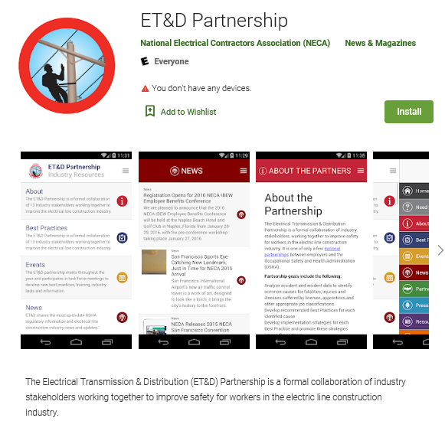
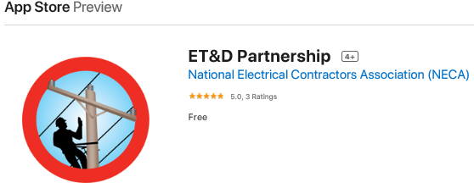
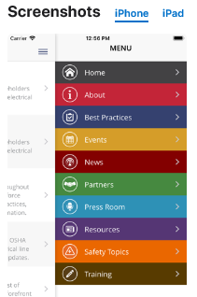
ET&D Mobile APP - Access Best Practices
Notes:
The ET&D Mobile APP is available at the APP store on your mobile device.
Mobile App
The ET&D Partnership launched an app in 2016 which features the 14 Partnership-developed Best Practices, ET&D Partnership news updates, and other relevant topics. The app is available through the ET&D Partnership Website, Apple’s Store and Google Play.

Slide 37
Summary
The fundamental goal of this OSHA Strategic Partnership (OSP) is to reduce the number of serious injuries and fatalities in the Industry.
ET& D Best Practices - The Best Practice can be applied throughout the electrical industry that will assist partnership companies in reducing the frequency of incidents.
Little things do count and if we take a few minutes to pay attention to all the potential hazards around us we can prevent serious injuries from happening.
Elimination of even one "little thing" can stop a serious injury or fatality from occurring.

